Slide 1
LA: LOUISIANA OR LOS ANGELES?

Slide 2
Question 1:
HAS THE SUPER BOWL BEEN PLAYED MORE TIMES IN LOUISIANA OR LOS ANGELES?

Slide 3
Question 2:
WHICH HAS A LARGER GDP (GROSS DOMESTIC PRODUCT)? LOUISIANA OR LOS ANGELES?

Slide 4
Question 3:
WAS ELLEN DEGENERES BORN IN LOUISIANA OR LOS ANGELES?

Slide 5
Question 4:
WHICH HAS A LARGER PERCENTAGE OF AFRICAN- AMERICANS? LOUISIANA OR LOS ANGELES?

Slide 6
Question 5:
WHICH CAME FIRST? LOUISIANA BECOMING A STATE, OR LOS ANGELES BECOMING A CITY?

Slide 7
Question 6:
ON AVERAGE, WHERE IS IT COLDER IN THE WINTER, LOUISIANA OR LOS ANGELES?

Slide 8
Question 7:
WAS THE DEATH TOLL HIGHER IN THE 1994 LOS ANGELES EARTHQUAKE, OR THE 1969 HURRICANE THAT HIT LOUISIANA?

Slide 9
Question 8:
IS IT LOUISIANA OR LOS ANGELES THAT CONTAINS PART OF INTERSTATE HIGHWAYS 5 AND 10?

Slide 10
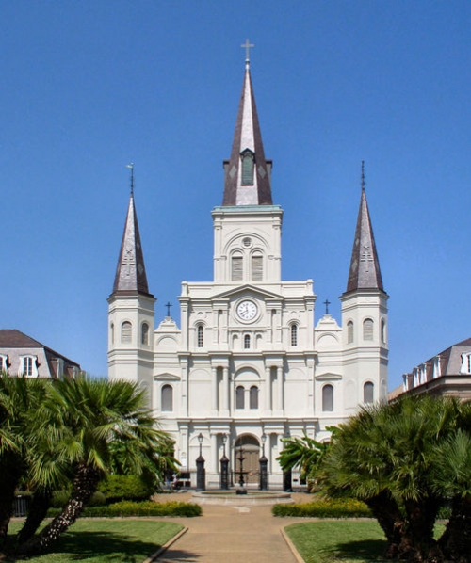
Question 9:
IS THE OLDEST CATHEDRAL IN NORTH AMERICA IN LOUISIANA OR LOS ANGELES?

Slide 11
Question 10:
WHICH HAS A LARGER POPULATION? LOUISIANA OR LOS ANGELES?

Slide 12
ANSWERS WILL BE PROVIDED SHORTLY

Slide 13
Question 1:
HAS THE SUPER BOWL BEEN PLAYED MORE TIMES IN LOUISIANA OR LOS ANGELES?
LOUISIANA (10 VS. 2)

Slide 14
Question 2:
WHICH HAS A LARGER GDP (GROSS DOMESTIC PRODUCT)? LOUISIANA OR LOS ANGELES?
LOS ANGELES ($700 BILLION VS. $200 BILLION)

Slide 15
Question 3:
WAS ELLEN DEGENERES BORN IN LOUISIANA OR LOS ANGELES?
LOUISIANA

Slide 16
Question 4:
WHICH HAS A LARGER PERCENTAGE OF AFRICAN- AMERICANS? LOUISIANA OR LOS ANGELES?
LOUISIANA (32% VS. 10%)

Slide 17
Question 5:
WHICH CAME FIRST? LOUISIANA BECOMING A STATE, OR LOS ANGELES BECOMING A CITY?
LOUISIANA (1812 VS. 1835)

Slide 18
Question 6:
ON AVERAGE, WHERE IS IT COLDER IN THE WINTER, LOUISIANA OR LOS ANGELES?
LOS ANGELES (58^{O} VS. 67^{O})

Slide 19
Question 7:
WAS THE DEATH TOLL HIGHER IN THE 1994 LOS ANGELES EARTHQUAKE, OR THE 1969 HURRICANE THAT HIT LOUISIANA?
LOUISIANA (259 VS. 57)

Slide 20
Question 8:
IS IT LOUISIANA OR LOS ANGELES THAT CONTAINS PART OF INTERSTATE HIGHWAYS 5 AND 10?
LOS ANGELES

Slide 21
Question 9:
IS THE OLDEST CATHEDRAL IN NORTH AMERICA IN LOUISIANA OR LOS ANGELES?
LOUISIANA

Slide 22
Question 10:
WHICH HAS A LARGER POPULATION? LOUISIANA OR LOS ANGELES?
LOUISIANA (4.7 VS. 3.8 MILLION)

