Slide 1
WHAT TWO ADJACENT U.S. STATES ARE SHOWN (WITHOUT THEIR COMMON BOUNDARY)?

Slide 2
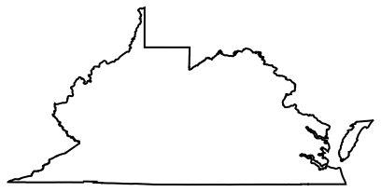
Question 1:

Slide 3
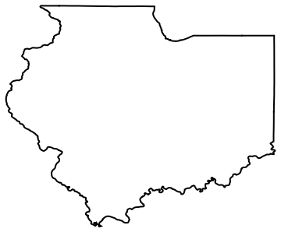
Question 2:

Slide 4
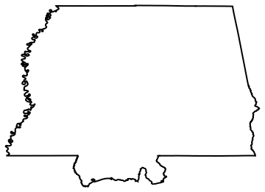
Question 3:

Slide 5
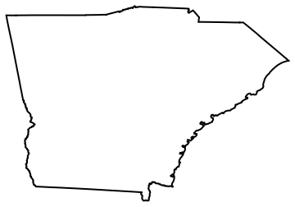
Question 4:

Slide 6
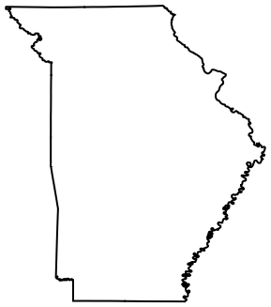
Question 5:

Slide 7
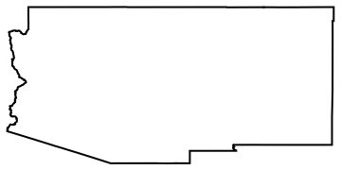
Question 6:

Slide 8
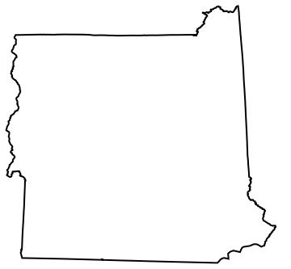
Question 7:

Slide 9

Question 8:

Slide 10

Question 9:

Slide 11
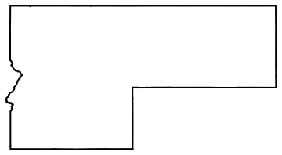
Question 10:

Slide 12
ANSWERS WILL BE PROVIDED SHORTLY

Slide 13
Question 1:
WEST VIRGINIA & VIRGINIA

Slide 14
Question 2:
ILLINOIS & INDIANA

Slide 15
Question 3:
MISSISSIPPI & ALABAMA

Slide 16
Question 4:
GEORGIA & SOUTH CAROLINA

Slide 17
Question 5:
MISSOURI & ARKANSAS

Slide 18
Question 6:
ARIZONA & NEW MEXICO

Slide 19
Question 7:
VERMONT & NEW HAMPSHIRE

Slide 20
Question 8:
UTAH & WYOMING

Slide 21
Question 9:
NORTH & SOUTH DAKOTA

Slide 22
Question 10:
IDAHO & MONTANA

