Slide 1
CHINA (THANKS BARBARA)

Slide 2
Question 1:
WHAT IS THE TECHNICAL TERM FOR CHINESE CHARACTERS? HANGUL, GRAPHEMES, OR LOGOGRAMS?

Slide 3
Question 2:
WHICH CHINESE DYNASTY WAS IN POWER WHEN SILK ROAD TRADE ESSENTIALLY ENDED IN THE MID-1400’S? SONG, HAN, OR MING?

Slide 4
Question 3:
DO MAINLAND CHINESE DRIVE ON THE LEFT OR RIGHT SIDE OF THE ROAD?

Slide 5
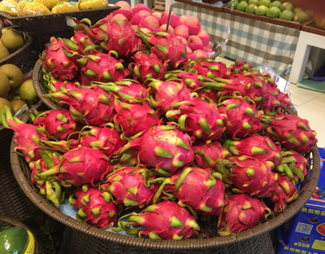
Question 4:
WHAT IS THE NAME OF THIS CHINESE FRUIT?

Slide 6
Question 5:
WHO IS THE PRESIDENT OF CHINA?

Slide 7
Question 6:
WHAT SOCIAL MEDIA APP IS BY FAR THE MOST POPULAR IN CHINA? FACEBOOK, WECHAT, OR WHATSAPP?

Slide 8
Question 7:
THE CHINESE INVENTED GUNPOWDER ORIGINALLY FOR WHAT PURPOSE? FIREWORKS, MINING, OR MEDICINE?

Slide 9
Question 8:
WHAT FRACTION OF RARE EARTH MINERALS COMES FROM CHINA? 1/3, 1/2, OR 2/3?

Slide 10
Question 9:
WHEN IS CHINA'S BUSIEST SHOPPING DAY OF THE YEAR? FEBRUARY 14TH, AUGUST 8TH, OR NOVEMBER 11TH?

Slide 11
Question 10:
WHAT COUNTRY IS CHINA'S BIGGEST TRADING PARTNER? THE UNITED STATES, JAPAN, OR HONG KONG?

Slide 12
ANSWERS WILL BE PROVIDED SHORTLY

Slide 13
Question 1:
WHAT IS THE TECHNICAL TERM FOR CHINESE CHARACTERS? HANGUL, GRAPHEMES, OR LOGOGRAMS?
LOGOGRAMS

Slide 14
Question 2:
WHICH CHINESE DYNASTY WAS IN POWER WHEN SILK ROAD TRADE ESSENTIALLY ENDED IN THE MID-1400’S? SONG, HAN, OR MING?
MING

Slide 15
Question 3:
DO MAINLAND CHINESE DRIVE ON THE LEFT OR RIGHT SIDE OF THE ROAD?
RIGHT

Slide 16
Question 4:
WHAT IS THE NAME OF THIS CHINESE FRUIT?
DRAGON FRUIT

Slide 17
Question 5:
WHO IS THE PRESIDENT OF CHINA?
XI JINPING

Slide 18
Question 6:
WHAT SOCIAL MEDIA APP IS BY FAR THE MOST POPULAR IN CHINA? FACEBOOK, WECHAT, OR WHATSAPP?
WECHAT

Slide 19
Question 7:
THE CHINESE INVENTED GUNPOWDER ORIGINALLY FOR WHAT PURPOSE? FIREWORKS, MINING, OR MEDICINE?
MEDICINE

Slide 20
Question 8:
WHAT FRACTION OF RARE EARTH MINERALS COMES FROM CHINA? 1/3, 1/2, OR 2/3?
1/3

Slide 21
Question 9:
WHEN IS CHINA'S BUSIEST SHOPPING DAY OF THE YEAR? FEBRUARY 14TH, AUGUST 8TH, OR NOVEMBER 11TH?
NOVEMBER 11TH

Slide 22
Question 10:
WHAT COUNTRY IS CHINA'S BIGGEST TRADING PARTNER? THE UNITED STATES, JAPAN, OR HONG KONG?
UNITED STATES

