Slide 1
WELCOME TO THURSDAY NIGHT TRIVIA AT THE ELUSIVE GRAPE

Slide 2
COMMON THREAD

Slide 3
Question 1:
WHAT ROCK BAND CONSISTS OF GENE SIMMONS, PAUL STANLEY, ERIC SINGER, AND ONE OTHER PERSON WHOSE LAST NAME DOESN'T START WITH "S"?

Slide 4
Question 2:
WHICH COLLEGE FOOTBALL BOWL IS PLAYED IN NEW ORLEANS AND IS CURRENTLY SPONSORED BY ALLSTATE?

Slide 5
Question 3:
ON "THE SIMPSONS", WHAT IS NAME OF THEIR SEQUENCE OF 5 PET CATS, ALL NAMED FOR THE FIRST WHITE ONE?

Slide 6
Question 4:
WHAT FINANCE MAGAZINE ALSO STARTING WITH "F" IS THE MAIN COMPETITOR OF "FORBES"?

Slide 7
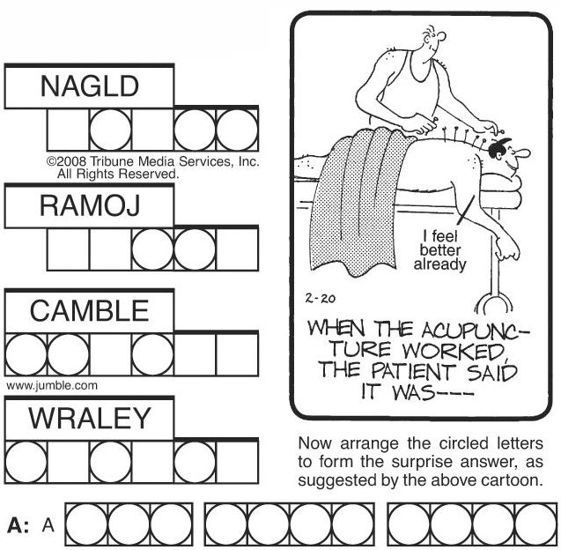
Question 5:
WHAT SORT OF WORD PUZZLE IS THIS?

Slide 8
Question 6:
WHAT FOOD DOES GEORGE WASHINGTON CARVER OFTEN GET CREDIT FOR INVENTING, THOUGH IT WAS PRODUCED MORE THAN 30 YEARS EARLIER?

Slide 9
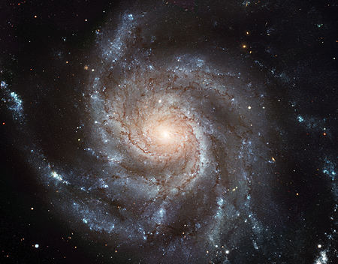
Question 7:
WHAT REVOLVING CHILDREN'S TOY WAS THIS GALAXY NAMED AFTER?

Slide 10
Question 8:
APPROPRIATELY ENOUGH, THREE DOG NIGHT HAD THREE #1 HIT SONGS: "MAMA TOLD ME", "JOY TO THE WORLD", AND WHAT OTHER SONG?

Slide 11
Question 9:
THE POST OFFICE IN WHAT TOWN BETWEEN ORLANDO AND TITUSVILLE SENDS MUCH MORE MAIL PER CAPITA THAN ANY OTHER CITY IN FLORIDA?

Slide 12
Question 10:
WHAT DO ALL THESE ANSWERS HAVE IN COMMON?

Slide 13
The End
Answers will be provided shortly

Slide 14
Question 1:
WHAT ROCK BAND CONSISTS OF GENE SIMMONS, PAUL STANLEY, ERIC SINGER, AND ONE OTHER PERSON WHOSE LAST NAME DOESN'T START WITH "S"?
KISS

Slide 15
Question 2:
WHICH COLLEGE FOOTBALL BOWL IS PLAYED IN NEW ORLEANS AND IS CURRENTLY SPONSORED BY ALLSTATE?
SUGAR

Slide 16
Question 3:
ON "THE SIMPSONS", WHAT IS NAME OF THEIR SEQUENCE OF 5 PET CATS, ALL NAMED FOR THE FIRST WHITE ONE?
SNOWBALL

Slide 17
Question 4:
WHAT FINANCE MAGAZINE ALSO STARTING WITH "F" IS THE MAIN COMPETITOR OF "FORBES"?
FORTUNE

Slide 18
Question 5:
WHAT SORT OF WORD PUZZLE IS THIS?
JUMBLE

Slide 19
Question 6:
WHAT FOOD DOES GEORGE WASHINGTON CARVER OFTEN GET CREDIT FOR INVENTING, THOUGH IT WAS PRODUCED MORE THAN 30 YEARS EARLIER?
PEANUT BUTTER

Slide 20
Question 7:
WHAT REVOLVING CHILDREN'S TOY WAS THIS GALAXY NAMED AFTER?
PINWHEEL

Slide 21
Question 8:
APPROPRIATELY ENOUGH, THREE DOG NIGHT HAD THREE #1 HIT SONGS: "MAMA TOLD ME", "JOY TO THE WORLD", AND WHAT OTHER SONG?
BLACK & WHITE

Slide 22
Question 9:
THE POST OFFICE IN WHAT TOWN BETWEEN ORLANDO AND TITUSVILLE SENDS MUCH MORE MAIL PER CAPITA THAN ANY OTHER CITY IN FLORIDA?
CHRISTMAS

Slide 23
Question 10:
WHAT DO ALL THESE ANSWERS HAVE IN COMMON?
TYPES OF COOKIES

