Slide 1
COMMON THREAD

Slide 2

Question 1:
WHAT DOES THIS SYMBOL MEAN IN MUSICAL NOTATION?

Slide 3
Question 2:
WHAT KACEY MUSGRAVES SONG ABOUT MINDING YOUR OWN BUSINESS DID BILLBOARD RANK AS THE BEST COUNTRY SONG OF 2015?

Slide 4
Question 3:
BECAUSE OF ITS SHAPE AND LOCATION IN EUROPE, ITALY IS SOMETIMES REFERRED TO AS WHAT PIECE OF CLOTHING?

Slide 5
Question 4:
WHAT 6-SEASON MOTORCYCLE COP SHOW STARRED LARRY WILCOX AND ERIK ESTRADA?

Slide 6
Question 5:
IN PHYSICS, WHEN AN OBJECT PASSES THROUGH AIR HORIZONTALLY, THE VERTICAL FORCE ACTING ON THE OBJECT IS CALLED WHAT?

Slide 7
Question 6:
IN NYC, WHAT DOES THE "G" IN "MSG" STAND FOR?

Slide 8
Question 7:
IN WHAT FILM DOES HAYDEN CHRISTENSEN REPEATEDLY TELEPORT TO ESCAPE A SECRET SOCIETY RUN BY SAMUEL L. JACKSON?

Slide 9
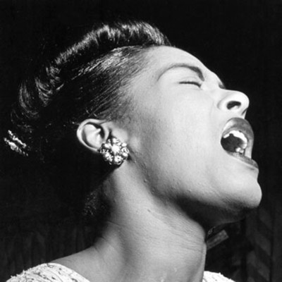
Question 8:
WHAT WAS THE LAST NAME OF THIS ICONIC JAZZ SINGER?

Slide 10
Question 9:
WHAT OCCUPATION WERE MICHAEL FARADAY, ANTOINE LAVOISIER, AND ROBERT BOYLE?

Slide 11
Question 10:
WHAT DO ALL THESE ANSWERS HAVE IN COMMON?

Slide 12
The End
Answers will be provided shortly

Slide 13
Question 1:
WHAT DOES THIS SYMBOL MEAN IN MUSICAL NOTATION?
FLAT

Slide 14
Question 2:
WHAT KACEY MUSGRAVES SONG ABOUT MINDING YOUR OWN BUSINESS DID BILLBOARD RANK AS THE BEST COUNTRY SONG OF 2015?
BISCUITS

Slide 15
Question 3:
BECAUSE OF ITS SHAPE AND LOCATION IN EUROPE, ITALY IS SOMETIMES REFERRED TO AS WHAT PIECE OF CLOTHING?
BOOT

Slide 16
Question 4:
WHAT 6-SEASON MOTORCYCLE COP SHOW STARRED LARRY WILCOX AND ERIK ESTRADA?
CHIPS

Slide 17
Question 5:
IN PHYSICS, WHEN AN OBJECT PASSES THROUGH AIR HORIZONTALLY, THE VERTICAL FORCE ACTING ON THE OBJECT IS CALLED WHAT?
LIFT

Slide 18
Question 6:
IN NYC, WHAT DOES THE "G" IN "MSG" STAND FOR?
(MADISON SQUARE) GARDEN

Slide 19
Question 7:
IN WHAT FILM DOES HAYDEN CHRISTENSEN REPEATEDLY TELEPORT TO ESCAPE A SECRET SOCIETY RUN BY SAMUEL L. JACKSON?
JUMPER

Slide 20
Question 8:
WHAT WAS THE LAST NAME OF THIS ICONIC JAZZ SINGER?
(BILLIE) HOLIDAY

Slide 21
Question 9:
WHAT OCCUPATION WERE MICHAEL FARADAY, ANTOINE LAVOISIER, AND ROBERT BOYLE?
CHEMISTS

Slide 22
Question 10:
WHAT DO ALL THESE ANSWERS HAVE IN COMMON?
HAVE DIFFERENT MEANINGS IN BRITISH AND AMERICAN ENGLISH

