Slide 1
COMMON THREAD

Slide 2
Question 1:
WHAT DID PRESIDENT OBAMA DO WHEN MEETING THE SAUDI KING IN APRIL 2009 THAT HE WAS CRITICIZED FOR?

Slide 3
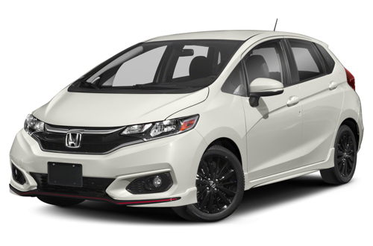
Question 2:
WHAT HONDA MODEL IS THIS?

Slide 4
Question 3:
ON WHAT 2005-2017 SERIES DID DR. TEMPERANCE BRENNAN AND SPECIAL AGENT SEELEY BOOTH SOLVE CRIMES?

Slide 5
Question 4:
WHAT FIRST MAJOR DISCOVERY DO HISTORIANS ESTIMATE HUMANS MADE 1-2 MILLION YEARS AGO?

Slide 6
Question 5:
WHAT DOES THE "E" STAND FOR IN "GRE"?

Slide 7
Question 6:
WHICH OF THESE GENRES SELLS THE MOST RECORDS? CHRISTIAN, COUNTRY, HEAVY METAL, OR RAP?

Slide 8
Question 7:
IN SURVEYING, WHAT NAME IS GIVEN TO 640 ACRES, OR 1/36TH OF A TOWNSHIP?

Slide 9
Question 8:
IN BOATING, WHAT TERM IS USED FOR THE WIDTH OF A BOAT AT ITS WIDEST POINT?

Slide 10
Question 9:
IN A 2002 DISNEY ANIMATED FILM, WHAT IS THE NAME OF THE ALIEN BEFRIENDED BY THE HAWAIIAN GIRL LILO?

Slide 11
Question 10:
WHAT DO ALL THESE ANSWERS HAVE IN COMMON?

Slide 12
The End
Answers will be provided shortly

Slide 13
Question 1:
WHAT DID PRESIDENT OBAMA DO WHEN MEETING THE SAUDI KING IN APRIL 2009 THAT HE WAS CRITICIZED FOR?
BOW

Slide 14
Question 2:
WHAT HONDA MODEL IS THIS?
FIT

Slide 15
Question 3:
ON WHAT 2005-2017 SERIES DID DR. TEMPERANCE BRENNAN AND SPECIAL AGENT SEELEY BOOTH SOLVE CRIMES?
BONES

Slide 16
Question 4:
WHAT FIRST MAJOR DISCOVERY DO HISTORIANS ESTIMATE HUMANS MADE 1-2 MILLION YEARS AGO?
FIRE

Slide 17
Question 5:
WHAT DOES THE "E" STAND FOR IN "GRE"?
(GRADUATE RECORD) EXAMINATION

Slide 18
Question 6:
WHICH OF THESE GENRES SELLS THE MOST RECORDS? CHRISTIAN, COUNTRY, HEAVY METAL, OR RAP?
COUNTRY

Slide 19
Question 7:
IN SURVEYING, WHAT NAME IS GIVEN TO 640 ACRES, OR 1/36TH OF A TOWNSHIP?
SECTION

Slide 20
Question 8:
IN BOATING, WHAT TERM IS USED FOR THE WIDTH OF A BOAT AT ITS WIDEST POINT?
BEAM

Slide 21
Question 9:
IN A 2002 DISNEY ANIMATED FILM, WHAT IS THE NAME OF THE ALIEN BEFRIENDED BY THE HAWAIIAN GIRL LILO?
STITCH

Slide 22
Question 10:
WHAT DO ALL THESE ANSWERS HAVE IN COMMON?
CAN FOLLOW "CROSS"

