Slide 1
COMMON THREAD

Slide 2
Question 1:
WHAT IS THE MOST COMMON 3-LETTER WORD THAT BEGINS NAMES OF U.S. CITIES?

Slide 3
Question 2:
WHAT IS THE FIRST NAME OF THE WOMAN WHO SERVED AS WHITE HOUSE COMMUNICATION DIRECTOR AFTER SEAN SPICER AND ANTHONY SCARAMUCCI?

Slide 4
Question 3:
WHAT KEY ON A MAC KEYBOARD DOES THE SAME THING AS THE "ENTER" KEY ON A PC KEYBOARD?

Slide 5
Question 4:
WHAT 2011-2015 ABC SERIES WAS INSPIRED BY "THE COUNT OF MONTE CRISTO" AND WAS SPELLED WITH AN "8" INSTEAD OF A "G"?

Slide 6
Question 5:
IN A GAME OF BOWLING, WHAT CAN THERE BE NO MORE THAN 12 OF?

Slide 7
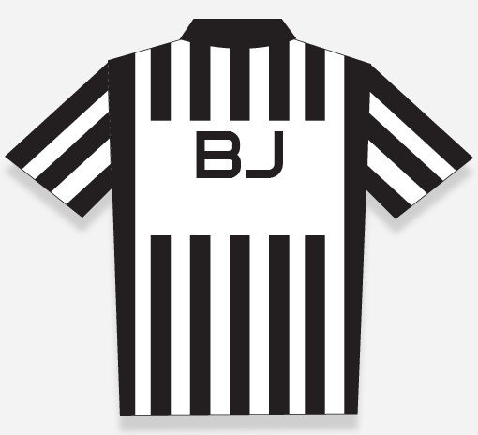
Question 6:
WHAT DOES THE "B" ON THIS FOOTBALL JERSEY MEAN?

Slide 8
Question 7:
WHAT TV SERIES ABOUT A HIGH SCHOOL THEATER PROGRAM STARRING JOSH RADNOR WAS CANCELED AFTER ONE SEASON IN 2018?

Slide 9
Question 8:
WHAT 2015-2020 FOX SERIES WITH AN ALMOST ENTIRELY BLACK CAST CENTERED ON THE CONTROL OF A HIP HOP MUSIC COMPANY?

Slide 10
Question 9:
IN THE FORMULA F=ma, WHAT DOES THE "F" STAND FOR?

Slide 11
Question 10:
WHAT DO ALL THESE ANSWERS HAVE IN COMMON?

Slide 12
The End
Answers will be provided shortly

Slide 13
Question 1:
WHAT IS THE MOST COMMON 3-LETTER WORD THAT BEGINS NAMES OF U.S. CITIES?
NEW

Slide 14
Question 2:
WHAT IS THE FIRST NAME OF THE WOMAN WHO SERVED AS WHITE HOUSE COMMUNICATION DIRECTOR AFTER SEAN SPICER AND ANTHONY SCARAMUCCI?
HOPE (HICKS)

Slide 15
Question 3:
WHAT KEY ON A MAC KEYBOARD DOES THE SAME THING AS THE "ENTER" KEY ON A PC KEYBOARD?
RETURN

Slide 16
Question 4:
WHAT 2011-2015 ABC SERIES WAS INSPIRED BY "THE COUNT OF MONTE CRISTO" AND WAS SPELLED WITH AN "8" INSTEAD OF A "G"?
REVENGE

Slide 17
Question 5:
IN A GAME OF BOWLING, WHAT CAN THERE BE NO MORE THAN 12 OF?
STRIKES

Slide 18
Question 6:
WHAT DOES THE "B" ON THIS FOOTBALL JERSEY MEAN?
BACK (JUDGE)

Slide 19
Question 7:
WHAT TV SERIES ABOUT A HIGH SCHOOL THEATER PROGRAM STARRING JOSH RADNOR WAS CANCELED AFTER ONE SEASON IN 2018?
RISE

Slide 20
Question 8:
WHAT 2015-2020 FOX SERIES WITH AN ALMOST ENTIRELY BLACK CAST CENTERED ON THE CONTROL OF A HIP HOP MUSIC COMPANY?
EMPIRE

Slide 21
Question 9:
IN THE FORMULA F=ma, WHAT DOES THE "F" STAND FOR?
FORCE

Slide 22
Question 10:
WHAT DO ALL THESE ANSWERS HAVE IN COMMON?
WORDS IN TITLES OF "STAR WARS" FILMS

Slide 23
End
And the winners are…

