Slide 1
COMMON THREAD

Slide 2
Question 1:
WHAT JIMI HENDRIX SONG WAS ALSO RELEASED IN THE U.K. BUT WITH ITS TITLE PRECEDED BY THE WORDS "LET ME LIGHT YOUR"?

Slide 3
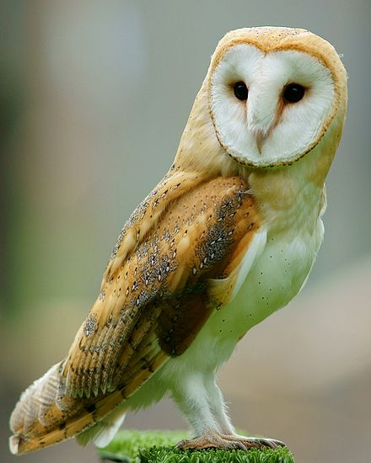
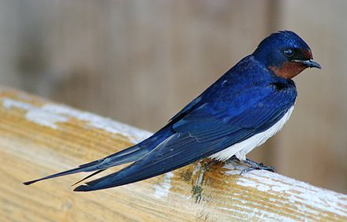
Question 2:
WHAT IS THE FIRST WORD IN THE NAME OF THESE BIRDS?

Slide 4

Question 3:
THIS TREE IS A "T" IN THE LOGO FOR A RESTAURANT. IN WHAT WORD DOES IT REPLACE THE "T"?

Slide 5
Question 4:
WHAT DOES THE "E" STAND FOR IN THE MUSICAL GROUP "ELO"?

Slide 6
Question 5:
"SAHARA" IS THE ARABIC WORD FOR WHAT?

Slide 7
Question 6:
ED SHEERAN HAS HAD TWO #1 SONGS: "THE SHAPE OF YOU" AND WHAT OTHER SONG?

Slide 8
Question 7:
WHAT BODY PART DID "ABBY NORMAL" CONTRIBUTE TO THE BUILDING OF "YOUNG FRANKENSTEIN"?

Slide 9
Question 8:
WHAT IS THE LAST NAME OF THE WOMAN WHO SANG "POETRY MAN"?

Slide 10
Question 9:
WHAT IS THE LAST WORD IN THE TITLE OF A 2008 FILM STARRING JACK BLACK, BEN STILLER, AND ROBERT DOWNEY JR. ABOUT THE FILMING OF A WAR MOVIE?

Slide 11
Question 10:
WHAT DO ALL THESE ANSWERS HAVE IN COMMON?

Slide 12
The End
Answers will be provided shortly

Slide 13
Question 1:
WHAT JIMI HENDRIX SONG WAS ALSO RELEASED IN THE U.K. BUT WITH ITS TITLE PRECEDED BY THE WORDS "LET ME LIGHT YOUR"?
FIRE

Slide 14
Question 2:
WHAT IS THE FIRST WORD IN THE NAME OF THESE BIRDS?
BARN (SWALLOW) (OWL)

Slide 15
Question 3:
THIS TREE IS A "T" IN THE LOGO FOR A RESTAURANT. IN WHAT WORD DOES IT REPLACE THE "T"?
(POLLO) TROPICAL

Slide 16
Question 4:
WHAT DOES THE "E" STAND FOR IN THE MUSICAL GROUP "ELO"?
ELECTRIC (LIGHT ORCHESTRA)

Slide 17
Question 5:
"SAHARA" IS THE ARABIC WORD FOR WHAT?
DESERT

Slide 18
Question 6:
ED SHEERAN HAS HAD TWO #1 SONGS: "THE SHAPE OF YOU" AND WHAT OTHER SONG?
PERFECT

Slide 19
Question 7:
WHAT BODY PART DID "ABBY NORMAL" CONTRIBUTE TO THE BUILDING OF "YOUNG FRANKENSTEIN"?
BRAIN

Slide 20
Question 8:
WHAT IS THE LAST NAME OF THE WOMAN WHO SANG "POETRY MAN"?
(PHOEBE) SNOW

Slide 21
Question 9:
WHAT IS THE LAST WORD IN THE TITLE OF A 2008 FILM STARRING JACK BLACK, BEN STILLER, AND ROBERT DOWNEY JR. ABOUT THE FILMING OF A WAR MOVIE?
(TROPIC) THUNDER

Slide 22
Question 10:
WHAT DO ALL THESE ANSWERS HAVE IN COMMON?
CAN BE FOLLOWED BY THE WORD "STORM"

