Slide 1
COMMON THREAD

Slide 2
Question 1:
THE BEST-KNOWN ALBERT CAMUS NOVEL IS KNOWN IN THE U.K. AS "THE OUTSIDER". IN THE U.S., IT IS KNOWN INSTEAD AS "THE" WHAT?

Slide 3
Question 2:
WHAT IS THE NAME OF THE WEATHER-CONTROLLING MUTANT PORTRAYED BY HALLE BERRY IN 4 X-MEN FILMS?

Slide 4
Question 3:
WHAT IS THE FIRST WORD OF THE TITLE OF HBO'S MOST POPULAR SERIES EVER, WHICH WON A RECORD 58 PRIMETIME EMMY AWARDS?

Slide 5
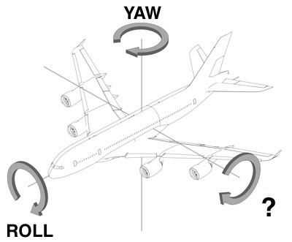
Question 4:
THE ROTATIONS OF AN AIRCRAFT ARE CALLED YAW, ROLL, AND WHAT?

Slide 6
Question 5:
WHAT DOES THE "S" STAND FOR IN "MSG", THE VENUE WHERE THE NY KNICKS AND NY RANGERS PLAY?

Slide 7
Question 6:
WHAT WORD IS AN ANAGRAM OF "TEENS"?

Slide 8
Question 7:
WHAT 2005-2010 TV SERIES FEATURED A MATHEMATICIAN HELPING HIS BROTHER IN THE FBI TO SOLVE CRIMES?

Slide 9
Question 8:
IN MATHEMATICS, THE SYMBOL ∩ MEANS INTERSECTION, AND THE SYMBOL ∪ MEANS WHAT?

Slide 10
Question 9:
THE 2 MOST POPULAR DATING SITES, "PLENTY OF FISH" AND "TINDER", ARE OWNED BY WHAT SITE THAT RECENTLY DROPPED ".COM" FROM ITS NAME?

Slide 11
Question 10:
WHAT DO ALL THESE ANSWERS HAVE IN COMMON?

Slide 12
The End
Answers will be provided shortly

Slide 13
Question 1:
THE BEST-KNOWN ALBERT CAMUS NOVEL IS KNOWN IN THE U.K. AS "THE OUTSIDER". IN THE U.S., IT IS KNOWN INSTEAD AS "THE" WHAT?
STRANGER

Slide 14
Question 2:
WHAT IS THE NAME OF THE WEATHER-CONTROLLING MUTANT PORTRAYED BY HALLE BERRY IN 4 X-MEN FILMS?
STORM

Slide 15
Question 3:
WHAT IS THE FIRST WORD OF THE TITLE OF HBO'S MOST POPULAR SERIES EVER, WHICH WON A RECORD 58 PRIMETIME EMMY AWARDS?
GAME (OF THRONES)

Slide 16
Question 4:
THE ROTATIONS OF AN AIRCRAFT ARE CALLED YAW, ROLL, AND WHAT?
PITCH

Slide 17
Question 5:
WHAT DOES THE "S" STAND FOR IN "MSG", THE VENUE WHERE THE NY KNICKS AND NY RANGERS PLAY?
(MADISON) SQUARE (GARDEN)

Slide 18
Question 6:
WHAT WORD IS AN ANAGRAM OF "TEENS"?
TENSE

Slide 19
Question 7:
WHAT 2005-2010 TV SERIES FEATURED A MATHEMATICIAN HELPING HIS BROTHER IN THE FBI TO SOLVE CRIMES?
NUMBERS

Slide 20
Question 8:
IN MATHEMATICS, THE SYMBOL ∩ MEANS INTERSECTION, AND THE SYMBOL ∪ MEANS WHAT?
UNION

Slide 21
Question 9:
THE 2 MOST POPULAR DATING SITES, "PLENTY OF FISH" AND "TINDER", ARE OWNED BY WHAT SITE THAT RECENTLY DROPPED ".COM" FROM ITS NAME?
MATCH

Slide 22
Question 10:
WHAT DO ALL THESE ANSWERS HAVE IN COMMON?
CAN FOLLOW "PERFECT"

