Slide 1
COMMON THREAD

Slide 2
Question 1:
WHAT WAS THE NAME OF THE DRUMMER ON "THE MUPPET SHOW"?

Slide 3
Question 2:
WHAT WERE THE INITIALS OF LYNDON JOHNSON'S VICE PRESIDENT?

Slide 4
Question 3:
WHAT IS THE STAGE NAME OF THE GUITARIST FOR U2?

Slide 5
Question 4:
THE RISKIEST SURGERY IS ON WHAT ORGAN?

Slide 6
Question 5:
WHO WAS THE LEAD SINGER FOR THE MUSICAL GROUP THE POLICE?

Slide 7
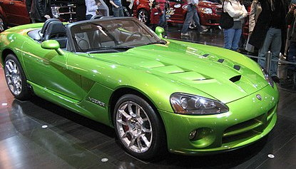
Question 6:
WHAT DODGE MODEL IS THIS?

Slide 8

Question 7:
WHAT ANNUAL COMPETITION HAS THIS LOGO?

Slide 9
Question 8:
WHAT NICKNAME DID JOHNNY CASH HAVE EARLY IN HIS CAREER, BECAUSE OF HIS TENDENCY TO DRESS ENTIRELY IN BLACK?

Slide 10
Question 9:
WHAT IS THE NICKNAME FOR ALCATRAZ PRISON, AND THE NAME OF A 1996 FILM THAT TAKES PLACE THERE?

Slide 11
Question 10:
WHAT DO ALL THESE ANSWERS HAVE IN COMMON?

Slide 12
The End
Answers will be provided shortly

Slide 13
Question 1:
WHAT WAS THE NAME OF THE DRUMMER ON "THE MUPPET SHOW"?
ANIMAL

Slide 14
Question 2:
WHAT WERE THE INITIALS OF LYNDON JOHNSON'S VICE PRESIDENT?
HHH (HUBERT HORATIO HUMPHREY)

Slide 15
Question 3:
WHAT IS THE STAGE NAME OF THE GUITARIST FOR U2?
EDGE

Slide 16
Question 4:
THE RISKIEST SURGERY IS ON WHAT ORGAN?
THE BRAIN

Slide 17
Question 5:
WHO WAS THE LEAD SINGER FOR THE MUSICAL GROUP THE POLICE?
STING

Slide 18
Question 6:
WHAT DODGE MODEL IS THIS?
VIPER

Slide 19
Question 7:
WHAT ANNUAL COMPETITION HAS THIS LOGO?
THE WORLD'S STRONGEST MAN

Slide 20
Question 8:
WHAT NICKNAME DID JOHNNY CASH HAVE EARLY IN HIS CAREER, BECAUSE OF HIS TENDENCY TO DRESS ENTIRELY IN BLACK?
THE UNDERTAKER

Slide 21
Question 9:
WHAT IS THE NICKNAME FOR ALCATRAZ PRISON, AND THE NAME OF A 1996 FILM THAT TAKES PLACE THERE?
THE ROCK

Slide 22
Question 10:
WHAT DO ALL THESE ANSWERS HAVE IN COMMON?
NICKNAMES OF PRO WRESTLERS

