Slide 1
SPORTS TERMS COMMON THREAD

Slide 2
Question 1:
ONE NINTH OF A BASEBALL GAME IS CALLED AN INNING. WHAT IS ONE TENTH OF A BOWLING GAME CALLED?

Slide 3
Question 2:
THE THREE MAIN TYPES OF GOLF CLUBS ARE IRON, PUTTER, AND WHAT?

Slide 4
Question 3:
IN BASKETBALL, WHAT IS THE SLANG TERM FOR A SHOT THAT HITS THE RIM, WITHOUT HITTING THE BACKBOARD OR GOING IN THE BASKET?

Slide 5
Question 4:
IN CURLING, WHAT IS THE CIRCULAR BULLSEYE TARGET CALLED?

Slide 6
Question 5:
IN BASEBALL, WHAT DOES THE "H" IN "HR" STAND FOR?

Slide 7
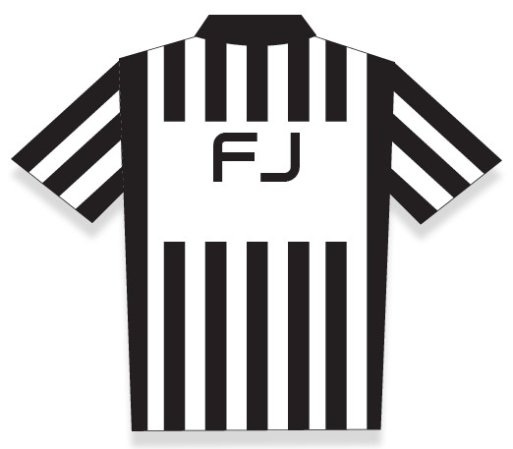
Question 6:
WHAT DOES THE "F" STAND FOR ON THIS NFL UNIFORM?

Slide 8
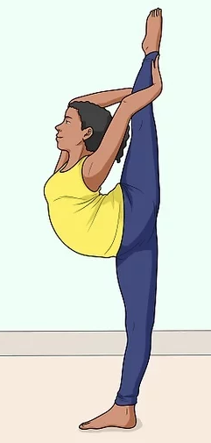
Question 7:
WHAT IS THIS CHEERLEADING MOVE CALLED?

Slide 9
Question 8:
IN BASEBALL, WHAT DOES THE "G" IN "GO" STAND FOR?

Slide 10
Question 9:
OF ALL SPORTS, TABLE TENNIS HAS THE SHORTEST WHAT?

Slide 11
Question 10:
WHAT DO ALL THESE ANSWERS HAVE IN COMMON?

Slide 12
ANSWERS WILL BE PROVIDED SHORTLY

Slide 13
Question 1:
ONE NINTH OF A BASEBALL GAME IS CALLED AN INNING. WHAT IS ONE TENTH OF A BOWLING GAME CALLED?
FRAME

Slide 14
Question 2:
THE THREE MAIN TYPES OF GOLF CLUBS ARE IRON, PUTTER, AND WHAT?
WOOD

Slide 15
Question 3:
IN BASKETBALL, WHAT IS THE SLANG TERM FOR A SHOT THAT HITS THE RIM, WITHOUT HITTING THE BACKBOARD OR GOING IN THE BASKET?
BRICK

Slide 16
Question 4:
IN CURLING, WHAT IS THE CIRCULAR BULLSEYE TARGET CALLED?
THE HOUSE

Slide 17
Question 5:
IN BASEBALL, WHAT DOES THE "H" IN "HR" STAND FOR?
HOME (RUN)

Slide 18
Question 6:
WHAT DOES THE "F" STAND FOR ON THIS NFL UNIFORM?
FIELD (JUDGE)

Slide 19
Question 7:
WHAT IS THIS CHEERLEADING MOVE CALLED?
NEEDLE

Slide 20
Question 8:
IN BASEBALL, WHAT DOES THE "G" IN "GO" STAND FOR?
GROUND (OUT)

Slide 21
Question 9:
OF ALL SPORTS, TABLE TENNIS HAS THE SHORTEST WHAT?
NET

Slide 22
Question 10:
WHAT DO ALL THESE ANSWERS HAVE IN COMMON?
CAN BE FOLLOWED BY "WORK"

