Slide 1
COMMON THREAD

Slide 2
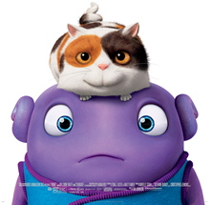
Question 1:
WHAT 2015 FILM HAD THIS MOVIE POSTER?

Slide 3
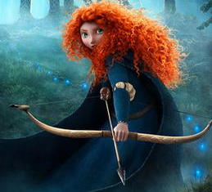
Question 2:
WHAT 2012 FILM HAD THIS MOVIE POSTER?

Slide 4
Question 3:
IN WHAT FILM DO ANTHONY HOPKINS, GWYNETH PALTROW, AND JAKE GYLLENHAAL ALL PLAY MATHEMATICIANS?

Slide 5
Question 4:
IN THE GOOGLE LOGO, WHAT COLOR IS THE "E"?

Slide 6
Question 5:
WHAT IS THE NAME OF HOUSTON'S NBA TEAM?

Slide 7
Question 6:
WHICH PROVIDES THE MUSIC INDUSTRY WITH THE LARGEST REVENUE? ALBUMS, DOWNLOADS, OR STREAMING?

Slide 8
Question 7:
WHAT IS THE BEST-SELLING BRAND OF DISHWASHING LIQUID IN THE U.S.?

Slide 9

Question 8:
WHAT 1981 FILM HAD THIS MOVIE POSTER?

Slide 10
Question 9:
WHAT SAGA OF 5 FILMS FEATURED THE CHARACTERS EDWARD THE VAMPIRE AND JACOB THE WEREWOLF?

Slide 11
Question 10:
WHAT DO ALL THESE ANSWERS HAVE IN COMMON?

Slide 12
The End
Answers will be provided shortly

Slide 13
Question 1:
WHAT 2015 FILM HAD THIS MOVIE POSTER?
HOME

Slide 14
Question 2:
WHAT 2012 FILM HAD THIS MOVIE POSTER?
BRAVE

Slide 15
Question 3:
IN WHAT FILM DO ANTHONY HOPKINS, GWYNETH PALTROW, AND JAKE GYLLENHAAL ALL PLAY MATHEMATICIANS?
PROOF

Slide 16
Question 4:
IN THE GOOGLE LOGO, WHAT COLOR IS THE "E"?
RED

Slide 17
Question 5:
WHAT IS THE NAME OF HOUSTON'S NBA TEAM?
ROCKETS

Slide 18
Question 6:
WHICH PROVIDES THE MUSIC INDUSTRY WITH THE LARGEST REVENUE? ALBUMS, DOWNLOADS, OR STREAMING?
STREAMING

Slide 19
Question 7:
WHAT IS THE BEST-SELLING BRAND OF DISHWASHING LIQUID IN THE U.S.?
DAWN

Slide 20
Question 8:
WHAT 1981 FILM HAD THIS MOVIE POSTER?
STRIPES

Slide 21
Question 9:
WHAT SAGA OF 5 FILMS FEATURED THE CHARACTERS EDWARD THE VAMPIRE AND JACOB THE WEREWOLF?
TWILIGHT

Slide 22
Question 10:
WHAT DO ALL THESE ANSWERS HAVE IN COMMON?
WORDS IN "THE STAR-SPANGLED BANNER"

