Slide 1
HIDDEN MESSAGE

Slide 2
Question 1:
WHAT BRAND OF CONDOMS HAS MORE THAN 2/3 OF THE U.S. MARKET?

Slide 3
Question 2:
WHAT 1944 HITCHCOCK FILM TAKES PLACE ENTIRELY AT SEA?

Slide 4
Question 3:
WHAT MATERIAL SERVES AS A FACADE FOR THE ENTIRE TAJ MAHAL?

Slide 5
Question 4:
WHAT SPICE ASSOCIATED WITH HUNGARIAN FOOD WAS ACTUALLY NOT POPULAR IN HUNGARY UNTIL THE LATE 19TH CENTURY?

Slide 6
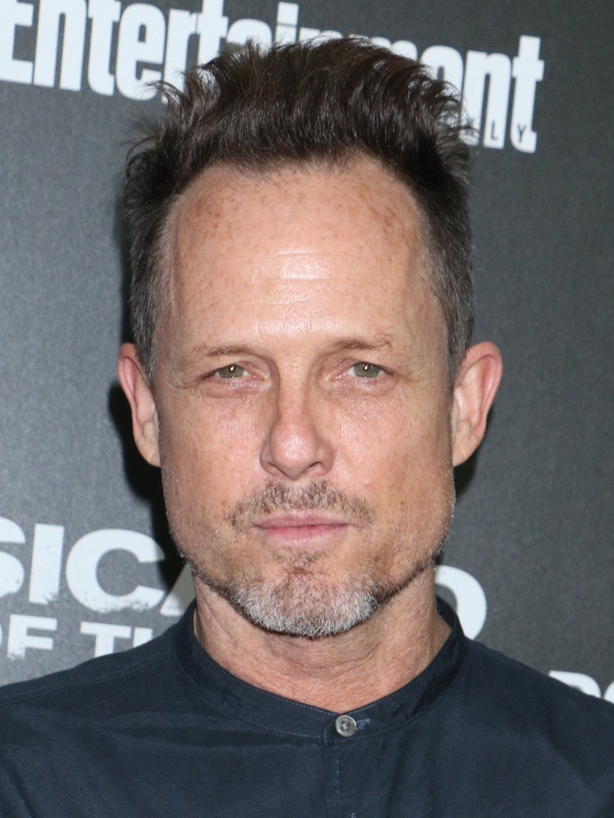
Question 5:
WHAT "CHARACTER" DOES THIS ACTOR PORTRAY IN ALLSTATE INSURANCE COMMERCIALS?

Slide 7
Question 6:
THE FILM "A DANGEROUS METHOD" DEPICTS SIGMUND FREUD'S COLLABORATION WITH WHAT OTHER PSYCHOLOGIST?

Slide 8
Question 7:
IN WHAT SHAKESPEARE PLAY DOES THE TERM "STAR-CROSSED LOVERS" APPEAR?

Slide 9
Question 8:
WHAT IS THE RELATION OF WYNONNA JUDD TO NAOMI JUDD?

Slide 10
Question 9:
WHAT RUSSIAN LEADER WAS SUCCEEDED BY NIKITA KHRUSHCHEV?

Slide 11
Question 10:
WHAT THEME IS HIDDEN INSIDE ALL THESE ANSWERS?

Slide 12
The End
Answers will be provided shortly

Slide 13
Question 1:
WHAT BRAND OF CONDOMS HAS MORE THAN 2/3 OF THE U.S. MARKET?
TROJAN

Slide 14
Question 2:
WHAT 1944 HITCHCOCK FILM TAKES PLACE ENTIRELY AT SEA?
LIFEBOAT

Slide 15
Question 3:
WHAT MATERIAL SERVES AS A FACADE FOR THE ENTIRE TAJ MAHAL?
MARBLE

Slide 16
Question 4:
WHAT SPICE ASSOCIATED WITH HUNGARIAN FOOD WAS ACTUALLY NOT POPULAR IN HUNGARY UNTIL THE LATE 19TH CENTURY?
PAPRIKA

Slide 17
Question 5:
WHAT "CHARACTER" DOES THIS ACTOR PORTRAY IN ALLSTATE INSURANCE COMMERCIALS?
MAYHEM

Slide 18
Question 6:
THE FILM "A DANGEROUS METHOD" DEPICTS SIGMUND FREUD'S COLLABORATION WITH WHAT OTHER PSYCHOLOGIST?
CARL JUNG

Slide 19
Question 7:
IN WHAT SHAKESPEARE PLAY DOES THE TERM "STAR-CROSSED LOVERS" APPEAR?
ROMEO AND JULIET

Slide 20
Question 8:
WHAT IS THE RELATION OF WYNONNA JUDD TO NAOMI JUDD?
DAUGHTER

Slide 21
Question 9:
WHAT RUSSIAN LEADER WAS SUCCEEDED BY NIKITA KHRUSHCHEV?
JOSEPH STALIN

Slide 22
Question 10:
WHAT THEME IS HIDDEN INSIDE ALL THESE ANSWERS?
ABBREVIATIONS FOR THE FIRST 9 MONTHS OF THE YEAR

