Slide 1
WELCOME TO THURSDAY NIGHT TRIVIA AT THE ELUSIVE GRAPE

Slide 2
WHAT ROCK BANDS HAVE THESE LOGOS?

Slide 3

Question 1:

Slide 4

Question 2:

Slide 5

Question 3:

Slide 6

Question 4:

Slide 7

Question 5:

Slide 8

Question 6:

Slide 9

Question 7:

Slide 10
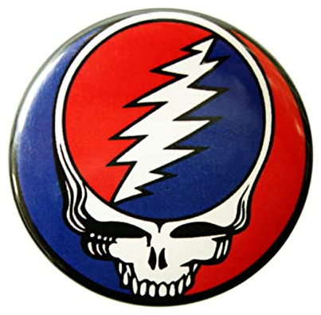
Question 8:

Slide 11

Question 9:

Slide 12

Question 10:

Slide 13
The End
Answers will be provided shortly

Slide 14
Question 1:
THE ROLLING STONES

Slide 15
Question 2:
NIRVANA

Slide 16
Question 3:
VAN HALEN

Slide 17
Question 4:
PUBLIC ENEMY

Slide 18
Question 5:
THE RAMONES

Slide 19
Question 6:
DEAD KENNEDYS

Slide 20
Question 7:
NINE INCH NAILS

Slide 21
Question 8:
THE GRATEFUL DEAD

Slide 22
Question 9:
RADIOHEAD

Slide 23
Question 10:
FOO FIGHTERS

