Slide 1
CUBES

Slide 2
Question 1:
BEFORE ICE CUBE BECAME AN ACTOR, HE FORMED WHAT RAP GROUP WITH DR. DRE AND EASY E?

Slide 3
Question 2:
TRUE OR FALSE? THE RUBIK'S CUBE REMAINS THE WORLD'S BEST-SELLING TOY?

Slide 4
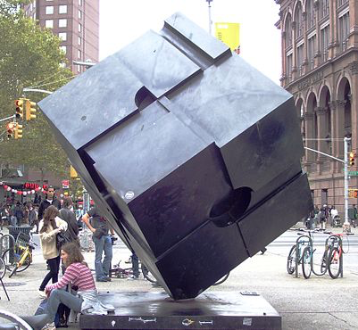
Question 3:
IN WHAT CITY IS THIS CUBICAL SCULPTURE LOCATED?

Slide 5
Question 4:
CUBE STEAK USUALLY COMES FROM WHAT CUT OF BEEF?

Slide 6
Question 5:
WHAT CAR COMPANY MAKES A MODEL CALLED THE CUBE?

Slide 7
Question 6:
WHAT IS THE CUBE ROOT OF ONE TRILLION?

Slide 8
Question 7:
WHAT POPULAR GAME CONTAINS SOMETHING CALLED A DOUBLING CUBE?

Slide 9
Question 8:
HOW MANY KILOGRAMS DOES ONE CUBIC METER OF WATER WEIGH?

Slide 10
Question 9:
A BUILDING WHOSE TRANSLATION IS "THE CUBE" IS AT THE CENTER OF THE MOST SACRED SITE OF WHAT RELIGION?

Slide 11
Question 10:
HOW MANY SUGAR CUBES YIELD AN OUNCE OF SUGAR? 4, 8, OR 16?

Slide 12
The End
Answers will be provided shortly

Slide 13
Question 1:
BEFORE ICE CUBE BECAME AN ACTOR, HE FORMED WHAT RAP GROUP WITH DR. DRE AND EASY E?
N. W. A.

Slide 14
Question 2:
TRUE OR FALSE? THE RUBIK'S CUBE REMAINS THE WORLD'S BEST-SELLING TOY?
TRUE

Slide 15
Question 3:
IN WHAT CITY IS THIS CUBICAL SCULPTURE LOCATED?
NEW YORK CITY

Slide 16
Question 4:
CUBE STEAK USUALLY COMES FROM WHAT CUT OF BEEF?
ROUND or SIRLOIN

Slide 17
Question 5:
WHAT CAR COMPANY MAKES A MODEL CALLED THE CUBE?
NISSAN

Slide 18
Question 6:
WHAT IS THE CUBE ROOT OF ONE TRILLION?
10,000

Slide 19
Question 7:
WHAT POPULAR GAME CONTAINS SOMETHING CALLED A DOUBLING CUBE?
BACKGAMMON

Slide 20
Question 8:
HOW MANY KILOGRAMS DOES ONE CUBIC METER OF WATER WEIGH?
1000

Slide 21
Question 9:
A BUILDING WHOSE TRANSLATION IS "THE CUBE" IS AT THE CENTER OF THE MOST SACRED SITE OF WHAT RELIGION?
ISLAM

Slide 22
Question 10:
HOW MANY SUGAR CUBES YIELD AN OUNCE OF SUGAR? 4, 8, OR 16?
8

