Slide 1
IDENTIFY THESE SINGERS BY THEIR MUGSHOTS

Slide 2
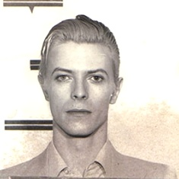
Question 1:

Slide 3
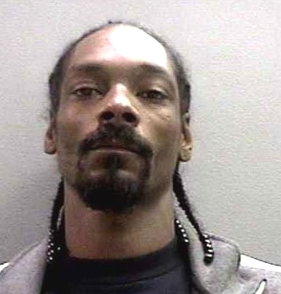
Question 2:

Slide 4
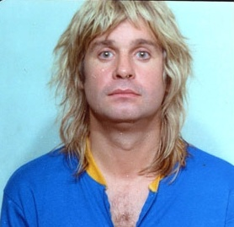
Question 3:

Slide 5
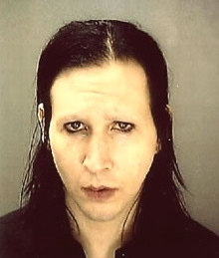
Question 4:

Slide 6
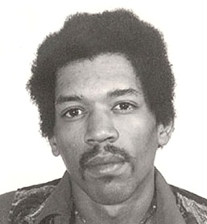
Question 5:

Slide 7
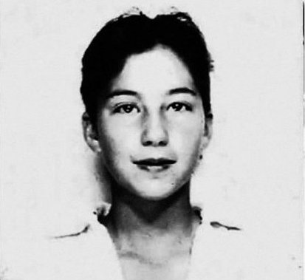
Question 6:

Slide 8
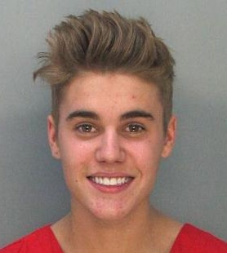
Question 7:

Slide 9
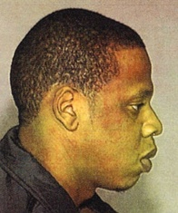
Question 8:

Slide 10
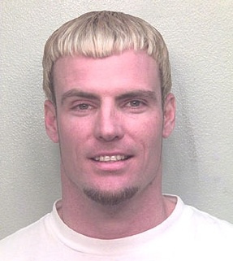
Question 9:

Slide 11
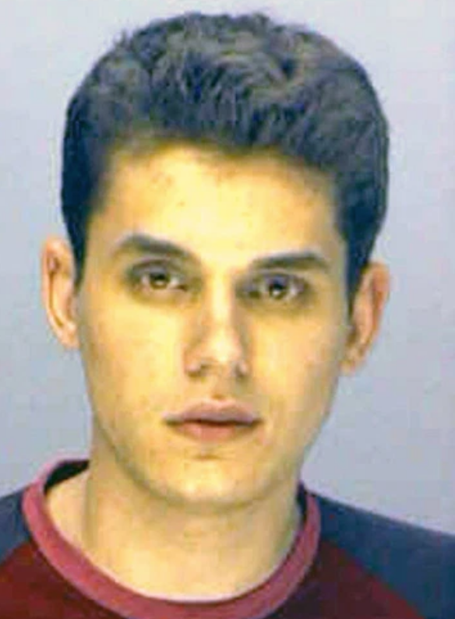
Question 10:

Slide 12
The End
Answers will be provided shortly

Slide 13
Question 1:
DAVID BOWIE

Slide 14
Question 2:
SNOOP DOG

Slide 15
Question 3:
OZZY OSBORNE

Slide 16
Question 4:
MARILYN MANSON

Slide 17
Question 5:
JIMI HENDRIX

Slide 18
Question 6:
CHER

Slide 19
Question 7:
JUSTIN BIEBER

Slide 20
Question 8:
JAY–Z

Slide 21
Question 9:
VANILLA ICE

Slide 22
Question 10:
JOHN MAYER

