Slide 1
IDENTIFY THESE SINGERS WHEN THEY WERE YOUNGER

Slide 2
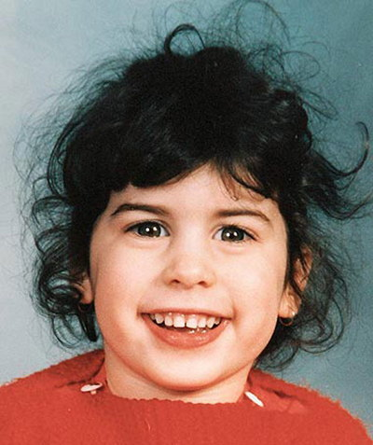
Question 1:

Slide 3
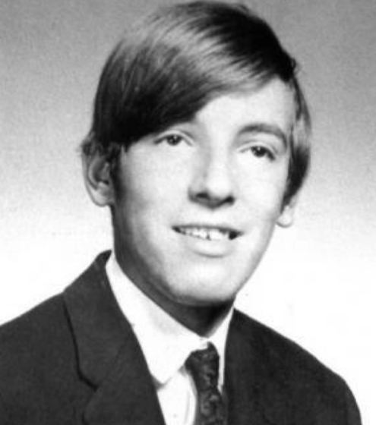
Question 2:

Slide 4
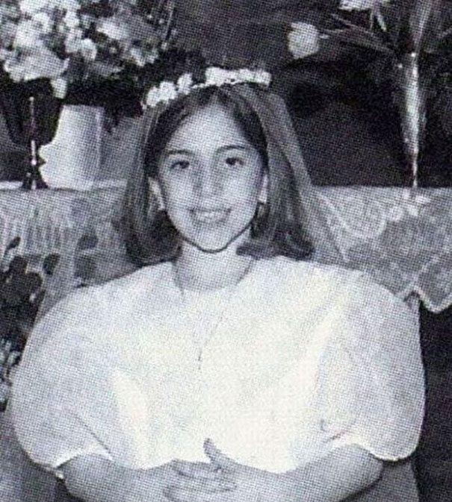
Question 3:

Slide 5
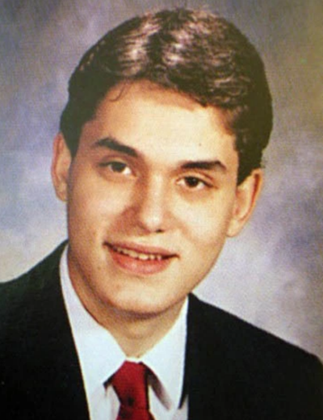
Question 4:

Slide 6
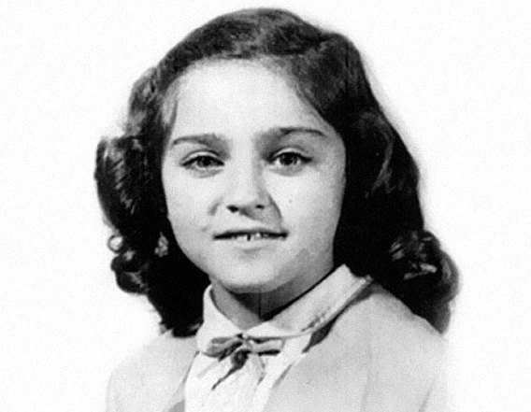
Question 5:

Slide 7
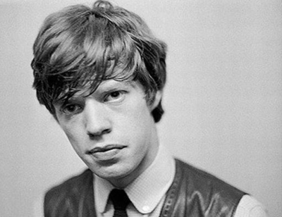
Question 6:

Slide 8
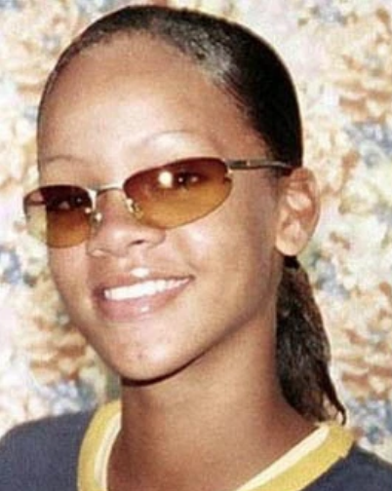
Question 7:

Slide 9
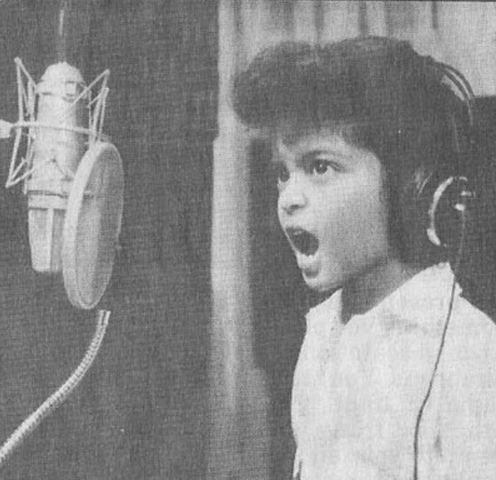
Question 8:

Slide 10
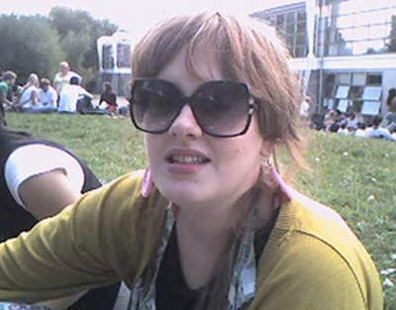
Question 9:

Slide 11
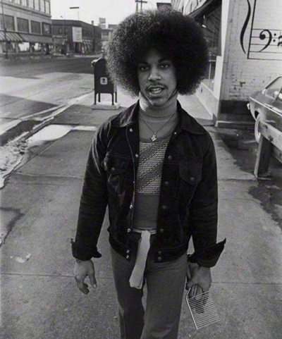
Question 10:

Slide 12
The End
Answers will be provided shortly

Slide 13
Question 1:
AMY WINEHOUSE

Slide 14
Question 2:
BRUCE SPRINGSTEEN

Slide 15
Question 3:
LADY GAGA

Slide 16
Question 4:
JOHN MAYER

Slide 17
Question 5:
MADONNA

Slide 18
Question 6:
MICK JAGGER

Slide 19
Question 7:
RIHANNA

Slide 20
Question 8:
BRUNO MARS

Slide 21
Question 9:
ADELE

Slide 22
Question 10:
PRINCE

