Slide 1
COMMON THREAD

Slide 2
Question 1:
WHAT IS THE FIRST NAME OF THE CHARACTER WHO FALLS ASLEEP FOR 20 YEARS IN A SHORT STORY BY WASHINGTON IRVING?

Slide 3
Question 2:
WHAT IS THE LAST WORD IN THE TITLE OF THE LONGEST-RUNNING SCIENCE FICTION TV SHOW IN THE WORLD?

Slide 4
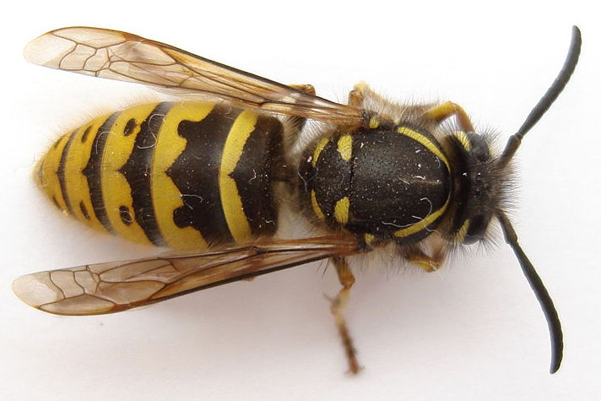
Question 3:
WHAT IS THIS INSECT?

Slide 5

Question 4:
WHAT IS THIS FISH? DUVALIER?

Slide 6
Question 5:
WHO SANG "CRAZY" AND "KISS FROM A ROSE"?

Slide 7
Question 6:
WHAT IS SODIUM CHLORIDE BETTER KNOWN AS?

Slide 8
Question 7:
WHAT GROUP SANG "LICK IT UP" AND "I WANNA ROCK AND ROLL ALL NIGHT"?

Slide 9
Question 8:
IN CHEMISTRY, WHAT IS THE OPPOSITE OF ACIDIC?

Slide 10
Question 9:
WHAT TV NETWORK SHOWED "THE CLOSER", "LEVERAGE", "RIZZOLI & ISLES", AND "MAJOR CRIMES"?

Slide 11
Question 10:
WHAT DO ALL THESE ANSWERS HAVE IN COMMON?

Slide 12
ANSWERS WILL BE PROVIDED SHORTLY

Slide 13
Question 1:
WHAT IS THE FIRST NAME OF THE CHARACTER WHO FALLS ASLEEP FOR 20 YEARS IN A SHORT STORY BY WASHINGTON IRVING?
RIP (VAN WINKLE)

Slide 14
Question 2:
WHAT IS THE LAST WORD IN THE TITLE OF THE LONGEST-RUNNING SCIENCE FICTION TV SHOW IN THE WORLD?
(DOCTOR) WHO

Slide 15
Question 3:
WHAT IS THIS INSECT?
WASP

Slide 16
Question 4:
WHAT IS THIS FISH?
COD

Slide 17
Question 5:
WHO SANG "CRAZY" AND "KISS FROM A ROSE"?
SEAL

Slide 18
Question 6:
WHAT IS SODIUM CHLORIDE BETTER KNOWN AS?
SALT

Slide 19
Question 7:
WHAT GROUP SANG "LICK IT UP" AND "I WANNA ROCK AND ROLL ALL NIGHT"?
KISS

Slide 20
Question 8:
IN CHEMISTRY, WHAT IS THE OPPOSITE OF ACIDIC?
BASIC

Slide 21
Question 9:
WHAT TV NETWORK SHOWED "THE CLOSER", "LEVERAGE", "RIZZOLI & ISLES", AND "MAJOR CRIMES"?
TNT

Slide 22
Question 10:
WHAT DO ALL THESE ANSWERS HAVE IN COMMON?
THEY ARE ALL ACRONYMS

