Slide 1
COMMON THREAD

Slide 2
Question 1:
ACCORDING TO LEGEND, WHO SLEW GOLIATH?

Slide 3
Question 2:
WHAT IS THE LAST NAME OF THE AUTHOR WHO WROTE "THE GREAT GATSBY"?

Slide 4
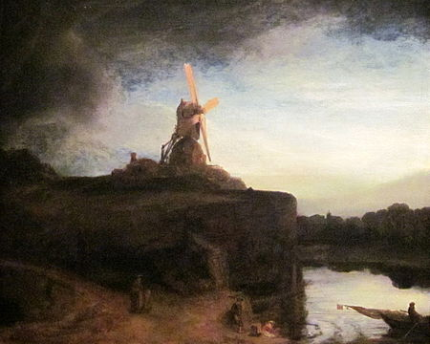
Question 3:
WHAT IS THE 4-LETTER TITLE OF THIS REMBRANDT?

Slide 5
Question 4:
ON WHAT TV SHOW DID HUGH LAURIE PORTRAY A MISANTHROPIC MEDICAL GENIUS?

Slide 6
Question 5:
WHAT IS THE NAME OF "THE MOST FAMOUS REINDEER OF ALL"?

Slide 7
Question 6:
IN THE OPENING CREDITS OF A 2005-2009 TV SHOW ABOUT KARMA, ACTOR JASON LEE INTRODUCES HIMSELF BY SAYING "MY NAME IS ____"?

Slide 8
Question 7:
WHAT IS THE NAME OF THE VOLLEYBALL IN THE FILM "CAST AWAY"?

Slide 9

Question 8:
WHICH MEMORIAL IS THIS? PRESIDENT PICTURED ON THE NICKEL?

Slide 10
Question 9:
WHAT IS THE LAST NAME OF THE PRESIDENT OF IRAQ TOPPLED BY OPERATION IRAQI FREEDOM?

Slide 11
Question 10:
WHAT DO ALL THESE ANSWERS HAVE IN COMMON?

Slide 12
ANSWERS WILL BE PROVIDED SHORTLY

Slide 13
Question 1:
ACCORDING TO LEGEND, WHO SLEW GOLIATH?
DAVID

Slide 14
Question 2:
WHAT IS THE LAST NAME OF THE AUTHOR WHO WROTE "THE GREAT GATSBY"?
(F. SCOTT) FITZGERALD

Slide 15
Question 3:
WHAT IS THE 4-LETTER TITLE OF THIS REMBRANDT?
MILL

Slide 16
Question 4:
ON WHAT TV SHOW DID HUGH LAURIE PORTRAY A MISANTHROPIC MEDICAL GENIUS?
HOUSE

Slide 17
Question 5:
WHAT IS THE NAME OF "THE MOST FAMOUS REINDEER OF ALL"?
RUDOLPH

Slide 18
Question 6:
IN THE OPENING CREDITS OF A 2005-2009 TV SHOW ABOUT KARMA, ACTOR JASON LEE INTRODUCES HIMSELF BY SAYING "MY NAME IS ____"?
EARL

Slide 19
Question 7:
WHAT IS THE NAME OF THE VOLLEYBALL IN THE FILM "CAST AWAY"?
WILSON

Slide 20
Question 8:
WHICH MEMORIAL IS THIS?
JEFFERSON

Slide 21
Question 9:
WHAT IS THE LAST NAME OF THE PRESIDENT OF IRAQ TOPPLED BY OPERATION IRAQI FREEDOM?
(SADDAM) HUSSEIN

Slide 22
Question 10:
WHAT DO ALL THESE ANSWERS HAVE IN COMMON?
MIDDLE NAMES OF RECENT U.S. PRESIDENTS

