Slide 1
COMMON THREAD

Slide 2
Question 1:
WHAT COOKING COMPETITION TV SHOW IS HOSTED BY CELEBRITY CHEF GORDON RAMSAY?

Slide 3
Question 2:
WHAT CLASSIC CHILDREN'S BOOK WAS WRITTEN IN 1908 BY LUCY MAUD MONTGOMERY?

Slide 4
Question 3:
WHAT 1951-1968 NY YANKEE IS CONSIDERED BY MANY TO HAVE BEEN THE BEST SWITCH HITTER IN HISTORY?

Slide 5
Question 4:
WHAT OPERATING SYSTEM RUNS ON 83% OF COMPUTERS?

Slide 6
Question 5:
WHAT IS THE SLANG TERM FOR A BOWLING ROLL THAT KNOCKS DOWN NO PINS?

Slide 7
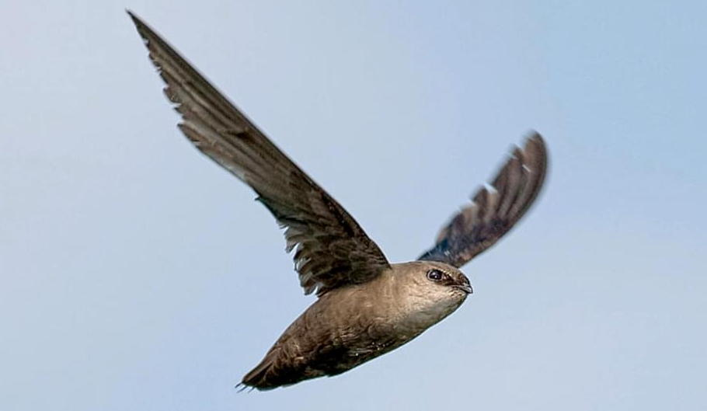
Question 6:
WHAT BIRD IS THIS?

Slide 8
Question 7:
WHAT 2008 ANIMATED FILM WAS ABOUT A TRASH COMPACTOR ROBOT?

Slide 9
Question 8:
WHAT IS THE USUAL METAPHOR FOR THE BARRIER KEEPING MINORITIES FROM ADVANCING THEIR CAREERS?

Slide 10
Question 9:
WHO WAS RESPONSIBLE FOR THE CHARLESTON CHURCH MASS-SHOOTING IN 2015?

Slide 11
Question 10:
WHAT DO ALL THESE ANSWERS HAVE IN COMMON?

Slide 12
ANSWERS WILL BE PROVIDED SHORTLY

Slide 13
Question 1:
WHAT COOKING COMPETITION TV SHOW IS HOSTED BY CELEBRITY CHEF GORDON RAMSAY?
HELL'S KITCHEN

Slide 14
Question 2:
WHAT CLASSIC CHILDREN'S BOOK WAS WRITTEN IN 1908 BY LUCY MAUD MONTGOMERY?
ANNE OF GREEN GABLES

Slide 15
Question 3:
WHAT 1951-1968 NY YANKEE IS CONSIDERED BY MANY TO HAVE BEEN THE BEST SWITCH HITTER IN HISTORY?
MICKEY MANTLE

Slide 16
Question 4:
WHAT OPERATING SYSTEM RUNS ON 83% OF COMPUTERS?
WINDOWS

Slide 17
Question 5:
WHAT IS THE SLANG TERM FOR A BOWLING ROLL THAT KNOCKS DOWN NO PINS?
GUTTER BALL

Slide 18
Question 6:
WHAT BIRD IS THIS?
CHIMNEY SWIFT

Slide 19
Question 7:
WHAT 2008 ANIMATED FILM WAS ABOUT A TRASH COMPACTOR ROBOT?
WALL-E

Slide 20
Question 8:
WHAT IS THE USUAL METAPHOR FOR THE BARRIER KEEPING MINORITIES FROM ADVANCING THEIR CAREERS?
GLASS CEILING

Slide 21
Question 9:
WHO WAS RESPONSIBLE FOR THE CHARLESTON CHURCH MASS-SHOOTING IN 2015?
DYLANN ROOF

Slide 22
Question 10:
WHAT DO ALL THESE ANSWERS HAVE IN COMMON?
CONTAIN PARTS OF A HOUSE

