Slide 1
SAME INITIALS

Slide 2
Question 1:
WHO WON THE OSCAR FOR BEST ACTRESS FOR "MONSTER"?

Slide 3
Question 2:
WHAT CURRENT SUPREME COURT JUDGE HAS SERVED ON THE COURT THE LONGEST?

Slide 4
Question 3:
WHAT STANDUP COMEDIAN IS KNOWN FOR HIS PROP COMEDY AND RED HAIR?

Slide 5
Question 4:
WHAT NICKEL CREEK AND PUNCH BROTHERS MANDOLIN PLAYER TOOK OVER "PRAIRIE HOME COMPANION"?

Slide 6
Question 5:
WHAT ACTRESS FAMOUS FOR PLAYING STRONG BLACK WOMEN WAS A KENNEDY CENTER HONOREE IN 2015?

Slide 7
Question 6:
WHAT COUNTRY SINGER WON THE CMA AWARD FOR BEST VOCAL DUO 4 YEARS IN A ROW, WITH LORETTA LYNN EACH TIME?

Slide 8
Question 7:
WHO STARRED IN "MAGIC MIKE", "21 JUMP STREET", AND THEIR SEQUELS?

Slide 9
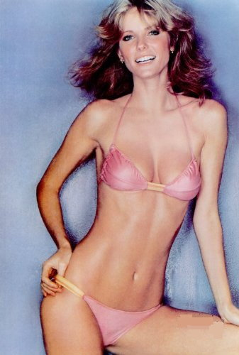
Question 8:
WHO HAS BEEN CALLED "THE FIRST AMERICAN SUPERMODEL"?

Slide 10
Question 9:
WHO STARRED WITH JACKIE CHAN IN 3 "RUSH HOUR" FILMS?

Slide 11
Question 10:
WHAT PRESIDENT OF LIBERIA 1997-2003 WAS SENTENCED TO 50 YEARS IN PRISON FOR CRIMES AGAINST HUMANITY?

Slide 12
ANSWERS WILL BE PROVIDED SHORTLY

Slide 13
Question 1:
WHO WON THE OSCAR FOR BEST ACTRESS FOR "MONSTER"?
CHARLIZE THERON

Slide 14
Question 2:
WHAT CURRENT SUPREME COURT JUDGE HAS SERVED ON THE COURT THE LONGEST?
CLARENCE THOMAS

Slide 15
Question 3:
WHAT STANDUP COMEDIAN IS KNOWN FOR HIS PROP COMEDY AND RED HAIR?
CARROT TOP

Slide 16
Question 4:
WHAT NICKEL CREEK AND PUNCH BROTHERS MANDOLIN PLAYER TOOK OVER "PRAIRIE HOME COMPANION"?
CHRIS THILE

Slide 17
Question 5:
WHAT ACTRESS FAMOUS FOR PLAYING STRONG BLACK WOMEN WAS A KENNEDY CENTER HONOREE IN 2015?
CICELY TYSON

Slide 18
Question 6:
WHAT COUNTRY SINGER WON THE CMA AWARD FOR BEST VOCAL DUO 4 YEARS IN A ROW, WITH LORETTA LYNN EACH TIME?
CONWAY TWITTY

Slide 19
Question 7:
WHO STARRED IN "MAGIC MIKE", "21 JUMP STREET", AND THEIR SEQUELS?
CHANNING TATUM

Slide 20
Question 8:
WHO HAS BEEN CALLED "THE FIRST AMERICAN SUPERMODEL"?
CHERYL TIEGS

Slide 21
Question 9:
WHO STARRED WITH JACKIE CHAN IN 3 "RUSH HOUR" FILMS?
CHRIS TUCKER

Slide 22
Question 10:
WHAT PRESIDENT OF LIBERIA 1997-2003 WAS SENTENCED TO 50 YEARS IN PRISON FOR CRIMES AGAINST HUMANITY?
CHARLES TAYLOR

