Slide 1
IDENTIFY THESE PAIRS OF COUNTRIES WITH OVERLAPPING NAMES

Slide 2
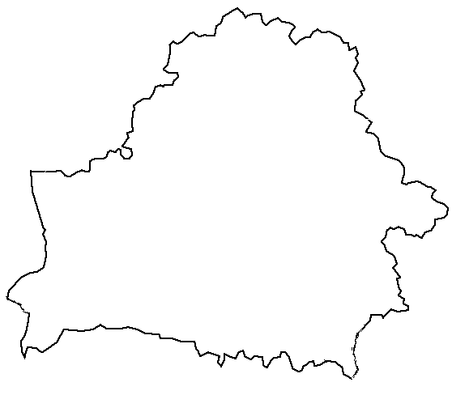
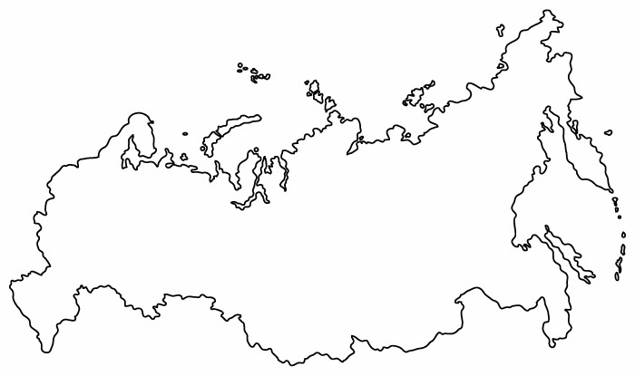
Question 1:

Slide 3
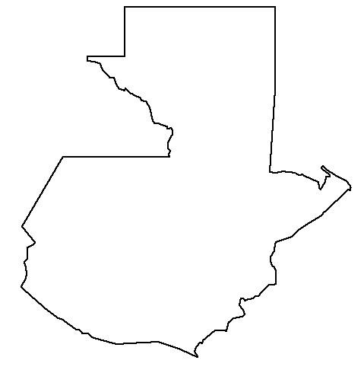
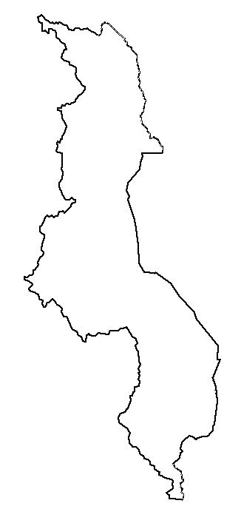
Question 2:

Slide 4
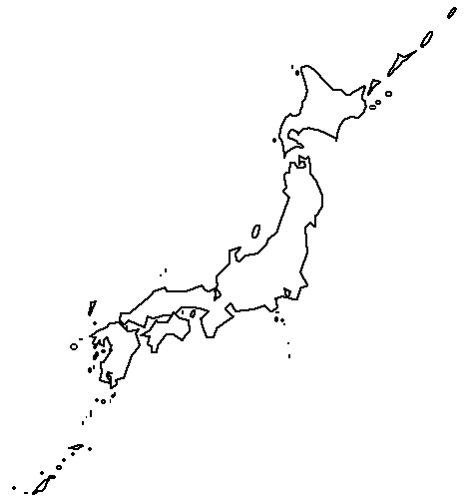
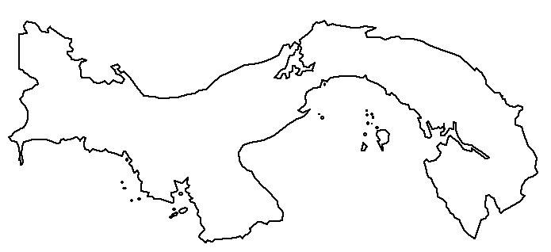
Question 3:

Slide 5
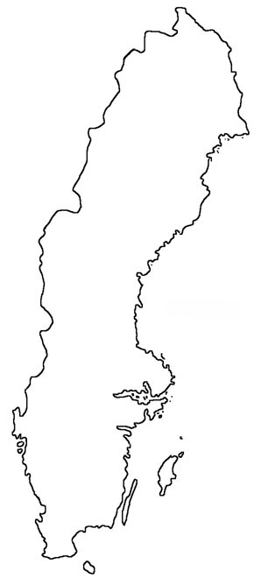
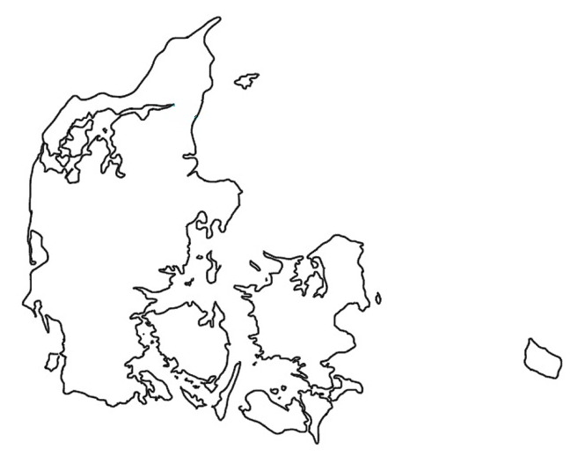
Question 4:

Slide 6
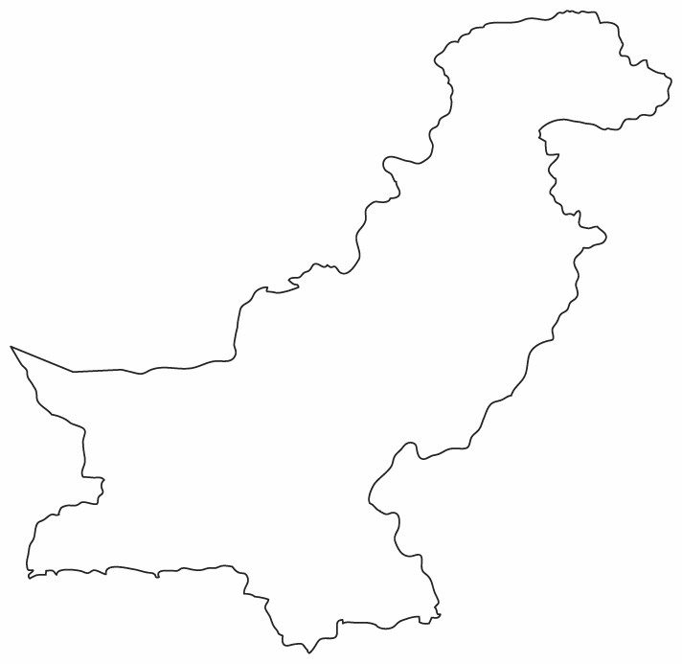
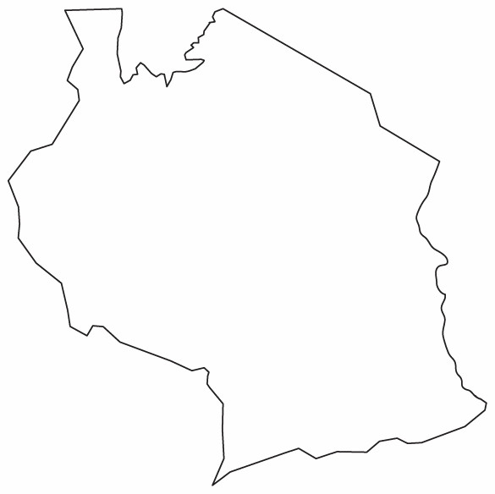
Question 5:

Slide 7
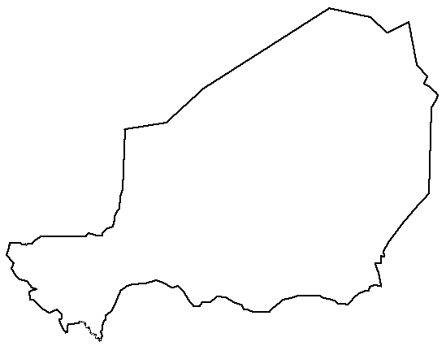
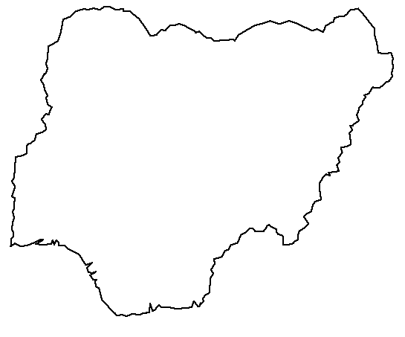
Question 6:

Slide 8
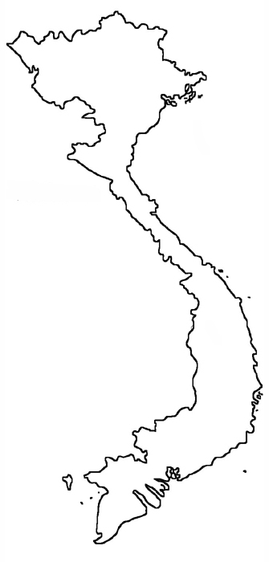
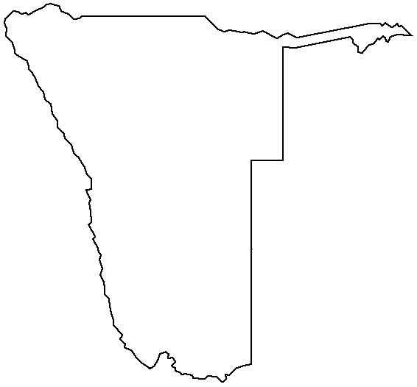
Question 7:

Slide 9
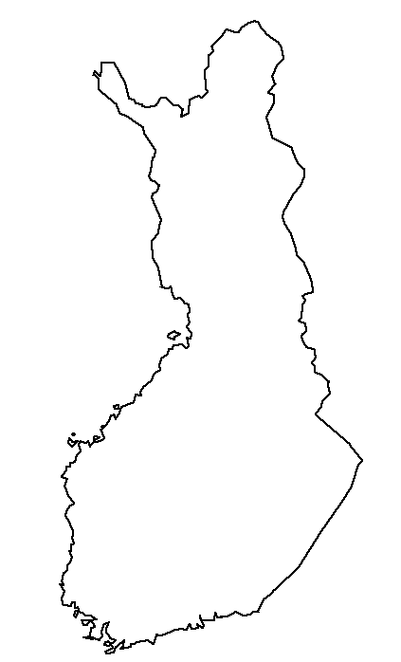
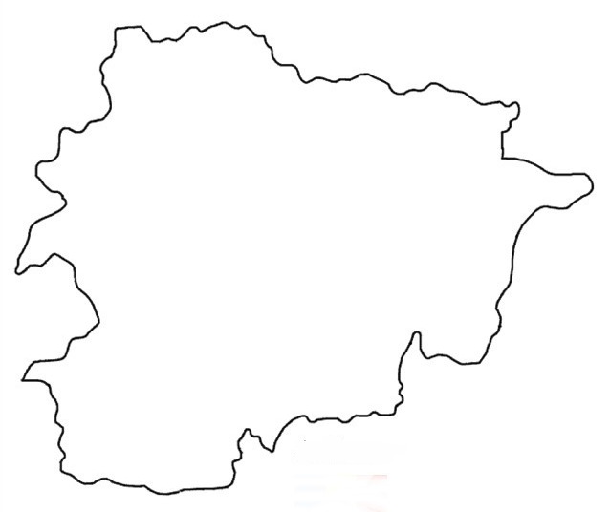
Question 8:

Slide 10
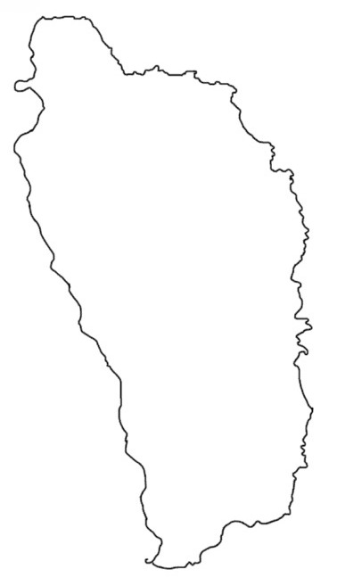
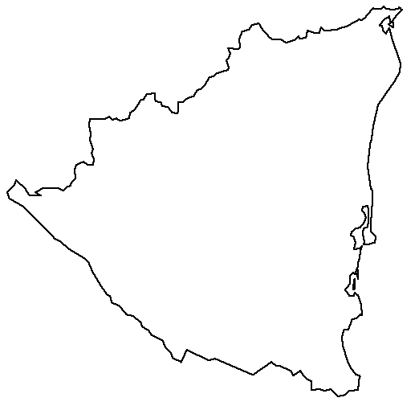
Question 9:

Slide 11
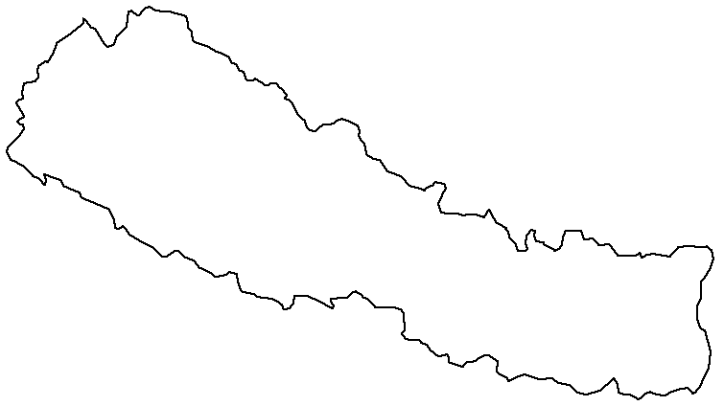
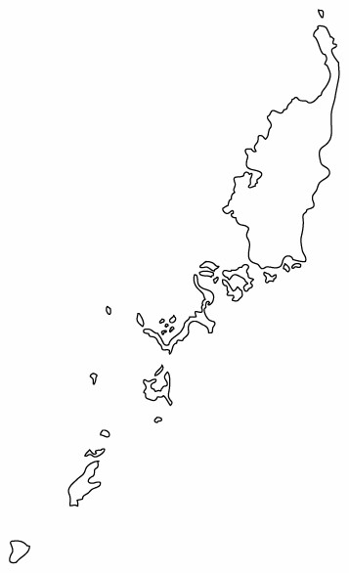
Question 10:

Slide 12
ANSWERS WILL BE PROVIDED SHORTLY

Slide 13
Question 1:
BELARUSSIA

Slide 14
Question 2:
GUATEMALAWI

Slide 15
Question 3:
JAPANAMA

Slide 16
Question 4:
SWEDENMARK

Slide 17
Question 5:
PAKISTANZANIA

Slide 18
Question 6:
NIGERIA

Slide 19
Question 7:
VIETNAMIBIA

Slide 20
Question 8:
FINLANDORRA

Slide 21
Question 9:
DOMINICARAGUA

Slide 22
Question 10:
NEPALAU

