Slide 1
TRUE OR FALSE?

Slide 2
Question 1:
TRUE OR FALSE? BETTY WHITE IS OLDER THAN COMMERCIALLY AVAILABLE SLICED BREAD?

Slide 3
Question 2:
TRUE OR FALSE? ALL THE GOLD IN THE WORLD WOULD FIT INSIDE AN OLYMPIC SWIMMING POOL?

Slide 4
Question 3:
TRUE OR FALSE? THERE ARE MORE PLASTIC FLAMINGOS IN THE WORLD THAN REAL ONES?

Slide 5
Question 4:
TRUE OR FALSE? A MAN ONCE ATE AN ENTIRE AIRPLANE?

Slide 6
Question 5:
TRUE OR FALSE? THE 10TH U.S. PRESIDENT HAS LIVING GRANDCHILDREN?

Slide 7
Question 6:
TRUE OR FALSE? ON SATURN, IT RAINS DIAMONDS?

Slide 8
Question 7:
TRUE OR FALSE? A SCUBA DIVER WAS SCOOPED UP BY A FIREFIGHTING PLANE PICKING UP WATER TO DUMP ON A FIRE?

Slide 9
Question 8:
TRUE OR FALSE? TWINKIES HAVE A SHELF LIFE OF OVER 5 YEARS?

Slide 10
Question 9:
TRUE OR FALSE? THE EXPRESSION "RULE OF THUMB" ORIGINATED FROM AN OLD BRITISH LAW ALLOWING A MAN TO BEAT HIS WIFE WITH A STICK NO THICKER THAN HIS THUMB?

Slide 11
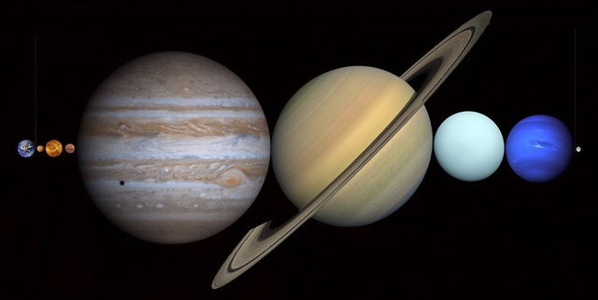
Question 10:
TRUE OR FALSE? ALL THE OTHER PLANETS WOULD FIT BETWEEN THE EARTH AND MOON?

Slide 12
ANSWERS WILL BE PROVIDED SHORTLY

Slide 13
Question 1:
TRUE OR FALSE? BETTY WHITE IS OLDER THAN COMMERCIALLY AVAILABLE SLICED BREAD?
TRUE

Slide 14
Question 2:
TRUE OR FALSE? ALL THE GOLD IN THE WORLD WOULD FIT INSIDE AN OLYMPIC SWIMMING POOL?
FALSE

Slide 15
Question 3:
TRUE OR FALSE? THERE ARE MORE PLASTIC FLAMINGOS IN THE WORLD THAN REAL ONES?
TRUE

Slide 16
Question 4:
TRUE OR FALSE? A MAN ONCE ATE AN ENTIRE AIRPLANE?
TRUE

Slide 17
Question 5:
TRUE OR FALSE? THE 10TH U.S. PRESIDENT HAS LIVING GRANDCHILDREN?
TRUE

Slide 18
Question 6:
TRUE OR FALSE? ON SATURN, IT RAINS DIAMONDS?
TRUE

Slide 19
Question 7:
TRUE OR FALSE? A SCUBA DIVER WAS SCOOPED UP BY A FIREFIGHTING PLANE PICKING UP WATER TO DUMP ON A FIRE?
FALSE

Slide 20
Question 8:
TRUE OR FALSE? TWINKIES HAVE A SHELF LIFE OF OVER 5 YEARS?
FALSE

Slide 21
Question 9:
TRUE OR FALSE? THE EXPRESSION "RULE OF THUMB" ORIGINATED FROM AN OLD BRITISH LAW ALLOWING A MAN TO BEAT HIS WIFE WITH A STICK NO THICKER THAN HIS THUMB?
FALSE

Slide 22
Question 10:
TRUE OR FALSE? ALL THE OTHER PLANETS WOULD FIT BETWEEN THE EARTH AND MOON?
TRUE

