Slide 1
COMMON THREAD

Slide 2
Question 1:
WHAT 2015 SCIENCE FICTION FILM NOMINATED FOR BEST PICTURE AND STARRING MATT DAMON HAD TAG LINE "BRING HIM HOME"?

Slide 3
Question 2:
WHO DOES CINDERELLA END UP WITH AT THE END OF THE STORY?

Slide 4
Question 3:
IN THE "BACK TO THE FUTURE" TRILOGY, WHO IS THE ANTAGONIST, WHO WAS BASED ON DONALD TRUMP?

Slide 5
Question 4:
WHAT RED PLUSH TOY WAS THE "MUST HAVE" CHRISTMAS FAD OF 1996?

Slide 6
Question 5:
WHO WAS THE ONLY MAN TO SERVE 2 NON-CONSECUTIVE TERMS AS U.S. PRESIDENT?

Slide 7
Question 6:
WHAT WAS THE NAME OF DICK VAN DYKE'S CHIMNEY SWEEP CHARACTER IN "MARY POPPINS"?

Slide 8
Question 7:
BESIDES "THE THREE MUSKETEERS", WHAT IS ALEXANDRE DUMAS' MOST FAMOUS NOVEL?

Slide 9
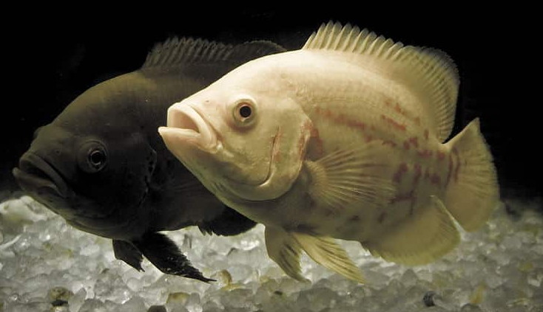
Question 8:
WHAT KIND OF FISH ARE THESE?

Slide 10
Question 9:
WHO SANG "SIXTEEN TONS" AND "THE SHOTGUN BOOGIE"?

Slide 11
Question 10:
WHAT DO ALL THESE ANSWERS HAVE IN COMMON?

Slide 12
ANSWERS WILL BE PROVIDED SHORTLY

Slide 13
Question 1:
WHAT 2015 SCIENCE FICTION FILM NOMINATED FOR BEST PICTURE AND STARRING MATT DAMON HAD TAG LINE "BRING HIM HOME"?
THE MARTIAN

Slide 14
Question 2:
WHO DOES CINDERELLA END UP WITH AT THE END OF THE STORY?
PRINCE CHARMING

Slide 15
Question 3:
IN THE "BACK TO THE FUTURE" TRILOGY, WHO IS THE ANTAGONIST, WHO WAS BASED ON DONALD TRUMP?
BIFF TANNEN

Slide 16
Question 4:
WHAT RED PLUSH TOY WAS THE "MUST HAVE" CHRISTMAS FAD OF 1996?
TICKLE ME ELMO

Slide 17
Question 5:
WHO WAS THE ONLY MAN TO SERVE 2 NON-CONSECUTIVE TERMS AS U.S. PRESIDENT?
GROVER CLEVELAND

Slide 18
Question 6:
WHAT WAS THE NAME OF DICK VAN DYKE'S CHIMNEY SWEEP CHARACTER IN "MARY POPPINS"?
BERT

Slide 19
Question 7:
BESIDES "THE THREE MUSKETEERS", WHAT IS ALEXANDRE DUMAS' MOST FAMOUS NOVEL?
THE COUNT OF MONTE CRISTO

Slide 20
Question 8:
WHAT KIND OF FISH ARE THESE?
OSCARS

Slide 21
Question 9:
WHO SANG "SIXTEEN TONS" AND "THE SHOTGUN BOOGIE"?
TENNESSEE ERNIE FORD

Slide 22
Question 10:
WHAT DO ALL THESE ANSWERS HAVE IN COMMON?
CONTAIN NAMES OF SESAME STREET CHARACTERS

