Slide 1
SAME INITIALS

Slide 2
Question 1:
WHAT ACTRESS WON TONY AWARDS FOR "SONG AND DANCE" AND "ANNIE GET YOUR GUN"?

Slide 3
Question 2:
WHO PLAYED A MORMON WITH 3 WIVES ON HBO'S "BIG LOVE"?

Slide 4
Question 3:
WHAT COUNTRY ARTIST SANG THE #1 SONGS "WE DANCED", "OLD ALABAMA", "TICKS", "THE WORLD", "ONLINE", "THEN", AND "WATER"?

Slide 5
Question 4:
WHO WROTE "THE TALE OF PETER RABBIT"?

Slide 6
Question 5:
WHOSE UNWED PREGNANCY AT AGE 17 WAS AN ISSUE IN HER MOTHER'S VICE PRESIDENTIAL CAMPAIGN?

Slide 7
Question 6:
WHO COACHED THE GIANTS (1983-1990), PATRIOTS (1993-1996), JETS (1997-1999), AND COWBOYS (2003-2006)?

Slide 8
Question 7:
WHAT FRENCH MATHEMATICIAN IS FAMOUS FOR HIS "ARITHMETICAL TRIANGLE"?

Slide 9
Question 8:
WHAT SESSION KEYBOARDIST IS THE ONLY NON-BEATLE TO GET CREDIT ON THEIR ALBUMS, AFTER WORKING ON "GET BACK" AND "ABBEY ROAD"?

Slide 10
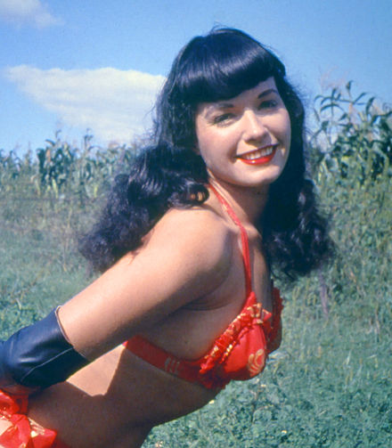
Question 9:
WHO WAS THE "QUEEN OF PINUPS" IN THE 1950'S?

Slide 11
Question 10:
WHO PLAYED THE MALE LEAD IN "WHILE YOU WERE SLEEPING", "LAKE PLACID", "CASPER", AND "LOST HIGHWAY"?

Slide 12
ANSWERS WILL BE PROVIDED SHORTLY

Slide 13
Question 1:
WHAT ACTRESS WON TONY AWARDS FOR "SONG AND DANCE" AND "ANNIE GET YOUR GUN"?
BERNADETTE PETERS

Slide 14
Question 2:
WHO PLAYED A MORMON WITH 3 WIVES ON HBO'S "BIG LOVE"?
BILL PAXTON

Slide 15
Question 3:
WHAT COUNTRY ARTIST SANG THE #1 SONGS "WE DANCED", "OLD ALABAMA", "TICKS", "THE WORLD", "ONLINE", "THEN", AND "WATER"?
BRAD PAISLEY

Slide 16
Question 4:
WHO WROTE "THE TALE OF PETER RABBIT"?
BEATRIX POTTER

Slide 17
Question 5:
WHOSE UNWED PREGNANCY AT AGE 17 WAS AN ISSUE IN HER MOTHER'S VICE PRESIDENTIAL CAMPAIGN?
BRISTOL PALIN

Slide 18
Question 6:
WHO COACHED THE GIANTS (1983-1990), PATRIOTS (1993-1996), JETS (1997-1999), AND COWBOYS (2003-2006)?
BILL PARCELLS

Slide 19
Question 7:
WHAT FRENCH MATHEMATICIAN IS FAMOUS FOR HIS "ARITHMETICAL TRIANGLE"?
BLAISE PASCAL

Slide 20
Question 8:
WHAT SESSION KEYBOARDIST IS THE ONLY NON-BEATLE TO GET CREDIT ON THEIR ALBUMS, AFTER WORKING ON "GET BACK" AND "ABBEY ROAD"?
BILLY PRESTON

Slide 21
Question 9:
WHO WAS THE "QUEEN OF PINUPS" IN THE 1950'S?
BETTIE PAGE

Slide 22
Question 10:
WHO PLAYED THE MALE LEAD IN "WHILE YOU WERE SLEEPING", "LAKE PLACID", "CASPER", AND "LOST HIGHWAY"?
BILL PULLMAN

