Slide 1
IDENTIFY THE FILM BY THE MOVIE POSTER COMMON THREAD

Slide 2
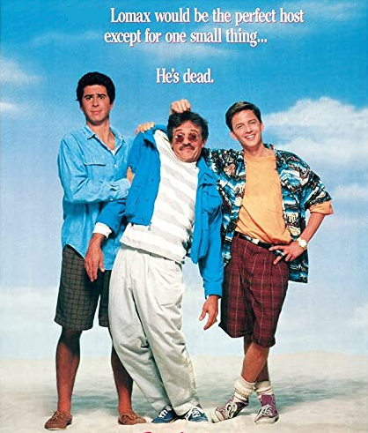
Question 1:

Slide 3
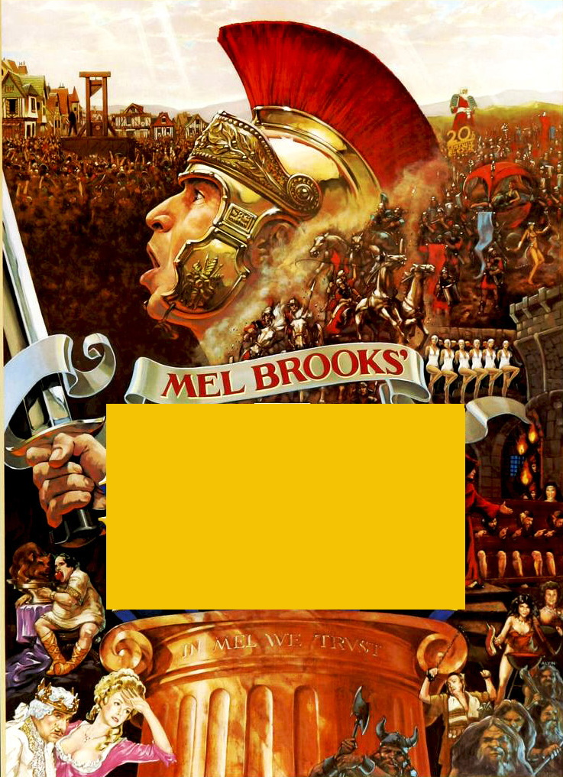
Question 2:

Slide 4
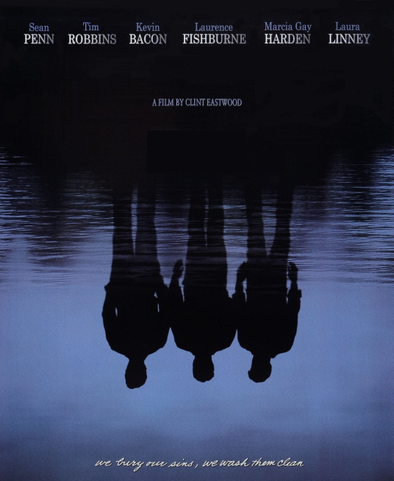
Question 3:

Slide 5
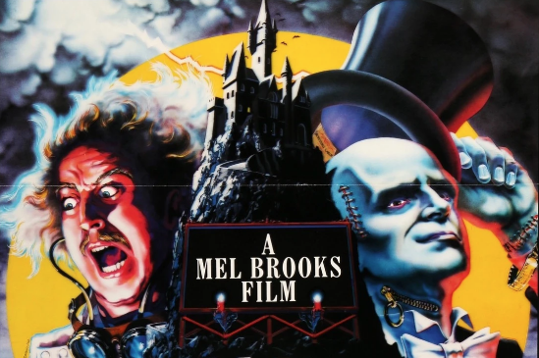
Question 4:

Slide 6
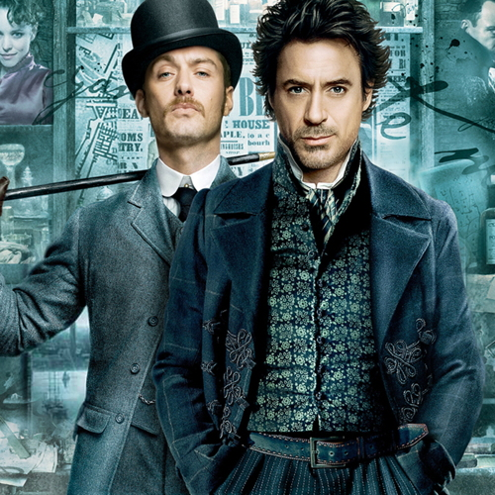
Question 5:

Slide 7
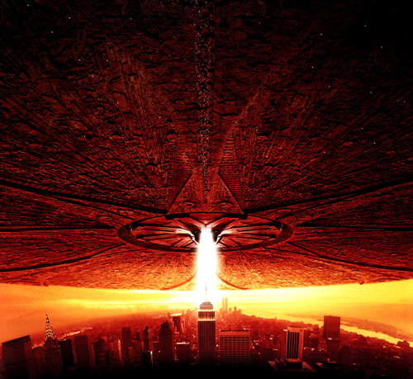
Question 6:

Slide 8
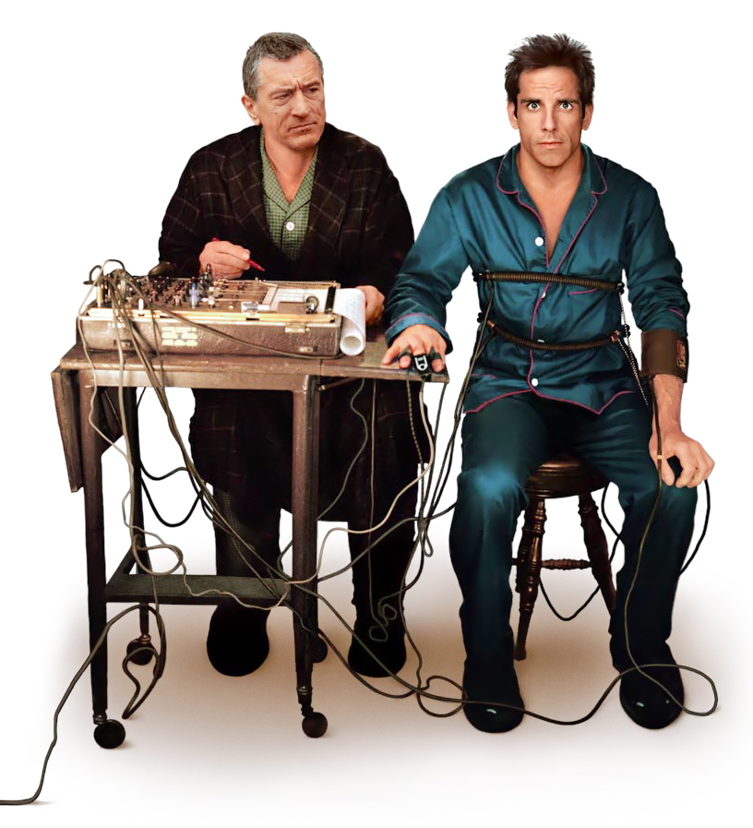
Question 7:

Slide 9
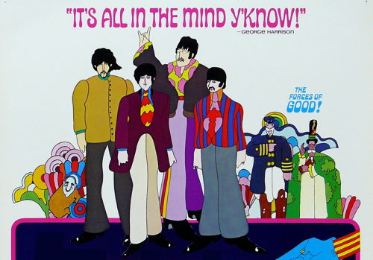
Question 8:

Slide 10
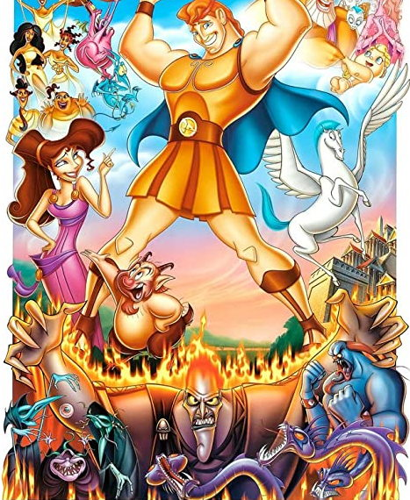
Question 9:

Slide 11
Question 10:
WHAT DO ALL THESE FILMS HAVE IN COMMON?

Slide 12
The End
Answers will be provided shortly

Slide 13
Question 1:
WEEKEND AT BERNIE'S

Slide 14
Question 2:
HISTORY OF THE WORLD PART 1

Slide 15
Question 3:
MYSTIC RIVER

Slide 16
Question 4:
YOUNG FRANKENSTEIN

Slide 17
Question 5:
SHERLOCK HOLMES

Slide 18
Question 6:
INDEPENDENCE DAY

Slide 19
Question 7:
MEET THE PARENTS

Slide 20
Question 8:
YELLOW SUBMARINE

Slide 21
Question 9:
HERCULES

Slide 22
Question 10:
WHAT DO ALL THESE FILMS HAVE IN COMMON?
THEIR TITLES START WITH PRONOUNS (WE, HIS, MY, YOU, SHE, I, ME, YE, HER)

