Slide 1
COMMON THREAD

Slide 2
Question 1:
ACCORDING TO A NURSERY RHYME, WHERE DOES ONE GO TO BUY A FAT PIG, A FAT HOG, AND A PLUM BUN?

Slide 3
Question 2:
WHAT IS THE NAME OF THE LONDON THEATER THAT WILLIAM SHAKESPEARE OWNED A 1/8 STAKE IN?

Slide 4
Question 3:
ON THE COVER OF THE 1967 ALBUM "THE WHO SELL OUT", ROGER DALTREY IS PICTURED IN A BATHTUB FILLED WITH WHAT FOOD?

Slide 5
Question 4:
WHAT AKC GROUP OF SMALL DOGS WERE ORIGINALLY BRED TO HUNT VERMIN THAT LIVE UNDERGROUND?

Slide 6
Question 5:
WHAT GRASSROOTS POLITICAL MOVEMENT FOUNDED BY MICHELE BACHMANN HAD 60 MEMBERS IN ITS CONGRESSIONAL CAUCUS?

Slide 7
Question 6:
WHAT MEDIEVAL TERM FOR BROWN BEARS DID UCLA ADOPT AS ITS NEW TEAM NAME, REPLACING "GRIZZLIES," IN 1926?

Slide 8
Question 7:
WHAT ELDERLY NICKNAME HAS BEEN THE TITLE OF BIOGRAPHIES OF BOTH LOUIS ARMSTRONG AND BASEBALL LEGEND WILLIE STARGELL?

Slide 9
Question 8:
WHAT RAPPER WON AN OSCAR IN 2015 FOR THE SONG "GLORY", WHICH HE RECORDED WITH JOHN LEGEND FOR THE "SELMA" SOUNDTRACK?

Slide 10
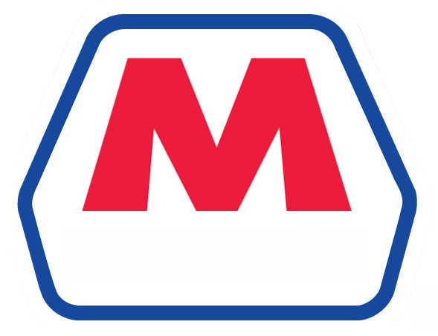
Question 9:
WHAT OIL COMPANY HAS THIS LOGO?

Slide 11
Question 10:
WHAT DO ALL THESE ANSWERS HAVE IN COMMON?

Slide 12
The End
Answers will be provided shortly

Slide 13
Question 1:
ACCORDING TO A NURSERY RHYME, WHERE DOES ONE GO TO BUY A FAT PIG, A FAT HOG, AND A PLUM BUN?
MARKET

Slide 14
Question 2:
WHAT IS THE NAME OF THE LONDON THEATER THAT WILLIAM SHAKESPEARE OWNED A 1/8 STAKE IN?
GLOBE

Slide 15
Question 3:
ON THE COVER OF THE 1967 ALBUM "THE WHO SELL OUT", ROGER DALTREY IS PICTURED IN A BATHTUB FILLED WITH WHAT FOOD?
BAKED BEANS

Slide 16
Question 4:
WHAT AKC GROUP OF SMALL DOGS WERE ORIGINALLY BRED TO HUNT VERMIN THAT LIVE UNDERGROUND?
TERRIERS

Slide 17
Question 5:
WHAT GRASSROOTS POLITICAL MOVEMENT FOUNDED BY MICHELE BACHMANN HAD 60 MEMBERS IN ITS CONGRESSIONAL CAUCUS?
TEA PARTY

Slide 18
Question 6:
WHAT MEDIEVAL TERM FOR BROWN BEARS DID UCLA ADOPT AS ITS NEW TEAM NAME, REPLACING "GRIZZLIES," IN 1926?
BRUINS

Slide 19
Question 7:
WHAT ELDERLY NICKNAME HAS BEEN THE TITLE OF BIOGRAPHIES OF BOTH LOUIS ARMSTRONG AND BASEBALL LEGEND WILLIE STARGELL?
POPS

Slide 20
Question 8:
WHAT RAPPER WON AN OSCAR IN 2015 FOR THE SONG "GLORY", WHICH HE RECORDED WITH JOHN LEGEND FOR THE "SELMA" SOUNDTRACK?
COMMON

Slide 21
Question 9:
WHAT OIL COMPANY HAS THIS LOGO?
MARATHON

Slide 22
Question 10:
WHAT DO ALL THESE ANSWERS HAVE IN COMMON?
CAN FOLLOW "BOSTON"

