Slide 1
COMMON THREAD

Slide 2
Question 1:
WHAT RAPPER WON AN OSCAR FOR THE BEST ORIGINAL SONG "GLORY" FOR THE FILM "SELMA", THAT HE ALSO APPEARED IN?

Slide 3
Question 2:
WHAT IS THE LAST NAME OF THE SINGER OF "TWO TICKETS TO PARADISE" AND "BABY HOLD ON"?

Slide 4
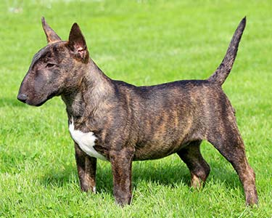
Question 3:
WHAT KIND OF TERRIER IS THIS?

Slide 5

Question 4:
WHAT INSURANCE COMPANY HAS THIS LOGO?

Slide 6
Question 5:
IN THE BASKETBALL ABBREVIATION "FT", WHAT DOES THE "F" STAND FOR?

Slide 7
Question 6:
WHAT IS THE LAST NAME OF THE FIRST ACTOR TO PORTRAY INSPECTOR JACQUES CLOUSEAU IN "THE PINK PANTHER" FILMS?

Slide 8
Question 7:
MICHAEL PETER BALZARY, THE BASSIST FOR THE RED HOT CHILI PEPPERS, IS KNOWN BY WHAT NICKNAME?

Slide 9
Question 8:
WHAT ANIMAL IS "PICTURED" BY THE CONSTELLATION CONTAINING THE STARS KNOWN AS THE BIG DIPPER?

Slide 10
Question 9:
WHAT COLOR OF CAR ABSORBS THE MOST ENERGY FROM THE SUN?

Slide 11
Question 10:
WHAT DO ALL THESE ANSWERS HAVE IN COMMON?

Slide 12
The End
Answers will be provided shortly

Slide 13
Question 1:
WHAT RAPPER WON AN OSCAR FOR THE BEST ORIGINAL SONG "GLORY" FOR THE FILM "SELMA", THAT HE ALSO APPEARED IN?
COMMON

Slide 14
Question 2:
WHAT IS THE LAST NAME OF THE SINGER OF "TWO TICKETS TO PARADISE" AND "BABY HOLD ON"?
(EDDIE) MONEY

Slide 15
Question 3:
WHAT KIND OF TERRIER IS THIS?
BULL

Slide 16
Question 4:
WHAT INSURANCE COMPANY HAS THIS LOGO?
FARMERS

Slide 17
Question 5:
IN THE BASKETBALL ABBREVIATION "FT", WHAT DOES THE "F" STAND FOR?
FREE (THROW)

Slide 18
Question 6:
WHAT IS THE LAST NAME OF THE FIRST ACTOR TO PORTRAY INSPECTOR JACQUES CLOUSEAU IN "THE PINK PANTHER" FILMS?
(PETER) SELLERS

Slide 19
Question 7:
MICHAEL PETER BALZARY, THE BASSIST FOR THE RED HOT CHILI PEPPERS, IS KNOWN BY WHAT NICKNAME?
FLEA

Slide 20
Question 8:
WHAT ANIMAL IS "PICTURED" BY THE CONSTELLATION CONTAINING THE STARS KNOWN AS THE BIG DIPPER?
BEAR

Slide 21
Question 9:
WHAT COLOR OF CAR ABSORBS THE MOST ENERGY FROM THE SUN?
BLACK

Slide 22
Question 10:
WHAT DO ALL THESE ANSWERS HAVE IN COMMON?
CAN BE FOLLOWED BY "MARKET"

