Slide 1
WHAT MUSICAL GROUPS HAD THESE ALBUM COVERS COMMON THREAD

Slide 2
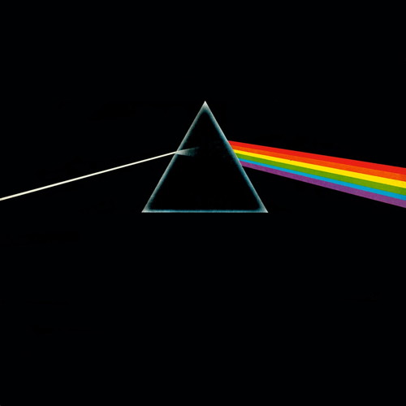
Question 1:

Slide 3
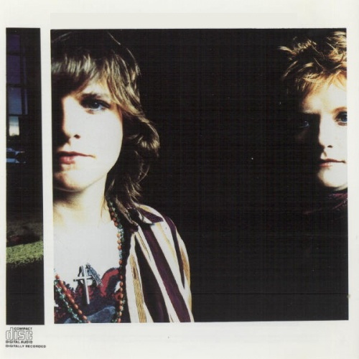
Question 2:

Slide 4

Question 3:

Slide 5

Question 4:

Slide 6

Question 5:

Slide 7
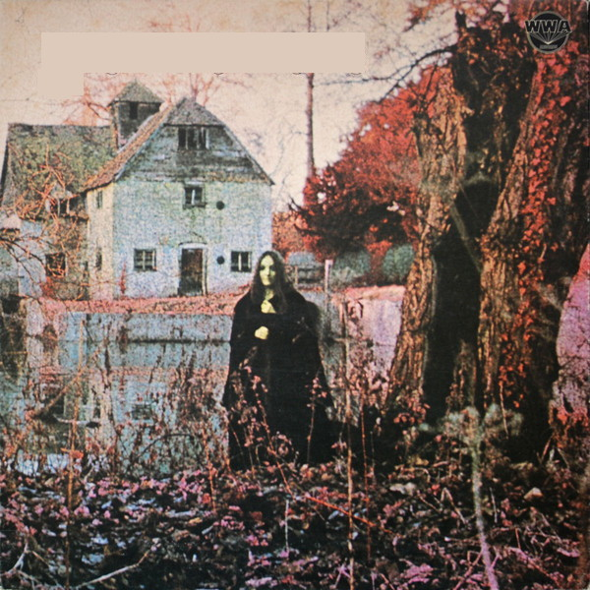
Question 6:

Slide 8
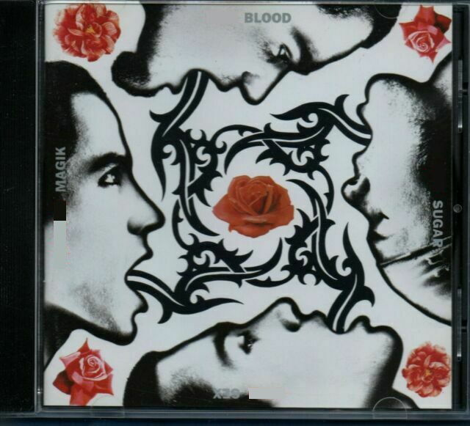
Question 7:

Slide 9
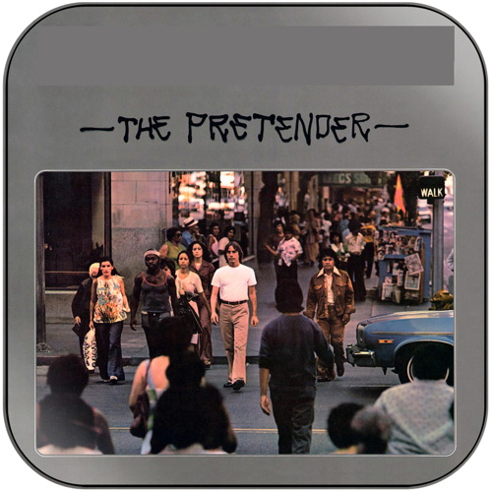
Question 8:

Slide 10

Question 9:

Slide 11
Question 10:
WHAT DO THESE ANSWERS HAVE IN COMMON?

Slide 12
The End
Answers will be provided shortly

Slide 13
Question 1:
PINK FLOYD

Slide 14
Question 2:
INDIGO GIRLS

Slide 15
Question 3:
GREEN DAY

Slide 16
Question 4:
MAROON 5

Slide 17
Question 5:
THE MOODY BLUES

Slide 18
Question 6:
BLACK SABBATH

Slide 19
Question 7:
RED HOT CHILI PEPPERS

Slide 20
Question 8:
JACKSON BROWNE

Slide 21
Question 9:
THE WHITE STRIPES

Slide 22
Question 10:
WHAT DO THESE ANSWERS HAVE IN COMMON?
THEY CONTAIN COLORS

