Slide 1
PEOPLE COMMON THREAD

Slide 2
Question 1:
WHO WON GOLD MEDALS IN THE VAULT AND FLOOR EXERCISE AT THE 2016 OLYMPICS, AND HAS THE MOST WORLD GOLD MEDALS OF ANY GYMNAST?

Slide 3
Question 2:
WHAT CONGRESSWOMAN SURVIVED AN ASSASSINATION ATTEMPT, AND IS MARRIED TO THE MAN WHO NOW HOLDS HER ARIZONA SEAT?

Slide 4
Question 3:
WHO WAS THE CO-FOUNDER, CHAIRMAN, AND CEO OF APPLE?

Slide 5
Question 4:
WHO FAMOUSLY GAVE A SPEECH AT THE 2016 DEMOCRATIC CONVENTION AND HELD UP A COPY OF THE U.S. CONSTITUTION?

Slide 6
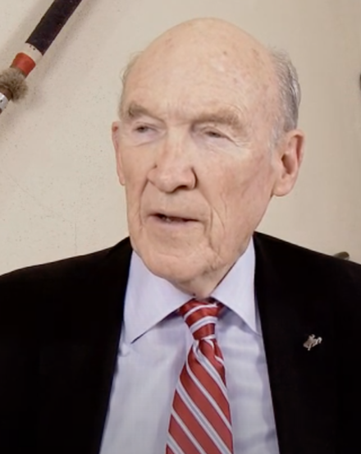
Question 5:
WHO IS THIS FORMER WYOMING CONGRESSMAN?

Slide 7
Question 6:
WHAT AFRICAN-AMERICAN ACTOR WAS NAMED THE BEST ACTOR OF THE 21ST CENTURY BY THE NEW YORK TIMES?

Slide 8
Question 7:
WHAT SOCCER PLAYER WITH PINK HAIR WAS NAMED THE BEST FIFA FEMALE SOCCER PLAYER IN 2019?

Slide 9
Question 8:
WHAT REPUBLICAN SENATOR LOST THE PRESIDENTIAL ELECTION OF 2008 TO OBAMA?

Slide 10
Question 9:
WHO WAS THE PRESIDENT OF THE UNITED MINE WORKERS 1982-1995 AND PRESIDENT OF THE AFL-CIO 2009-2021?

Slide 11
Question 10:
WHAT DO ALL THESE PEOPLE HAVE IN COMMON?

Slide 12
ANSWERS WILL BE PROVIDED SHORTLY

Slide 13
Question 1:
WHO WON GOLD MEDALS IN THE VAULT AND FLOOR EXERCISE AT THE 2016 OLYMPICS, AND HAS THE MOST WORLD GOLD MEDALS OF ANY GYMNAST?
SIMONE BILES

Slide 14
Question 2:
WHAT CONGRESSWOMAN SURVIVED AN ASSASSINATION ATTEMPT, AND IS MARRIED TO THE MAN WHO NOW HOLDS HER ARIZONA SEAT?
GABBY GIFFORDS

Slide 15
Question 3:
WHO WAS THE CO-FOUNDER, CHAIRMAN, AND CEO OF APPLE?
STEVE JOBS

Slide 16
Question 4:
WHO FAMOUSLY GAVE A SPEECH AT THE 2016 DEMOCRATIC CONVENTION AND HELD UP A COPY OF THE U.S. CONSTITUTION?
KHIZR KHAN

Slide 17
Question 5:
WHO IS THIS FORMER WYOMING CONGRESSMAN?
ALAN SIMPSON

Slide 18
Question 6:
WHAT AFRICAN-AMERICAN ACTOR WAS NAMED THE BEST ACTOR OF THE 21ST CENTURY BY THE NEW YORK TIMES?
DENZEL WASHINGTON

Slide 19
Question 7:
WHAT SOCCER PLAYER WITH PINK HAIR WAS NAMED THE BEST FIFA FEMALE SOCCER PLAYER IN 2019?
MEGAN RAPINOE

Slide 20
Question 8:
WHAT REPUBLICAN SENATOR LOST THE PRESIDENTIAL ELECTION OF 2008 TO OBAMA?
JOHN MCCAIN

Slide 21
Question 9:
WHO WAS THE PRESIDENT OF THE UNITED MINE WORKERS 1982-1995 AND PRESIDENT OF THE AFL-CIO 2009-2021?
RICHARD TRUMKA

Slide 22
Question 10:
WHAT DO ALL THESE PEOPLE HAVE IN COMMON?
AWARDED THE PRESIDENTIAL MEDAL OF FREEDOM BY BIDEN

