Slide 1
STARTS WITH Q

Slide 2
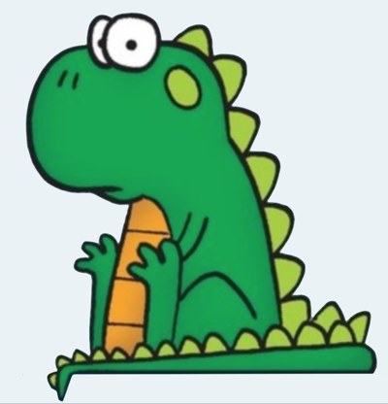
Question 1:
WHAT IS THE NAME OF THIS IGUANA FROM "FOXTROT"?

Slide 3
Question 2:
WHAT IS THE SMALLEST-KNOWN TYPE OF PARTICLE, THAT EVEN NEUTRONS AND PROTONS ARE MADE FROM?

Slide 4
Question 3:
IN THE U.S., WHAT IS THE NAME OF 1,000,000,000,000,000,000?

Slide 5
Question 4:
WHAT RELIGIOUS DENOMINATION IS ASSOCIATED WITH BRYN MAWR, SWATHMORE, AND EARLHAM COLLEGES?

Slide 6
Question 5:
WHAT IS THE LARGEST BOROUGH OF NYC BY AREA?

Slide 7
Question 6:
WHAT DO THE INITIALS OF THE SHOPPING CHANNEL QVC STAND FOR?

Slide 8
Question 7:
WHAT IS THE NAME FOR THE PAPER SIZE SLIGHTLY SMALLER THAN LETTER (8½⨯11) AND SLIGHTLY LARGER THAN GOVERNMENT LETTER (8⨯10)?

Slide 9
Question 8:
WHAT DRUG IS TYPICALLY USED TO TREAT MALARIA?

Slide 10
Question 9:
THE 4 MORE ADVANCED LIBERAL ARTS (ARITHMETIC, GEOMETRY, MUSIC, AND ASTRONOMY) ARE TOGETHER KNOWN AS WHAT?

Slide 11
Question 10:
WHAT IS THE ONLY COUNTRY IN THE WORLD WHOSE NAME STARTS WITH A "Q"?

Slide 12
ANSWERS WILL BE PROVIDED SHORTLY

Slide 13
Question 1:
WHAT IS THE NAME OF THIS IGUANA FROM "FOXTROT"?
QUINCY

Slide 14
Question 2:
WHAT IS THE SMALLEST-KNOWN TYPE OF PARTICLE, THAT EVEN NEUTRONS AND PROTONS ARE MADE FROM?
QUARK

Slide 15
Question 3:
IN THE U.S., WHAT IS THE NAME OF 1,000,000,000,000,000,000?
QUINTILLION

Slide 16
Question 4:
WHAT RELIGIOUS DENOMINATION IS ASSOCIATED WITH BRYN MAWR, SWATHMORE, AND EARLHAM COLLEGES?
QUAKERS

Slide 17
Question 5:
WHAT IS THE LARGEST BOROUGH OF NYC BY AREA?
QUEENS

Slide 18
Question 6:
WHAT DO THE INITIALS OF THE SHOPPING CHANNEL QVC STAND FOR?
QUALITY, VALUE, CONVENIENCE

Slide 19
Question 7:
WHAT IS THE NAME FOR THE PAPER SIZE SLIGHTLY SMALLER THAN LETTER (8½⨯11) AND SLIGHTLY LARGER THAN GOVERNMENT LETTER (8⨯10)?
QUARTO

Slide 20
Question 8:
WHAT DRUG IS TYPICALLY USED TO TREAT MALARIA?
QUININE

Slide 21
Question 9:
THE 4 MORE ADVANCED LIBERAL ARTS (ARITHMETIC, GEOMETRY, MUSIC, AND ASTRONOMY) ARE TOGETHER KNOWN AS WHAT?
QUADRIVIUM

Slide 22
Question 10:
WHAT IS THE ONLY COUNTRY IN THE WORLD WHOSE NAME STARTS WITH A "Q"?
QATAR

