Slide 1
CALIFORNIA CITIES

Slide 2
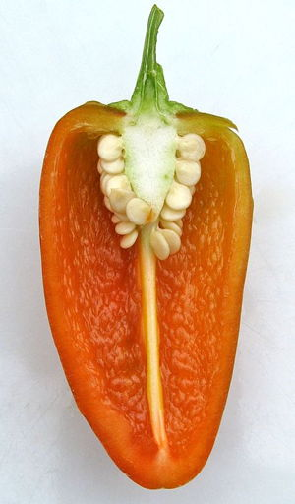
Question 1:
WHAT CALIFORNIA CITY HAS A CHILE PEPPER NAMED FOR IT?

Slide 3
Question 2:
WHAT CALIFORNIA CITY SHARES ITS NAME WITH A PROVINCE OF CANADA?

Slide 4
Question 3:
WHAT CALIFORNIA CITY IS THE NAME OF A FRUIT?

Slide 5
Question 4:
WHAT CALIFORNIA CITY USED TO HAVE 3 PRO SPORTS TEAMS, BUT NOW ONLY HAS 1?

Slide 6
Question 5:
WHAT CALIFORNIA CITY WILL HOST THE 2028 SUMMER OLYMPICS?

Slide 7
Question 6:
WHAT CALIFORNIA CITY SHARES ITS NAME WITH THE CAPITAL OF COSTA RICA?

Slide 8
Question 7:
WHAT IS THE CAPITAL OF CALIFORNIA?

Slide 9
Question 8:
WHAT CALIFORNIA CITY IS THE SECOND DENSEST CITY IN THE COUNTRY, AFTER NYC?

Slide 10
Question 9:
WHAT CALIFORNIA CITY IS THE LAST NAME OF A FICTIONAL CHARACTER NAMED CARMEN?

Slide 11
Question 10:
WHAT CALIFORNIA CITY HAS A WIND NAMED AFTER IT?

Slide 12
The End
Answers will be provided shortly

Slide 13
Question 1:
WHAT CALIFORNIA CITY HAS A CHILE PEPPER NAMED FOR IT?
FRESNO

Slide 14
Question 2:
WHAT CALIFORNIA CITY SHARES ITS NAME WITH A PROVINCE OF CANADA?
ONTARIO

Slide 15
Question 3:
WHAT CALIFORNIA CITY IS THE NAME OF A FRUIT?
ORANGE

Slide 16
Question 4:
WHAT CALIFORNIA CITY USED TO HAVE 3 PRO SPORTS TEAMS, BUT NOW ONLY HAS 1?
OAKLAND

Slide 17
Question 5:
WHAT CALIFORNIA CITY WILL HOST THE 2028 SUMMER OLYMPICS?
LOS ANGELES

Slide 18
Question 6:
WHAT CALIFORNIA CITY SHARES ITS NAME WITH THE CAPITAL OF COSTA RICA?
SAN JOSE

Slide 19
Question 7:
WHAT IS THE CAPITAL OF CALIFORNIA?
SACRAMENTO

Slide 20
Question 8:
WHAT CALIFORNIA CITY IS THE SECOND DENSEST CITY IN THE COUNTRY, AFTER NYC?
SAN FRANCISCO

Slide 21
Question 9:
WHAT CALIFORNIA CITY IS THE LAST NAME OF A FICTIONAL CHARACTER NAMED CARMEN?
SAN DIEGO

Slide 22
Question 10:
WHAT CALIFORNIA CITY HAS A WIND NAMED AFTER IT?
SANTA ANA

