Slide 1
IDENTIFY THESE FAMOUS PEOPLE FROM CARICATURES

Slide 2
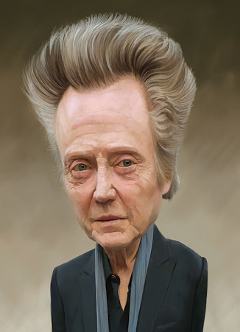
Question 1:

Slide 3
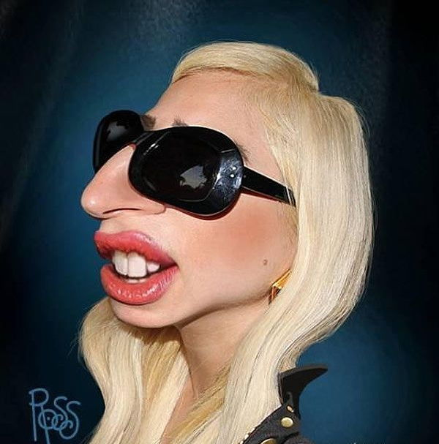
Question 2:

Slide 4
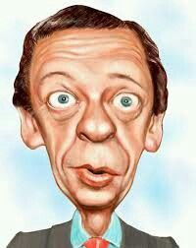
Question 3:

Slide 5
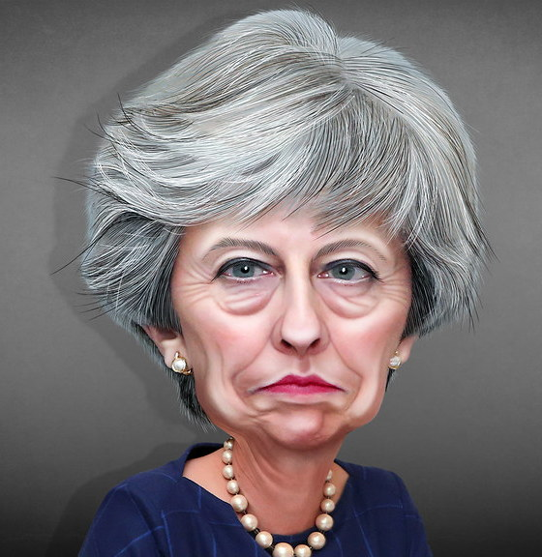
Question 4:

Slide 6
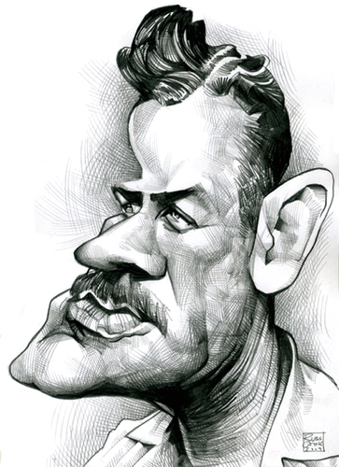
Question 5:

Slide 7
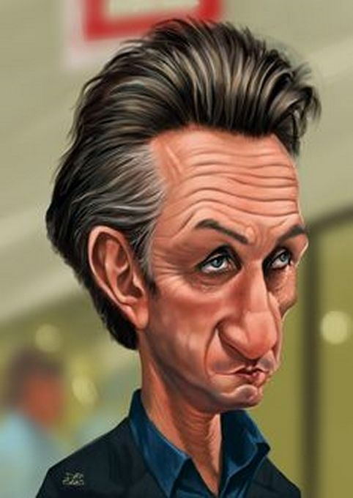
Question 6:

Slide 8
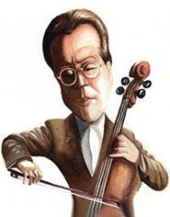
Question 7:

Slide 9
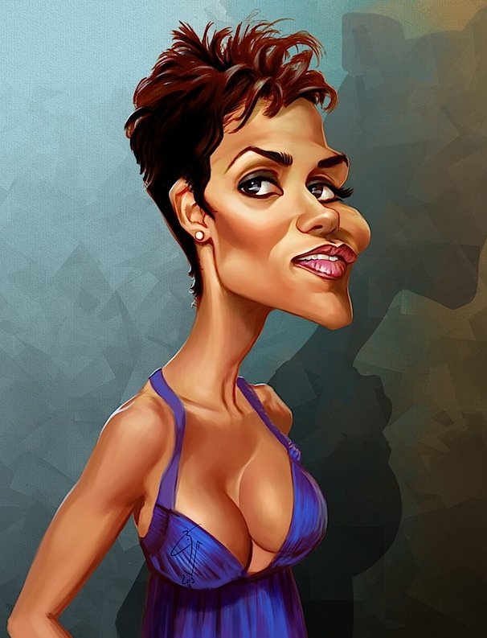
Question 8:

Slide 10
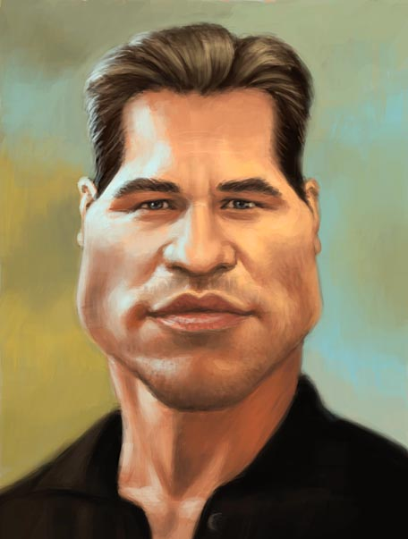
Question 9:

Slide 11
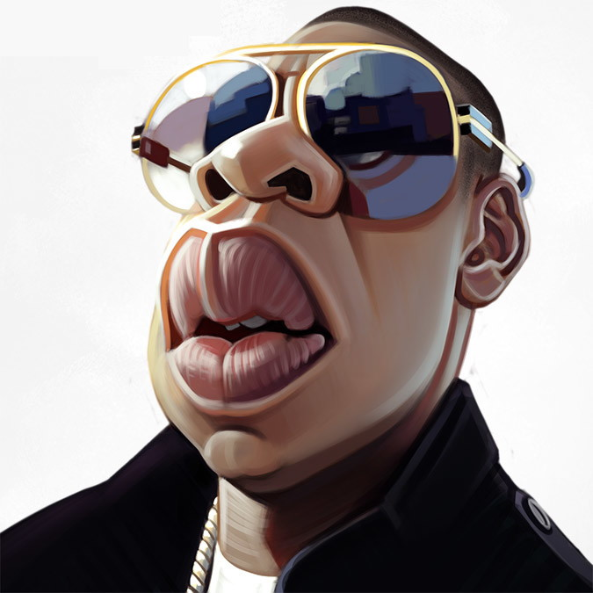
Question 10:

Slide 12
The End
Answers will be provided shortly

Slide 13
Question 1:
CHRISTOPHER WALKEN

Slide 14
Question 2:
LADY GAGA

Slide 15
Question 3:
DON KNOTTS

Slide 16
Question 4:
THERESA MAY

Slide 17
Question 5:
JOHN STEINBECK

Slide 18
Question 6:
SEAN PENN

Slide 19
Question 7:
YO–YO MA

Slide 20
Question 8:
HALLE BERRY

Slide 21
Question 9:
VAL KILMER

Slide 22
Question 10:
JAY–Z

