Slide 1
COMMON THREAD

Slide 2
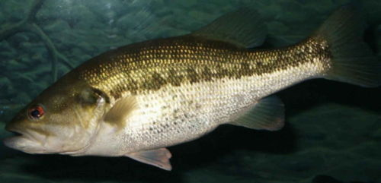
Question 1:
WHAT KIND OF FISH IS THIS?

Slide 3
Question 2:
WHAT IS THE FIRST FLORIDA KEY TO BE REACHED FROM THE OVERSEAS HIGHWAY?

Slide 4
Question 3:
WHAT ARMY RANK BARELY OUTRANKS A CAPTAIN?

Slide 5
Question 4:
WHAT CRIME SERIES WAS VOTED BY "TV GUIDE" IN 2013 TO BE THE BEST TV SERIES OF ALL TIME?

Slide 6
Question 5:
AN AIRCRAFT CAN ROTATE ON 3 AXES, WHICH ARE CALLED YAW, ROLL, AND WHAT?

Slide 7
Question 6:
WHAT WAS THE NAME OF THE PENGUIN IN "BLOOM COUNTY"?

Slide 8
Question 7:
WHAT IS THE LAST NAME OF THE ACTOR WHO CREATED, WROTE, AND STARRED IN "THE LAST MAN ON EARTH"?

Slide 9
Question 8:
WHAT WORD CAN MEAN "RIGID PLATE" OR "A MEASURING DEVICE"?

Slide 10
Question 9:
WHAT 1984 ROBERT REDFORD BASEBALL FILM WAS THE FIRST MOVIE PRODUCED BY TRISTAR PICTURES?

Slide 11
Question 10:
WHAT DO ALL THESE ANSWERS HAVE IN COMMON?

Slide 12
The End
Answers will be provided shortly

Slide 13
Question 1:
WHAT KIND OF FISH IS THIS?
BASS

Slide 14
Question 2:
WHAT IS THE FIRST FLORIDA KEY TO BE REACHED FROM THE OVERSEAS HIGHWAY?
LARGO

Slide 15
Question 3:
WHAT ARMY RANK BARELY OUTRANKS A CAPTAIN?
MAJOR

Slide 16
Question 4:
WHAT CRIME SERIES WAS VOTED BY "TV GUIDE" IN 2013 TO BE THE BEST TV SERIES OF ALL TIME?
THE SOPRANOS

Slide 17
Question 5:
AN AIRCRAFT CAN ROTATE ON 3 AXES, WHICH ARE CALLED YAW, ROLL, AND WHAT?
PITCH

Slide 18
Question 6:
WHAT WAS THE NAME OF THE PENGUIN IN "BLOOM COUNTY"?
OPUS

Slide 19
Question 7:
WHAT IS THE LAST NAME OF THE ACTOR WHO CREATED, WROTE, AND STARRED IN "THE LAST MAN ON EARTH"?
(WILL) FORTE

Slide 20
Question 8:
WHAT WORD CAN MEAN "RIGID PLATE" OR "A MEASURING DEVICE"?
SCALE

Slide 21
Question 9:
WHAT 1984 ROBERT REDFORD BASEBALL FILM WAS THE FIRST MOVIE PRODUCED BY TRISTAR PICTURES?
THE NATURAL

Slide 22
Question 10:
WHAT DO ALL THESE ANSWERS HAVE IN COMMON?
MUSIC TERMS

