Slide 1
COMMON THREAD

Slide 2
Question 1:
A MILLION KILOBYTES IS A WHAT?

Slide 3
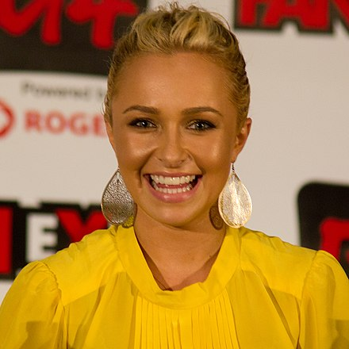
Question 2:
WHAT ARE THE INITIALS OF THIS ACTRESS FROM "HEROES" AND "NASHVILLE"?

Slide 4
Question 3:
WHAT FAMILY, WHICH OWNS WALMART, IS THE RICHEST FAMILY IN THE U.S.?

Slide 5
Question 4:
IN COORDINATE GEOMETRY, WHERE DO THE X-AXIS AND Y-AXIS MEET?

Slide 6
Question 5:
IN BRIDGE, THE CARDS ACE, KING, QUEEN, JACK, AND TEN CALLED WHAT SORT OF CARD?

Slide 7
Question 6:
WHAT IS THE MOST VISITED WEBSITE IN THE WORLD?

Slide 8
Question 7:
COMPLETE THIS NURSERY RHYME LYRIC: "HI-HO, THE DERRY-O, THE FARMER IN THE ____"?

Slide 9
Question 8:
WHAT WAS THE NAME OF "THE FRIENDLY GHOST"?

Slide 10
Question 9:
EMPIRE, FUJI, AND GALA ARE VARIETIES OF WHAT?

Slide 11
Question 10:
WHAT DO ALL THESE ANSWERS HAVE IN COMMON?

Slide 12
ANSWERS WILL BE PROVIDED SHORTLY

Slide 13
Question 1:
A MILLION KILOBYTES IS A WHAT?
GIGABYTE

Slide 14
Question 2:
WHAT ARE THE INITIALS OF THIS ACTRESS FROM "HEROES" AND "NASHVILLE"?
HP (HAYDEN PANETTIERE)

Slide 15
Question 3:
WHAT FAMILY, WHICH OWNS WALMART, IS THE RICHEST FAMILY IN THE U.S.?
WALTON

Slide 16
Question 4:
IN COORDINATE GEOMETRY, WHERE DO THE X-AXIS AND Y-AXIS MEET?
ORIGIN

Slide 17
Question 5:
IN BRIDGE, THE CARDS ACE, KING, QUEEN, JACK, AND TEN CALLED WHAT SORT OF CARD?
HONOR

Slide 18
Question 6:
WHAT IS THE MOST VISITED WEBSITE IN THE WORLD?
GOOGLE

Slide 19
Question 7:
COMPLETE THIS NURSERY RHYME LYRIC: "HI-HO, THE DERRY-O, THE FARMER IN THE ____"?
DELL

Slide 20
Question 8:
WHAT WAS THE NAME OF "THE FRIENDLY GHOST"?
CASPER

Slide 21
Question 9:
EMPIRE, FUJI, AND GALA ARE VARIETIES OF WHAT?
APPLE

Slide 22
Question 10:
WHAT DO ALL THESE ANSWERS HAVE IN COMMON?
BRANDS OF LAPTOP COMPUTERS

