Slide 1
WHICH MLB LOGOS CONTAIN THESE IMAGES?

Slide 2

Question 1:

Slide 3

Question 2:

Slide 4
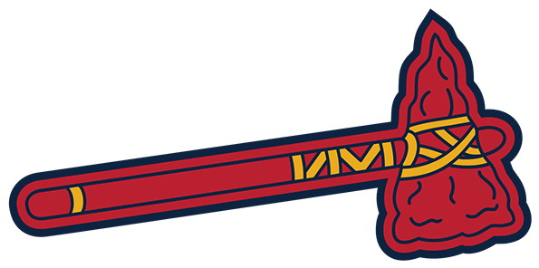
Question 3:

Slide 5

Question 4:

Slide 6
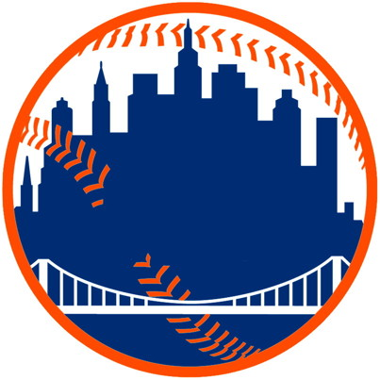
Question 5:

Slide 7

Question 6:

Slide 8

Question 7:

Slide 9

Question 8:

Slide 10

Question 9:

Slide 11

Question 10:

Slide 12
ANSWERS WILL BE PROVIDED SHORTLY

Slide 13
Question 1:
MILWAUKEE BREWERS

Slide 14
Question 2:
SEATTLE MARINERS

Slide 15
Question 3:
ATLANTA BRAVES

Slide 16
Question 4:
KANSAS CITY ROYALS

Slide 17
Question 5:
NEW YORK METS

Slide 18
Question 6:
LOS ANGELES DODGERS

Slide 19
Question 7:
TORONTO BLUE JAYS

Slide 20
Question 8:
TAMPA BAY RAYS

Slide 21
Question 9:
CLEVELAND GUARDIANS

Slide 22
Question 10:
CINCINNATI REDS

