Slide 1
HIDDEN QUOTE

Slide 2
Question 1:
WHAT ANTI-VIETNAM SLOGAN PROMPTED THEN GOVERNOR RONALD REAGAN TO QUIP "THOSE GUYS LOOK LIKE THEY CAN'T MAKE EITHER"?

Slide 3
Question 2:
WHILE SITTING ON A BENCH WAITING FOR A BUS, WHAT DID FORREST GUMP RECALL HIS MOTHER TELLING HIM?

Slide 4
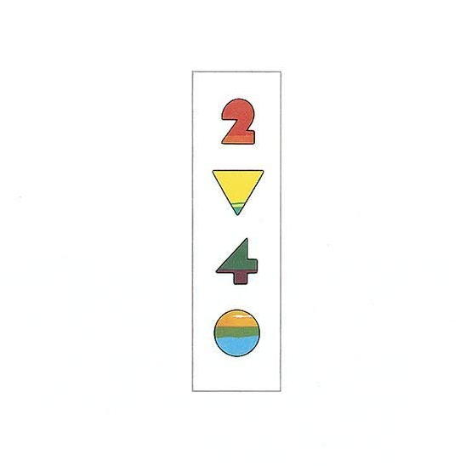
Question 3:
WHAT WAS THE NAME OF THIS ELTON JOHN ALBUM?

Slide 5
Question 4:
WHAT SOAP OPERA, ON THE AIR SINCE 1973, FEATURES THE ABBOTT, WILLIAMS, AND NEWMAN FAMILIES?

Slide 6
Question 5:
THE BEATLES' 1ST #1 HIT IN ENGLAND WAS "SHE LOVES YOU". WHAT WAS THEIR FIRST #1 HIT IN THE U.S.?

Slide 7
Question 6:
WHAT IS FOREIGNER'S ONLY #1 SONG?

Slide 8
Question 7:
JIMMY RUFFIN HAD ONLY 2 TOP-10 SONGS: "HOLD ON (TO MY LOVE)" AND WHAT?

Slide 9
Question 8:
WHAT 1960 BOOK BY BARRY GOLDWATER PUT HIM ON THE POLITICAL MAP?

Slide 10
Question 9:
PAUL MCCARTNEY AND MICHAEL JACKSON RECORDED 3 DUETS: "SAY, SAY, SAY", "THE MAN", AND WHAT OTHER SONG?

Slide 11
Question 10:
WHAT WILLIAM SHAKESPEARE QUOTE CONTAINS 1 WORD FROM EACH OF THE PREVIOUS ANSWERS?

Slide 12
ANSWERS WILL BE PROVIDED SHORTLY

Slide 13
Question 1:
WHAT ANTI-VIETNAM SLOGAN PROMPTED THEN GOVERNOR RONALD REAGAN TO QUIP "THOSE GUYS LOOK LIKE THEY CAN'T MAKE EITHER"?
MAKE LOVE, NOT WAR

Slide 14
Question 2:
WHILE SITTING ON A BENCH WAITING FOR A BUS, WHAT DID FORREST GUMP RECALL HIS MOTHER TELLING HIM?
LIFE IS LIKE A BOX OF CHOCOLATES

Slide 15
Question 3:
WHAT WAS THE NAME OF THIS ELTON JOHN ALBUM?
TOO LOW FOR ZERO

Slide 16
Question 4:
WHAT SOAP OPERA, ON THE AIR SINCE 1973, FEATURES THE ABBOTT, WILLIAMS, AND NEWMAN FAMILIES?
THE YOUNG AND THE RESTLESS

Slide 17
Question 5:
THE BEATLES' 1ST #1 HIT IN ENGLAND WAS "SHE LOVES YOU". WHAT WAS THEIR FIRST #1 HIT IN THE U.S.?
I WANT TO HOLD YOUR HAND

Slide 18
Question 6:
WHAT IS FOREIGNER'S ONLY #1 SONG?
I WANT TO KNOW WHAT LOVE IS

Slide 19
Question 7:
JIMMY RUFFIN HAD ONLY 2 TOP-10 SONGS: "HOLD ON (TO MY LOVE)" AND WHAT?
WHAT BECOMES OF THE BROKENHEARTED

Slide 20
Question 8:
WHAT 1960 BOOK BY BARRY GOLDWATER PUT HIM ON THE POLITICAL MAP?
THE CONSCIENCE OF A CONSERVATIVE

Slide 21
Question 9:
PAUL MCCARTNEY AND MICHAEL JACKSON RECORDED 3 DUETS: "SAY, SAY, SAY", "THE MAN", AND WHAT OTHER SONG?
THE GIRL IS MINE

Slide 22
Question 10:
WHAT WILLIAM SHAKESPEARE QUOTE CONTAINS 1 WORD FROM EACH OF THE PREVIOUS ANSWERS?
LOVE IS TOO YOUNG TO KNOW WHAT CONSCIENCE IS.

