Slide 1
IN WHAT COUNTRIES ARE THESE BUILDINGS LOCATED?

Slide 2
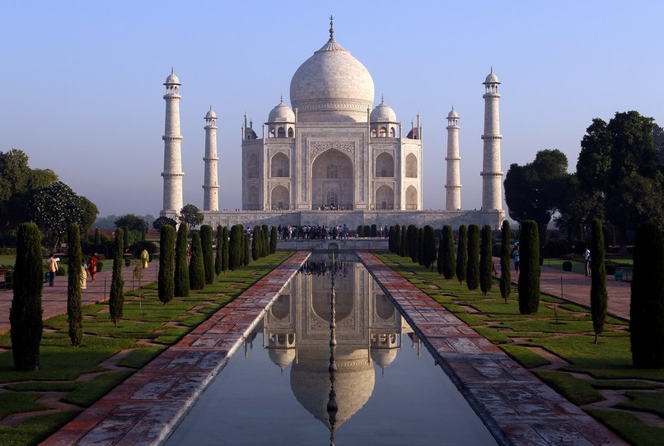
Question 1:

Slide 3
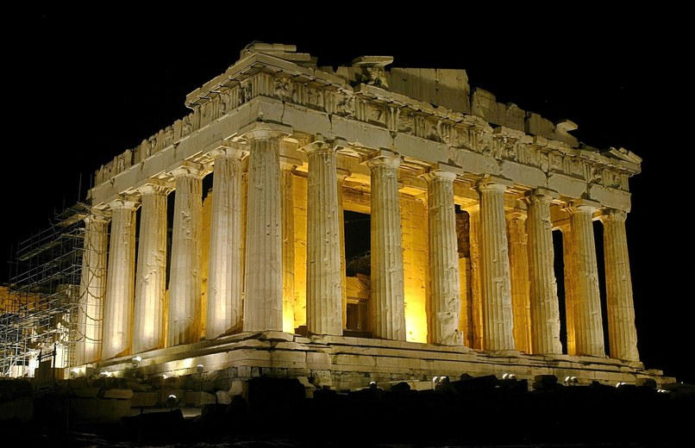
Question 2:

Slide 4
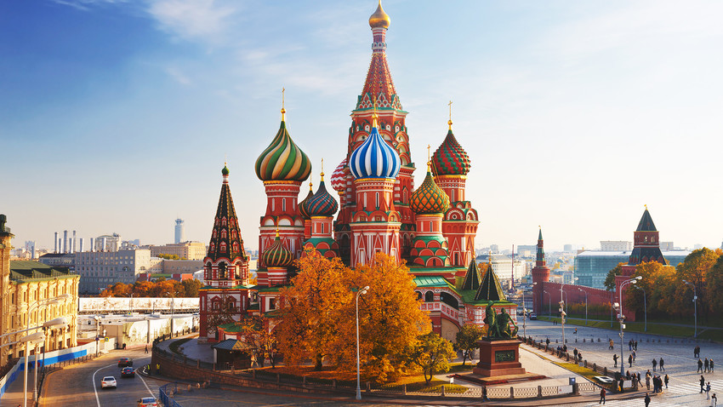
Question 3:

Slide 5
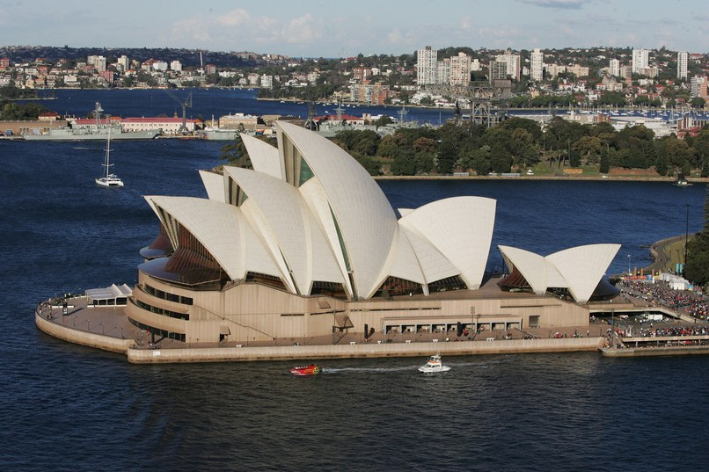
Question 4:

Slide 6
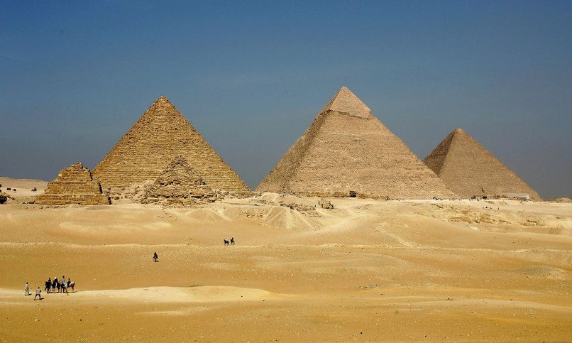
Question 5:

Slide 7
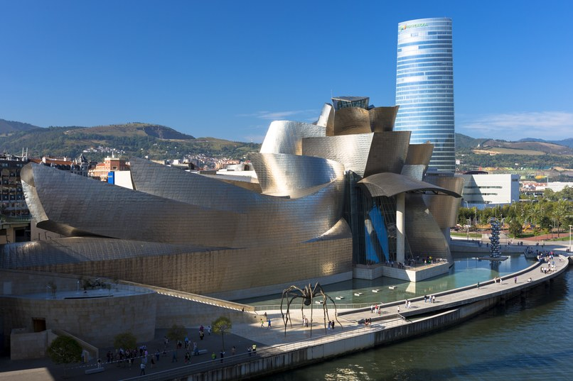
Question 6:

Slide 8
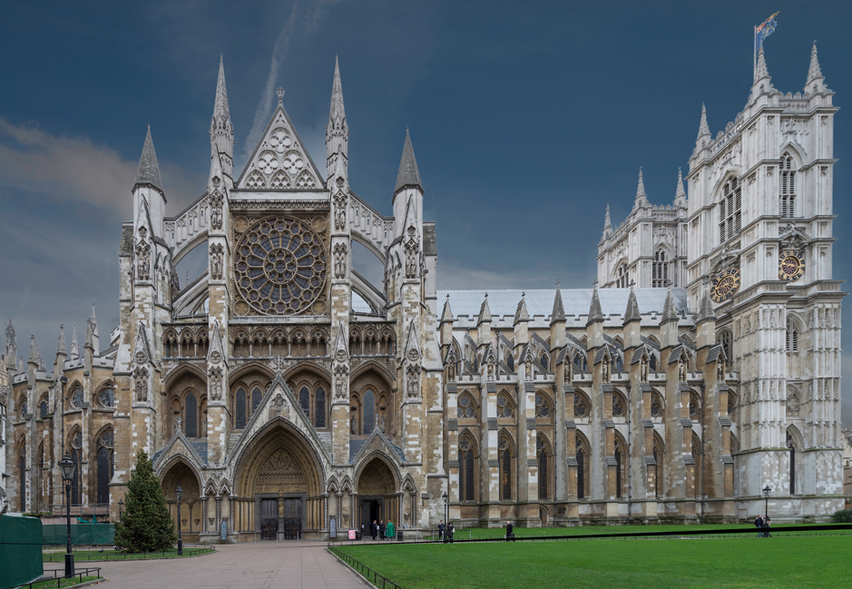
Question 7:

Slide 9
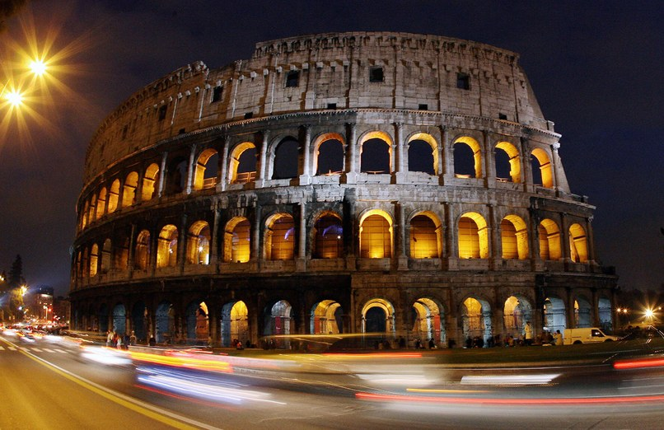
Question 8:

Slide 10
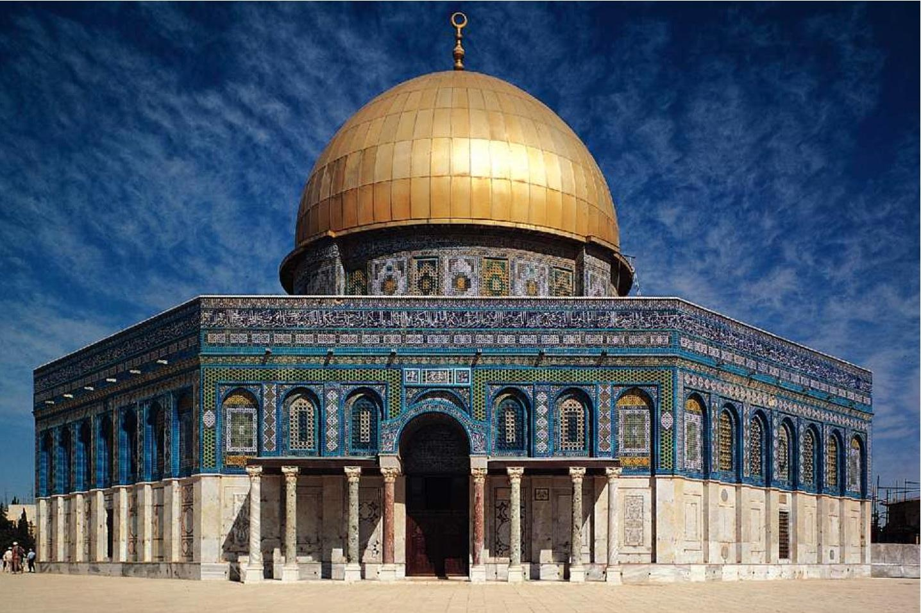
Question 9:

Slide 11
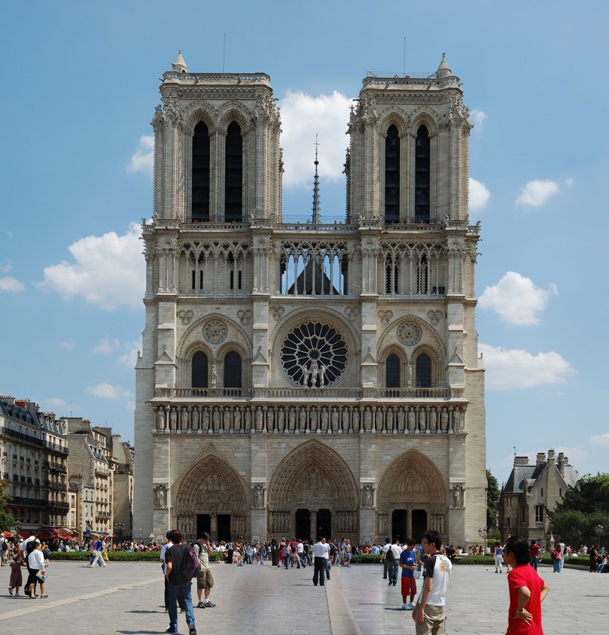
Question 10:

Slide 12
ANSWERS WILL BE PROVIDED SHORTLY

Slide 13
Question 1:
INDIA (TAJ MAHAL)

Slide 14
Question 2:
GREECE (THE ACROPOLIS)

Slide 15
Question 3:
RUSSIA (ST. BASIL'S CATHEDRAL)

Slide 16
Question 4:
AUSTRALIA (SYDNEY OPERA HOUSE)

Slide 17
Question 5:
EGYPT (PYRAMIDS OF GIZA)

Slide 18
Question 6:
SPAIN (GUGGENHEIM MUSEUM)

Slide 19
Question 7:
ENGLAND (WESTMINSTER ABBEY)

Slide 20
Question 8:
ITALY (THE COLOSSEUM)

Slide 21
Question 9:
ISRAEL (DOME OF THE ROCK)

Slide 22
Question 10:
FRANCE (NOTRE–DAME)

