Slide 1
COMMON THREAD

Slide 2
Question 1:
IN WHAT YEAR DID HUMANS FIRST SET FOOT ON THE MOON?

Slide 3
Question 2:
WHAT COMIC ACTOR OF SILENT FILM WAS FAMOUS FOR HIS PERSONA "THE TRAMP"?

Slide 4
Question 3:
WHAT 2016 FILM ABOUT HOLLYWOOD IN THE 50'S HAS A TITLE MORE FITTING THE ROMAN EMPIRE?

Slide 5
Question 4:
WHO WAS KING OF ENGLAND AFTER EDWARD V AND BEFORE HENRY VII?

Slide 6

Question 5:
WHAT KIND OF COOKIES ARE THESE?

Slide 7
Question 6:
WHAT CLASSIFICATION SCHEME ASSIGNS 1 OF 12 ANIMALS TO EACH YEAR?

Slide 8
Question 7:
WHAT FICTIONAL CHARACTER LIVES AT 221 B BAKER STREET?

Slide 9
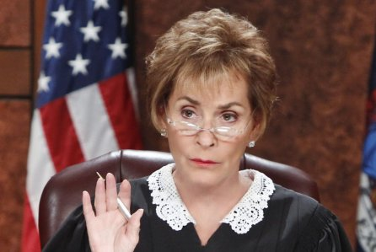
Question 8:
WHO IS THIS?

Slide 10
Question 9:
WHAT SUPERHERO IS THE ALTER EGO OF TONY STARK?

Slide 11
Question 10:
WHAT DO ALL THESE ANSWERS HAVE IN COMMON?

Slide 12
ANSWERS WILL BE PROVIDED SHORTLY

Slide 13
Question 1:
IN WHAT YEAR DID HUMANS FIRST SET FOOT ON THE MOON?
1969

Slide 14
Question 2:
WHAT COMIC ACTOR OF SILENT FILM WAS FAMOUS FOR HIS PERSONA "THE TRAMP"?
CHARLIE CHAPLIN

Slide 15
Question 3:
WHAT 2016 FILM ABOUT HOLLYWOOD IN THE 50'S HAS A TITLE MORE FITTING THE ROMAN EMPIRE?
HAIL, CAESAR!

Slide 16
Question 4:
WHO WAS KING OF ENGLAND AFTER EDWARD V AND BEFORE HENRY VII?
RICHARD III

Slide 17
Question 5:
WHAT KIND OF COOKIES ARE THESE?
BLACK AND WHITE

Slide 18
Question 6:
WHAT CLASSIFICATION SCHEME ASSIGNS 1 OF 12 ANIMALS TO EACH YEAR?
CHINESE ZODIAC

Slide 19
Question 7:
WHAT FICTIONAL CHARACTER LIVES AT 221 B BAKER STREET?
SHERLOCK HOLMES

Slide 20
Question 8:
WHO IS THIS?
JUDGE JUDY

Slide 21
Question 9:
WHAT SUPERHERO IS THE ALTER EGO OF TONY STARK?
IRON MAN

Slide 22
Question 10:
WHAT DO ALL THESE ANSWERS HAVE IN COMMON?
CONTAIN NAMES OF ROBERT DOWNEY JR. MOVIES

