Slide 1
COMMON THREAD

Slide 2
Question 1:
WHAT IS THE NICKNAME OF THE SPORTS TEAMS OF SOUTHERN METHODIST UNIVERSITY?

Slide 3
Question 2:
WHAT PROCESS IS RESPONSIBLE FOR MOST OF A STAR'S ENERGY?

Slide 4
Question 3:
WHAT IS THE MOST POPULAR PHONE MADE BY SAMSUNG?

Slide 5
Question 4:
WHICH TEAM WON THE 2016 SUPER BOWL, BEATING THE PANTHERS 24-10?

Slide 6
Question 5:
WHAT 1994 WESTERN FILM STARRED MEL GIBSON AND JODIE FOSTER AS CON ARTISTS AND JAMES GARNER AS A MARSHALL?

Slide 7
Question 6:
WHAT IS THE MOST POPULAR BEAN VARIETY IN THE U.S.?

Slide 8
Question 7:
IN OPTICS, WHAT IS THE NAME OF THE POINT AT WHICH LIGHT RAYS CONVERGE?

Slide 9
Question 8:
WHO IS THE LEAD GUITARIST AND KEYBOARDIST FOR U2?

Slide 10
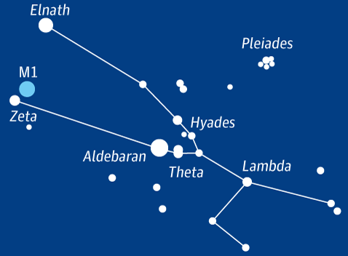
Question 9:
WHICH CONSTELLATION OF
THE ZODIAC IS THIS?

Slide 11
Question 10:
WHAT DO ALL THESE ANSWERS HAVE IN COMMON?

Slide 12
ANSWERS WILL BE PROVIDED SHORTLY

Slide 13
Question 1:
WHAT IS THE NICKNAME OF THE SPORTS TEAMS OF SOUTHERN METHODIST UNIVERSITY?
MUSTANGS

Slide 14
Question 2:
WHAT PROCESS IS RESPONSIBLE FOR MOST OF A STAR'S ENERGY?
FUSION

Slide 15
Question 3:
WHAT IS THE MOST POPULAR PHONE MADE BY SAMSUNG?
GALAXY

Slide 16
Question 4:
WHICH TEAM WON THE 2016 SUPER BOWL, BEATING THE PANTHERS 24-10?
BRONCOS

Slide 17
Question 5:
WHAT 1994 WESTERN FILM STARRED MEL GIBSON AND JODIE FOSTER AS CON ARTISTS AND JAMES GARNER AS A MARSHALL?
MAVERICK

Slide 18
Question 6:
WHAT IS THE MOST POPULAR BEAN VARIETY IN THE U.S.?
PINTO

Slide 19
Question 7:
IN OPTICS, WHAT IS THE NAME OF THE POINT AT WHICH LIGHT RAYS CONVERGE?
FOCUS

Slide 20
Question 8:
WHO IS THE LEAD GUITARIST AND KEYBOARDIST FOR U2?
EDGE

Slide 21
Question 9:
WHICH CONSTELLATION OF
THE ZODIAC IS THIS?
TAURUS

Slide 22
Question 10:
WHAT DO ALL THESE ANSWERS HAVE IN COMMON?
NAMES OF FORD MODELS

