Slide 1
COMMON THREAD

Slide 2
Question 1:
WHAT FOOD ASSOCIATED WITH THE CHESAPEAKE BAY AREA IS MADE FROM SEAFOOD, BREADCRUMBS, MAYO, AND SEASONING?

Slide 3
Question 2:
WHAT ISLAND NATION SOLD THEIR COUNTRY'S INTERNET EXTENSION ".TV" FOR $50 MILLION?

Slide 4
Question 3:
WHAT ARE THE FILMS "NON-STOP", "AIR FORCE ONE", AND "CAPTAIN PHILLIPS" ABOUT?

Slide 5
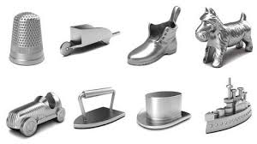
Question 4:
WHAT GAME ARE THESE PIECES FROM?

Slide 6
Question 5:
WHAT KING OF ARGOS COMMANDED THE GREEK FORCES IN THE TROJAN WAR?

Slide 7
Question 6:
WHAT JOB DID ROBERT GATES, LEON PANETTA, CHUCK HAGEL, AND ASHTON CARTER HOLD IN THE OBAMA CABINET?

Slide 8
Question 7:
WHAT IS THE COMMON TERM FOR NITROUS OXIDE?

Slide 9
Question 8:
WHICH AMENDMENT TO THE U.S. CONSTITUTION ESTABLISHES THE FREE EXERCISE OF RELIGION?

Slide 10
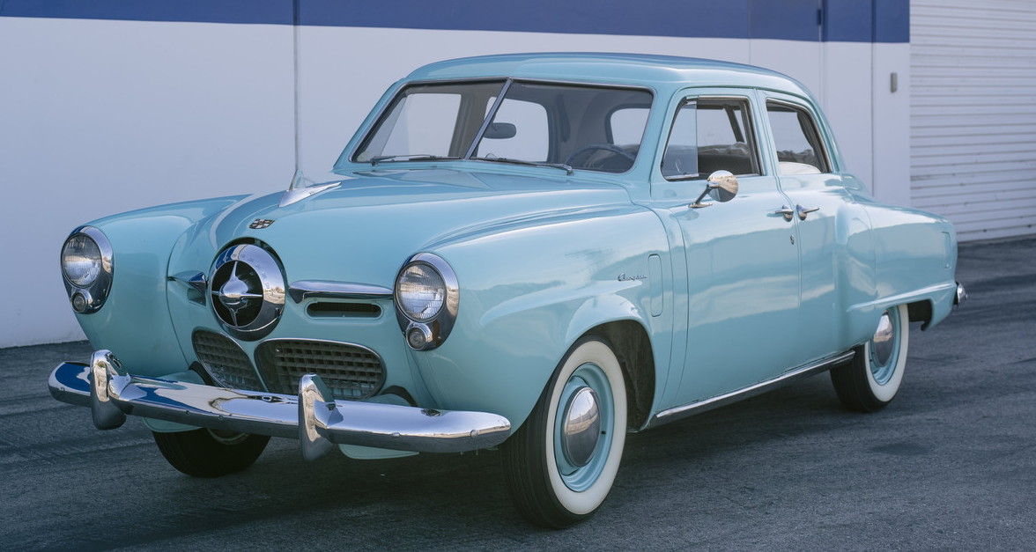
Question 9:
WHAT COMPANY THAT CLOSED IN 1966 MADE THIS CAR?

Slide 11
Question 10:
WHAT DO ALL THESE ANSWERS HAVE IN COMMON?

Slide 12
ANSWERS WILL BE PROVIDED SHORTLY

Slide 13
Question 1:
WHAT FOOD ASSOCIATED WITH THE CHESAPEAKE BAY AREA IS MADE FROM SEAFOOD, BREADCRUMBS, MAYO, AND SEASONING?
CRAB CAKES

Slide 14
Question 2:
WHAT ISLAND NATION SOLD THEIR COUNTRY'S INTERNET EXTENSION ".TV" FOR $50 MILLION?
TUVALU

Slide 15
Question 3:
WHAT ARE THE FILMS "NON-STOP", "AIR FORCE ONE", AND "CAPTAIN PHILLIPS" ABOUT?
HIJACKINGS

Slide 16
Question 4:
WHAT GAME ARE THESE PIECES FROM?
MONOPOLY

Slide 17
Question 5:
WHAT KING OF ARGOS COMMANDED THE GREEK FORCES IN THE TROJAN WAR?
AGAMEMNON

Slide 18
Question 6:
WHAT JOB DID ROBERT GATES, LEON PANETTA, CHUCK HAGEL, AND ASHTON CARTER HOLD IN THE OBAMA CABINET?
SECRETARY OF DEFENSE

Slide 19
Question 7:
WHAT IS THE COMMON TERM FOR NITROUS OXIDE?
LAUGHING GAS

Slide 20
Question 8:
WHICH AMENDMENT TO THE U.S. CONSTITUTION ESTABLISHES THE FREE EXERCISE OF RELIGION?
FIRST

Slide 21
Question 9:
WHAT COMPANY THAT CLOSED IN 1966 MADE THIS CAR?
STUDEBAKER

Slide 22
Question 10:
WHAT DO ALL THESE ANSWERS HAVE IN COMMON?
THEY CONTAIN 3 CONSECUTIVE LETTERS THAT ARE ADJACENT IN THE ALPHABET

