Slide 1
COMMON THREAD (THANKS MARGIE)

Slide 2
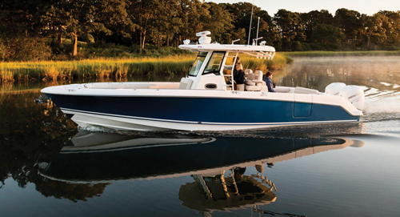
Question 1:
WHAT KIND OF BOAT IS THIS?

Slide 3
Question 2:
IN CRICKET, WHAT IS THE EDGE OF THE PLAYING FIELD CALLED?

Slide 4
Question 3:
WHAT GEORGIA MEMORIAL HAS GARNERED RECENT CONTROVERSY?

Slide 5
Question 4:
WHO MADE THE ROADRUNNER AND DUSTER PERFORMANCE CARS?

Slide 6
Question 5:
WHO FOUNDED THE AMERICAN RED CROSS?

Slide 7
Question 6:
WHAT COMIC STRIP CO-STARS JON AND HIS DOG ODIE?

Slide 8
Question 7:
WHO IS CONSIDERED THE FOUNDER OF GEOMETRY?

Slide 9
Question 8:
WHO DISAPPEARED NEAR HOWLAND ISLAND IN 1937?

Slide 10
Question 9:
WHICH IS THE MIDDLE-SIZED GREAT LAKE, IN TERMS OF AREA OR AVERAGE DEPTH?

Slide 11
Question 10:
WHAT DO ALL THESE ANSWERS HAVE IN COMMON?

Slide 12
ANSWERS WILL BE PROVIDED SHORTLY

Slide 13
Question 1:
WHAT KIND OF BOAT IS THIS?
BOSTON WHALER

Slide 14
Question 2:
IN CRICKET, WHAT IS THE EDGE OF THE PLAYING FIELD CALLED?
BOUNDARY

Slide 15
Question 3:
WHAT GEORGIA MEMORIAL HAS GARNERED RECENT CONTROVERSY?
STONE MOUNTAIN

Slide 16
Question 4:
WHO MADE THE ROADRUNNER AND DUSTER PERFORMANCE CARS?
PLYMOUTH

Slide 17
Question 5:
WHO FOUNDED THE AMERICAN RED CROSS?
CLARA BARTON

Slide 18
Question 6:
WHAT COMIC STRIP CO-STARS JON AND HIS DOG ODIE?
GARFIELD

Slide 19
Question 7:
WHO IS CONSIDERED THE FOUNDER OF GEOMETRY?
EUCLID

Slide 20
Question 8:
WHO DISAPPEARED NEAR HOWLAND ISLAND IN 1937?
AMELIA EARHART

Slide 21
Question 9:
WHICH IS THE MIDDLE-SIZED GREAT LAKE, IN TERMS OF AREA OR AVERAGE DEPTH?
MICHIGAN

Slide 22
Question 10:
WHAT DO ALL THESE ANSWERS HAVE IN COMMON?
CONTAIN MAJOR STREET NAMES IN DELAND

