Slide 1
COMMON THREAD

Slide 2
Question 1:
THE BATTLE OF BUNKER HILL TOOK PLACE NEARBY WHAT MAJOR CITY?

Slide 3
Question 2:
FOUR OF THE TEN RICHEST PEOPLE IN THE WORLD LIVE IN WHAT STATE?

Slide 4
Question 3:
IN WHAT CITY WAS THE DECLARATION OF INDEPENDENCE SIGNED?

Slide 5
Question 4:
THE TALLEST MOUNTAIN IN NORTH AMERICA IS LOCATED IN WHAT STATE?

Slide 6
Question 5:
WHAT IS THE MAIN FOOD OF ALASKAN BEARS DURING AUGUST?

Slide 7
Question 6:
WHAT IS THE ONLY STOCK IN THE DJIA WHOSE TICKER ABBREVIATION IS AN ENGLISH WORD?

Slide 8
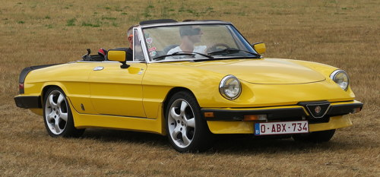
Question 7:
WHAT ALFA ROMEO MODEL IS THIS?

Slide 9
Question 8:
WHAT IS THE FIRST NAME OF THE CHARACTER PORTRAYED BY TRACEE ELLIS ROSS ON THE TV SERIES "BLACK-ISH"?

Slide 10
Question 9:
WHAT WAS BRUCE LEE'S NICKNAME AND THE TITLE OF THE FILM ABOUT HIS LIFE?

Slide 11
Question 10:
WHAT DO ALL THESE ANSWERS HAVE IN COMMON?

Slide 12
ANSWERS WILL BE PROVIDED SHORTLY

Slide 13
Question 1:
THE BATTLE OF BUNKER HILL TOOK PLACE NEARBY WHAT MAJOR CITY?
BOSTON

Slide 14
Question 2:
FOUR OF THE TEN RICHEST PEOPLE IN THE WORLD LIVE IN WHAT STATE?
CALIFORNIA

Slide 15
Question 3:
IN WHAT CITY WAS THE DECLARATION OF INDEPENDENCE SIGNED?
PHILADELPHIA

Slide 16
Question 4:
THE TALLEST MOUNTAIN IN NORTH AMERICA IS LOCATED IN WHAT STATE?
ALASKA

Slide 17
Question 5:
WHAT IS THE MAIN FOOD OF ALASKAN BEARS DURING AUGUST?
SALMON

Slide 18
Question 6:
WHAT IS THE ONLY STOCK IN THE DJIA WHOSE TICKER ABBREVIATION IS AN ENGLISH WORD?
CATERPILLAR (CAT)

Slide 19
Question 7:
WHAT ALFA ROMEO MODEL IS THIS?
SPIDER

Slide 20
Question 8:
WHAT IS THE FIRST NAME OF THE CHARACTER PORTRAYED BY TRACEE ELLIS ROSS ON THE TV SERIES "BLACK-ISH"?
RAINBOW (JOHNSON)

Slide 21
Question 9:
WHAT WAS BRUCE LEE'S NICKNAME AND THE TITLE OF THE FILM ABOUT HIS LIFE?
DRAGON

Slide 22
Question 10:
WHAT DO ALL THESE ANSWERS HAVE IN COMMON?
NAMES OF SUSHI ROLLS

