Slide 1
COMMON THREAD

Slide 2
Question 1:
WHAT WAS THE LAST NAME OF THE TOP-RANKED GOLFER FOR MOST OF 1999 TO 2010?

Slide 3
Question 2:
WHAT MEDICAL DRAMA WAS THE MOST-WATCHED TV PROGRAM IN THE WORLD IN 2008?

Slide 4
Question 3:
WHAT SORT OF "PEOPLE" SANG THE HIT SONG "Y.M.C.A."?

Slide 5
Question 4:
WHAT IS THE LAST NAME OF DONALD SUTHERLAND'S CHARACTER IN "THE HUNGER GAMES" FILMS?

Slide 6
Question 5:
WHAT DOES THE "Q" STAND FOR IN "LGBTQ"?

Slide 7
Question 6:
WHAT ANIMATED FILM FEATURED THE OSCAR-WINNING SONG "LET IT GO"?

Slide 8
Question 7:
WHAT IS THE LAST NAME OF THE JUNIOR SENATOR FROM ARIZONA WHO DID NOT RUN FOR REELECTION IN 2018?

Slide 9
Question 8:
WHAT ERIC CLAPTON SONG BEGINS WITH THE LYRICS "I DON'T MIND IF YOU NEVER COME HOME"?

Slide 10
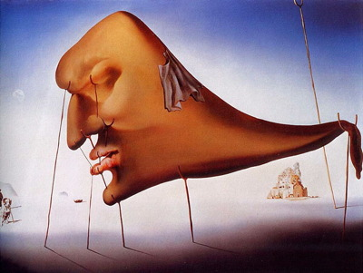
Question 9:
WHAT IS THE 5-LETTER TITLE OF THIS DALI PAINTING?

Slide 11
Question 10:
WHAT DO ALL THESE ANSWERS HAVE IN COMMON?

Slide 12
ANSWERS WILL BE PROVIDED SHORTLY

Slide 13
Question 1:
WHAT WAS THE LAST NAME OF THE TOP-RANKED GOLFER FOR MOST OF 1999 TO 2010?
(TIGER) WOODS

Slide 14
Question 2:
WHAT MEDICAL DRAMA WAS THE MOST-WATCHED TV PROGRAM IN THE WORLD IN 2008?
HOUSE

Slide 15
Question 3:
WHAT SORT OF "PEOPLE" SANG THE HIT SONG "Y.M.C.A."?
VILLAGE

Slide 16
Question 4:
WHAT IS THE LAST NAME OF DONALD SUTHERLAND'S CHARACTER IN "THE HUNGER GAMES" FILMS?
(CORIOLANUS) SNOW

Slide 17
Question 5:
WHAT DOES THE "Q" STAND FOR IN "LGBTQ"?
QUEER

Slide 18
Question 6:
WHAT ANIMATED FILM FEATURED THE OSCAR-WINNING SONG "LET IT GO"?
FROZEN

Slide 19
Question 7:
WHAT IS THE LAST NAME OF THE JUNIOR SENATOR FROM ARIZONA WHO DID NOT RUN FOR REELECTION IN 2018?
(JEFF) FLAKE

Slide 20
Question 8:
WHAT ERIC CLAPTON SONG BEGINS WITH THE LYRICS "I DON'T MIND IF YOU NEVER COME HOME"?
PROMISES

Slide 21
Question 9:
WHAT IS THE 5-LETTER TITLE OF THIS DALI PAINTING?
SLEEP

Slide 22
Question 10:
WHAT DO ALL THESE ANSWERS HAVE IN COMMON?
CONTAIN WORDS FROM "STOPPING BY WOODS ON A SNOWY EVENING" BY ROBERT FROST

