Slide 1
ACTOR COMMON THREAD

Slide 2
Question 1:
WHO WON 2 ACADEMY AWARDS FOR "DANCES WITH WOLVES"?

Slide 3
Question 2:
WHO WON BEST SUPPORTING ACTOR FOR "A FISH CALLED WANDA"?

Slide 4
Question 3:
WHAT MEMBER OF MONTY PYTHON STARRED IN AND WROTE THE SCREENPLAY FOR "A FISH CALLED WANDA"?

Slide 5
Question 4:
WHAT "NCIS:LA" STAR WAS THE FIRST PERSON TO WIN AN OSCAR FOR PLAYING A CHARACTER OF THE OPPOSITE GENDER?

Slide 6
Question 5:
WHO STARRED IN 3 "JURASSIC PARK" FILMS AND 2 "INDEPENDENCE DAY" FILMS?

Slide 7
Question 6:
WHO STARRED WITH MEL GIBSON IN THE "LETHAL WEAPON" FILMS?

Slide 8
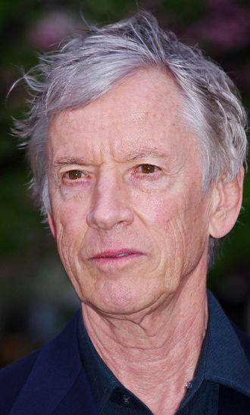
Question 7:
WHO IS THIS ACTOR FROM "BACKDRAFT", "URBAN COWBOY", AND "TRAINING DAY"?

Slide 9
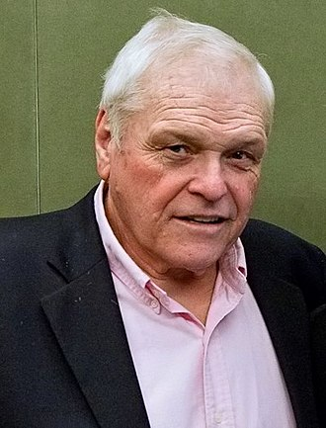
Question 8:
WHO IS THIS ACTOR, FROM "COCOON", "GORKY PARK", AND "FIRST BLOOD"?

Slide 10
Question 9:
WHO PLAYED "BARNEY MILLER"?

Slide 11
Question 10:
WHAT DO ALL THESE ACTORS HAVE IN COMMON?

Slide 12
The End
Answers will be provided shortly

Slide 13
Question 1:
WHO WON 2 ACADEMY AWARDS FOR "DANCES WITH WOLVES"?
KEVIN COSTNER

Slide 14
Question 2:
WHO WON BEST SUPPORTING ACTOR FOR "A FISH CALLED WANDA"?
KEVIN KLINE

Slide 15
Question 3:
WHAT MEMBER OF MONTY PYTHON STARRED IN AND WROTE THE SCREENPLAY FOR "A FISH CALLED WANDA"?
JOHN CLEESE

Slide 16
Question 4:
WHAT "NCIS:LA" STAR WAS THE FIRST PERSON TO WIN AN OSCAR FOR PLAYING A CHARACTER OF THE OPPOSITE GENDER?
LINDA HUNT

Slide 17
Question 5:
WHO STARRED IN 3 "JURASSIC PARK" FILMS AND 2 "INDEPENDENCE DAY" FILMS?
JEFF GOLDBLUM

Slide 18
Question 6:
WHO STARRED WITH MEL GIBSON IN THE "LETHAL WEAPON" FILMS?
DANNY GLOVER

Slide 19
Question 7:
WHO IS THIS ACTOR FROM "BACKDRAFT", "URBAN COWBOY", AND "TRAINING DAY"?
SCOTT GLENN

Slide 20
Question 8:
WHO IS THIS ACTOR, FROM "COCOON", "GORKY PARK", AND "FIRST BLOOD"?
BRIAN DENNEHY

Slide 21
Question 9:
WHO PLAYED "BARNEY MILLER"?
HAL LINDEN

Slide 22
Question 10:
WHAT DO ALL THESE ACTORS HAVE IN COMMON?
IN THE FILM "SILVERADO"

