Slide 1
IDENTIFY THESE ACTOR CARICATURES (BY MAGIXL) COMMON THREAD

Slide 2
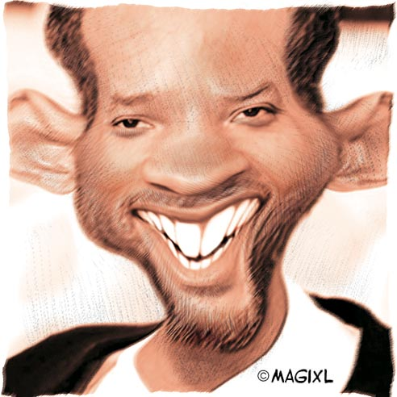
Question 1:

Slide 3
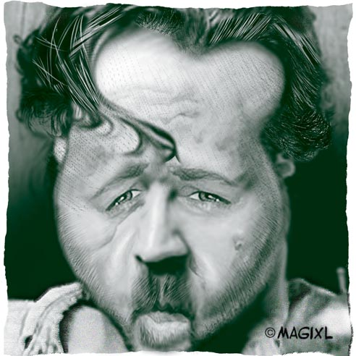
Question 2:

Slide 4
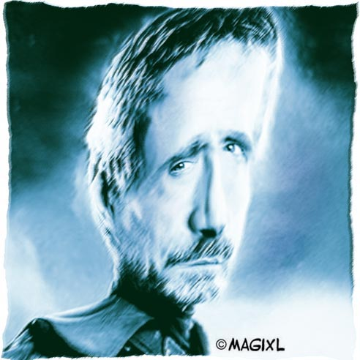
Question 3:

Slide 5
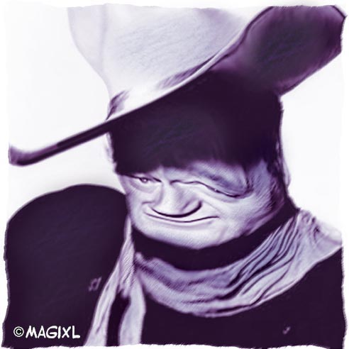
Question 4:

Slide 6
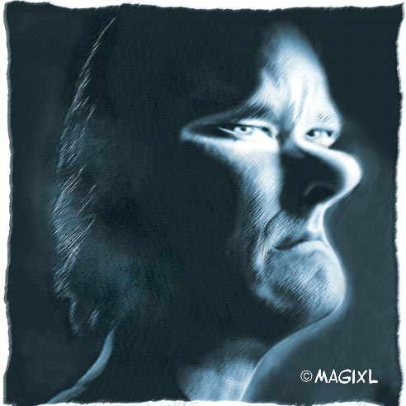
Question 5:

Slide 7
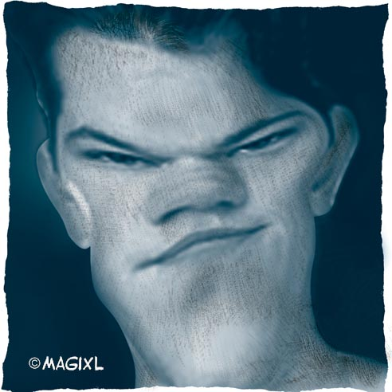
Question 6:

Slide 8
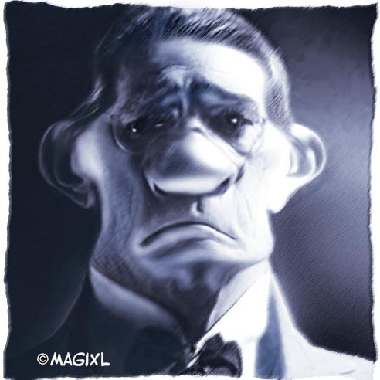
Question 7:

Slide 9
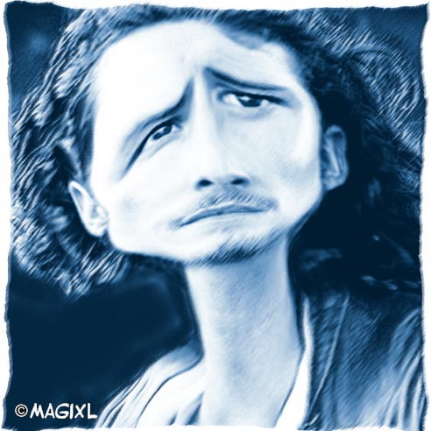
Question 8:

Slide 10
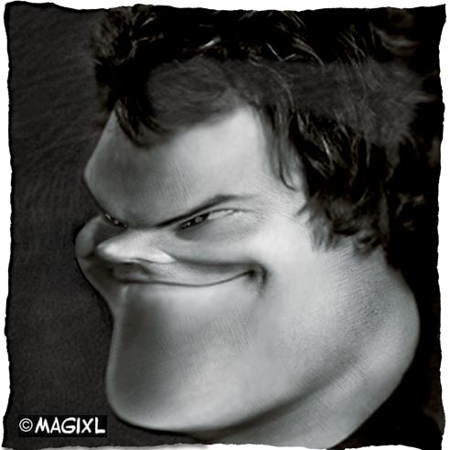
Question 9:

Slide 11
Question 10:
WHAT DO ALL THESE ACTORS HAVE IN COMMON?

Slide 12
ANSWERS WILL BE PROVIDED SHORTLY

Slide 13
Question 1:
WILL SMITH

Slide 14
Question 2:
RUSSELL CROWE

Slide 15
Question 3:
JEREMY IRONS

Slide 16
Question 4:
JOHN WAYNE

Slide 17
Question 5:
TOM HANKS

Slide 18
Question 6:
MATT DAMON

Slide 19
Question 7:
TOMMY LEE JONES

Slide 20
Question 8:
ORLANDO BLOOM

Slide 21
Question 9:
JACK BLACK

Slide 22
Question 10:
WHAT DO ALL THESE ACTORS HAVE IN COMMON?
5–LETTER LAST NAMES

