Slide 1
COMMON THREAD

Slide 2
Question 1:
ON MOST COMPUTER KEYBOARDS, WHAT IS THE UPPER LEFT KEY?

Slide 3
Question 2:
ON MOST COMPUTER KEYBOARDS, WHAT IS THE LOWER RIGHT KEY?

Slide 4
Question 3:
WHAT COMPANY WAS THE MOST TRUSTED POLLSTER FROM THE 30'S TO THE 80'S?

Slide 5
Question 4:
WHAT WAS THE ONLY #1 HIT SONG BY INCUBUS?

Slide 6

Question 5:
WHAT TELECOM COMPANY HAS THIS LOGO?

Slide 7
Question 6:
IN COOKING, THERE ARE 3 DROPS IN A SMIDGEN, 2 SMIDGENS IN A PINCH, AND 2 PINCHES IN A WHAT?

Slide 8
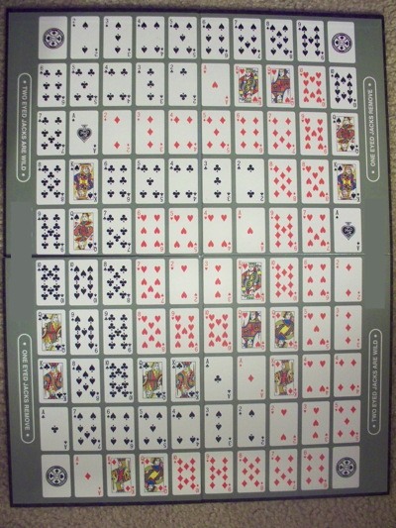
Question 7:
WHAT GAME HAS THIS BOARD?

Slide 9
Question 8:
WHAT IS THE STARTING SPACE ON A MONOPOLY BOARD?

Slide 10
Question 9:
IN ECONOMICS, WHAT DOES THE "C" IN "AFC" STAND FOR?

Slide 11
Question 10:
WHAT DO ALL THESE ANSWERS HAVE IN COMMON?

Slide 12
The End
Answers will be provided shortly

Slide 13
Question 1:
ON MOST COMPUTER KEYBOARDS, WHAT IS THE UPPER LEFT KEY?
ESCAPE

Slide 14
Question 2:
ON MOST COMPUTER KEYBOARDS, WHAT IS THE LOWER RIGHT KEY?
ENTER

Slide 15
Question 3:
WHAT COMPANY WAS THE MOST TRUSTED POLLSTER FROM THE 30'S TO THE 80'S?
GALLOP

Slide 16
Question 4:
WHAT WAS THE ONLY #1 HIT SONG BY INCUBUS?
DRIVE

Slide 17
Question 5:
WHAT TELECOM COMPANY HAS THIS LOGO?
SPRINT

Slide 18
Question 6:
IN COOKING, THERE ARE 3 DROPS IN A SMIDGEN, 2 SMIDGENS IN A PINCH, AND 2 PINCHES IN A WHAT?
DASH

Slide 19
Question 7:
WHAT GAME HAS THIS BOARD?
SEQUENCE

Slide 20
Question 8:
WHAT IS THE STARTING SPACE ON A MONOPOLY BOARD?
GO

Slide 21
Question 9:
IN ECONOMICS, WHAT DOES THE "C" IN "AFC" STAND FOR?
(AVERAGE FIXED) COST

Slide 22
Question 10:
WHAT DO ALL THESE ANSWERS HAVE IN COMMON?
SYNONYMS FOR "RUN"

