Slide 1
COMMON THREAD

Slide 2
Question 1:
WHAT 4-LETTER WORD WAS THE MOST COMMON WORD IN TITLES OF 1960'S POP SONGS?

Slide 3
Question 2:
WHAT IS THE NAME OF MINNESOTA'S PRO HOCKEY TEAM?

Slide 4
Question 3:
WHAT IS THE LONGEST-RUNNING BRITISH SCI-FI TV SHOW EVER?

Slide 5
Question 4:
THE COMMON LOGARITHM USES BASE 10. WHAT LOGARITHM USES BASE e?

Slide 6
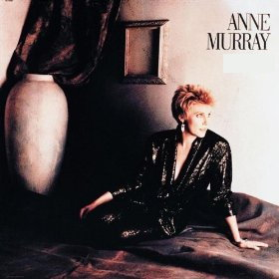
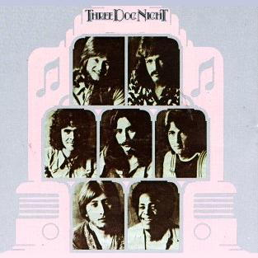
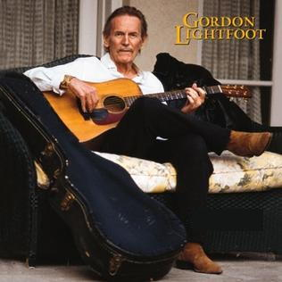
Question 5:
WHAT MUSICAL TERM IS THE TITLE OF THESE 3 ALBUMS?

Slide 7
Question 6:
IN WHAT 2014 FILM DOES JON FAVREAU QUIT HIS JOB TO OPEN A FOOD TRUCK WITH HIS SON?

Slide 8
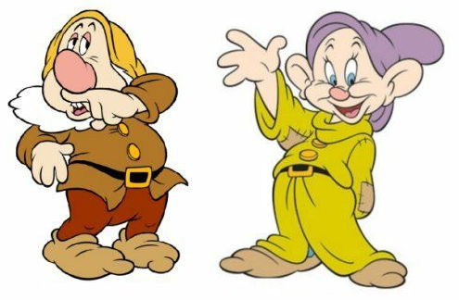
Question 7:
WHICH 2 OF THE 7 DWARFS ARE THESE?

Slide 9
Question 8:
WHAT IS THE BEST-SELLING BRAND OF TRASH BAGS?

Slide 10
Question 9:
WHAT IS THE NATO PHONETIC ALPHABET WORD FOR "P"?

Slide 11
Question 10:
WHAT DO ALL THESE ANSWERS HAVE IN COMMON?

Slide 12
The End
Answers will be provided shortly

Slide 13
Question 1:
WHAT 4-LETTER WORD WAS THE MOST COMMON WORD IN TITLES OF 1960'S POP SONGS?
BABY

Slide 14
Question 2:
WHAT IS THE NAME OF MINNESOTA'S PRO HOCKEY TEAM?
WILD

Slide 15
Question 3:
WHAT IS THE LONGEST-RUNNING BRITISH SCI-FI TV SHOW EVER?
DOCTOR WHO

Slide 16
Question 4:
THE COMMON LOGARITHM USES BASE 10. WHAT LOGARITHM USES BASE e?
NATURAL

Slide 17
Question 5:
WHAT MUSICAL TERM IS THE TITLE OF THESE 3 ALBUMS?
HARMONY

Slide 18
Question 6:
IN WHAT 2014 FILM DOES JON FAVREAU QUIT HIS JOB TO OPEN A FOOD TRUCK WITH HIS SON?
CHEF

Slide 19
Question 7:
WHICH 2 OF THE 7 DWARFS ARE THESE?
SNEEZY & DOPEY

Slide 20
Question 8:
WHAT IS THE BEST-SELLING BRAND OF TRASH BAGS?
HEFTY

Slide 21
Question 9:
WHAT IS THE NATO PHONETIC ALPHABET WORD FOR "P"?
PAPA

Slide 22
Question 10:
WHAT DO ALL THESE ANSWERS HAVE IN COMMON?
NAMES OF SMURFS

