Slide 1
COMMON THREAD

Slide 2
Question 1:
IN WRITTEN ENGLISH, WHAT IS THE MOST COMMON 5-LETTER WORD STARTING WITH "U"?

Slide 3
Question 2:
IN THE OLYMPICS, BOXING, JUDO, TAEKWONDO, AND WRESTLING AWARD TWO OF WHAT TYPE OF MEDAL?

Slide 4
Question 3:
WHAT DOES THE "I" IN "TMI" STAND FOR?

Slide 5
Question 4:
WHAT WAS THE ONLY #1 SONG BY JIMMY EAT WORLD, WITH CHORUS REFRAIN "LITTLE GIRL, YOU'RE IN ____ ____ OF THE RIDE"?

Slide 6
Question 5:
THE NICKNAME OF CALIFORNIA IS THE WHAT STATE?

Slide 7
Question 6:
WHAT WORD IS ASSOCIATED WITH THE WORDS NEW, BORROWED, AND BLUE?

Slide 8
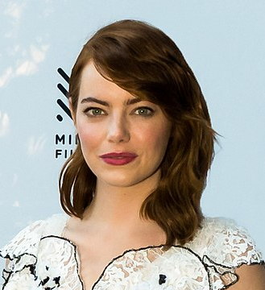
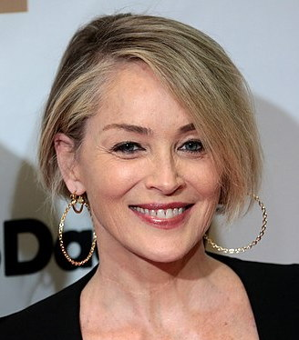
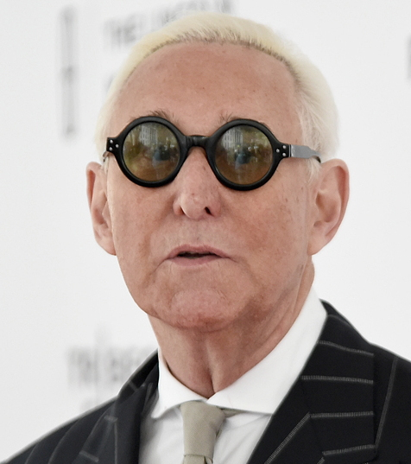
Question 7:
WHAT IS THE LAST NAME OF THESE PEOPLE?

Slide 9
Question 8:
WHAT ELEMENT HAS CHEMICAL SYMBOL Fe?

Slide 10
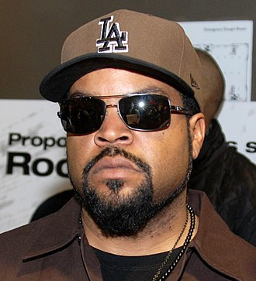
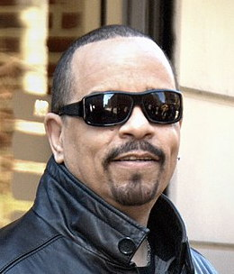
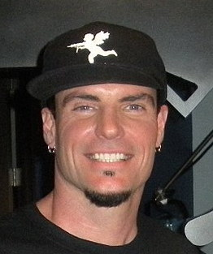
Question 9:
WHAT WORD DO THESE 3 RAPPERS HAVE IN THEIR NAMES?

Slide 11
Question 10:
WHAT DO ALL THESE ANSWERS HAVE IN COMMON?

Slide 12
The End
Answers will be provided shortly

Slide 13
Question 1:
IN WRITTEN ENGLISH, WHAT IS THE MOST COMMON 5-LETTER WORD STARTING WITH "U"?
UNDER

Slide 14
Question 2:
IN THE OLYMPICS, BOXING, JUDO, TAEKWONDO, AND WRESTLING AWARD TWO OF WHAT TYPE OF MEDAL?
BRONZE

Slide 15
Question 3:
WHAT DOES THE "I" IN "TMI" STAND FOR?
(TOO MUCH) INFORMATION

Slide 16
Question 4:
WHAT WAS THE ONLY #1 SONG BY JIMMY EAT WORLD, WITH CHORUS REFRAIN "LITTLE GIRL, YOU'RE IN ____ ____ OF THE RIDE"?
THE MIDDLE

Slide 17
Question 5:
THE NICKNAME OF CALIFORNIA IS THE WHAT STATE?
GOLDEN

Slide 18
Question 6:
WHAT WORD IS ASSOCIATED WITH THE WORDS NEW, BORROWED, AND BLUE?
OLD

Slide 19
Question 7:
WHAT IS THE LAST NAME OF THESE PEOPLE?
STONE (EMMA, SHARON, ROGER)

Slide 20
Question 8:
WHAT ELEMENT HAS CHEMICAL SYMBOL Fe?
IRON

Slide 21
Question 9:
WHAT WORD DO THESE 3 RAPPERS HAVE IN THEIR NAMES?
ICE (CUBE, T, VANILLA)

Slide 22
Question 10:
WHAT DO ALL THESE ANSWERS HAVE IN COMMON?
CAN BE FOLLOWED BY "AGE"

