Slide 1
COMMON THREAD

Slide 2
Question 1:
IN GYMNASTICS, ONE OF THE EVENTS IS ABBREVIATED "FX". WHAT DOES THE "F" STAND FOR?

Slide 3
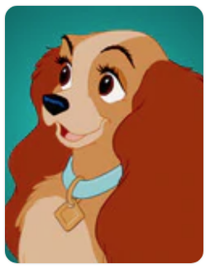
Question 2:
WHAT IS THE NAME OF THIS DOG WHO STARRED IN A 1955 DISNEY FILM?

Slide 4
Question 3:
WHAT UNIT ARE HORSE HEIGHTS MEASURED IN, ESPECIALLY IN ENGLISH SPEAKING COUNTRIES?

Slide 5
Question 4:
IN PHYSICS, THE NAMES OF THE 6 FLAVORS OF QUARK ARE UP, TOP, BOTTOM, CHARM, STRANGE, AND WHAT?

Slide 6
Question 5:
IN FINANCE, WHAT DOES THE "R" STAND FOR IN "ARM"?

Slide 7
Question 6:
WHAT WAS THE NAME OF THE GOO GOO DOLLS' BIGGEST HIT SONG, WHICH IS ALSO CONTAINED IN THIS CLUE?

Slide 8
Question 7:
IN THE EXPRESSION x^{n}, n IS CALLED THE EXPONENT AND x IS CALLED THE WHAT?

Slide 9
Question 8:
WHAT TAXONOMIC RANK IS BETWEEN PHYLUM AND ORDER?

Slide 10
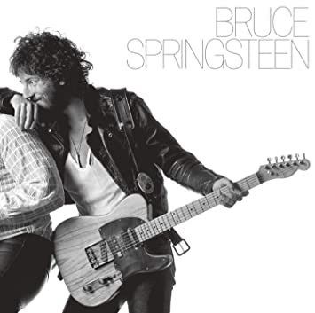

Question 9:
WHAT IS THE FIRST WORD OF THE TITLE OF BOTH BRUCE SPRINGSTEEN'S 3RD AND 7TH STUDIO ALBUMS?

Slide 11
Question 10:
WHAT DO ALL THESE ANSWERS HAVE IN COMMON?

Slide 12
The End
Answers will be provided shortly

Slide 13
Question 1:
IN GYMNASTICS, ONE OF THE EVENTS IS ABBREVIATED "FX". WHAT DOES THE "F" STAND FOR?
FLOOR (EXERCISE)

Slide 14
Question 2:
WHAT IS THE NAME OF THIS DOG WHO STARRED IN A 1955 DISNEY FILM?
LADY (AND THE TRAMP)

Slide 15
Question 3:
WHAT UNIT ARE HORSE HEIGHTS MEASURED IN, ESPECIALLY IN ENGLISH SPEAKING COUNTRIES?
HAND

Slide 16
Question 4:
IN PHYSICS, THE NAMES OF THE 6 FLAVORS OF QUARK ARE UP, TOP, BOTTOM, CHARM, STRANGE, AND WHAT?
DOWN

Slide 17
Question 5:
IN FINANCE, WHAT DOES THE "R" STAND FOR IN "ARM"?
(ADJUSTABLE) RATE (MORTGAGE)

Slide 18
Question 6:
WHAT WAS THE NAME OF THE GOO GOO DOLLS' BIGGEST HIT SONG, WHICH IS ALSO CONTAINED IN THIS CLUE?
NAME

Slide 19
Question 7:
IN THE EXPRESSION x^{n}, n IS CALLED THE EXPONENT AND x IS CALLED THE WHAT?
BASE

Slide 20
Question 8:
WHAT TAXONOMIC RANK IS BETWEEN PHYLUM AND ORDER?
CLASS

Slide 21
Question 9:
WHAT IS THE FIRST WORD OF THE TITLE OF BOTH BRUCE SPRINGSTEEN'S 3RD AND 7TH STUDIO ALBUMS?
BORN (...TO RUN, ...IN THE U.S.A.)

Slide 22
Question 10:
WHAT DO ALL THESE ANSWERS HAVE IN COMMON?
CAN FOLLOW "FIRST"

